Slide 1


Investigating the Sustainability of a Sustained 360 Process
by
Frank Shipper
Professor of Management & Chair
Franklin P. Perdue School of Business
Salisbury University
1101 Camden Avenue
Salisbury, MD 21801
fmshipper@salisbury.edu
Phone: 410 543-6333

Slide 2
Reported Results from Reviews of 360 Feedback
A meta-analysis of 24 longitudinal studies showed that improvement in direct report, peer, and supervisor ratings over time is generally small (Smither, London & Reilly, 2005).
  Note: Studies where 360 feedback was combined with training were excluded.
In summary, there is little evidence that multisource feedback is effective for changing managerial behavior (Seifert, Yukl, & McDonald, 2003).
  Of 16 research reports of 360 feedback, only five incorporated follow-up interventions. Of the five that incorporated follow-up interventions, three were judged to show significant improvements, whereas only two of the 11 that did not incorporate follow-up interventions were judged to show significant improvements.

Slide 3

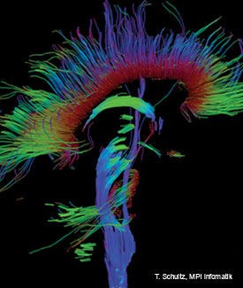
Investigating Active Neural Paths
fMRI
Diffusion Tensor Image

Slide 4
A Quick Demo of the Plasticity of the Human Brain
Cna yuo raed tihs? Olny 55 plepoe out of 100 can. fi yuo cna raed tihs, yuo hvae a sgtrane mnid too
i cdnuolt blveiee taht I cluod aulaclty uesdnatnrd waht I was rdanieg. The phaonmneal pweor of the hmuan mnid, aoccdrnig to a rscheearch at Cmabrigde Uinervtisy, it dseno't mtaetr in waht oerdr the ltteres in a wrod are, the olny iproamtnt tihng is taht the frsit and lsat ltteer be in the rghit pclae. The rset can be a taotl mses and you can sitll raed it whotuit a pboerlm. Tihs is bcuseae the huamn mnid deos not raed ervey lteter by istlef, but the wrod as a wlohe. Azanmig huh? yaeh and I awlyas tghuhot slpeling was ipmorantt!

Slide 5
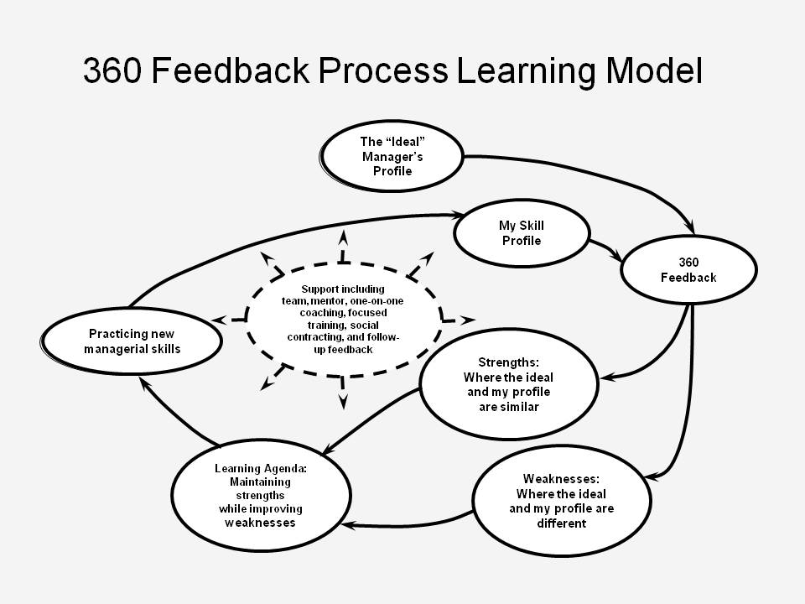
360 Feedback Process Learning model. Adapted from Boyatzis R., 1999. Self-Directed Change and Learning as a Necessary Meta-Competency for Success and Effectiveness in the 21st Century. In R. Sims & J. G. Veres, III (Eds.), Keys to Employee Success in the Coming Decades.

Slide 6
Changes in Intervention
Use of learning contracts encouraged.
Change in delivery from cross-organizational management retreats to in situ intact teams.

Slide 7
Methodology
Sample (n=13,661, age = 41, tenure = 11, male = 75%)
Measures
  Superior Rated Effectiveness – SMP (α = .90)
  Time Between Measurements – 18 Months
Analyses
  One-Group, Pretest-Posttest Design;
  t-tests & Repeated Measures MANOVA
  Static Group Comparisons;
  ANOVA
  Pretest-Posttest, Control Group Design
  ANOVA

Slide 8
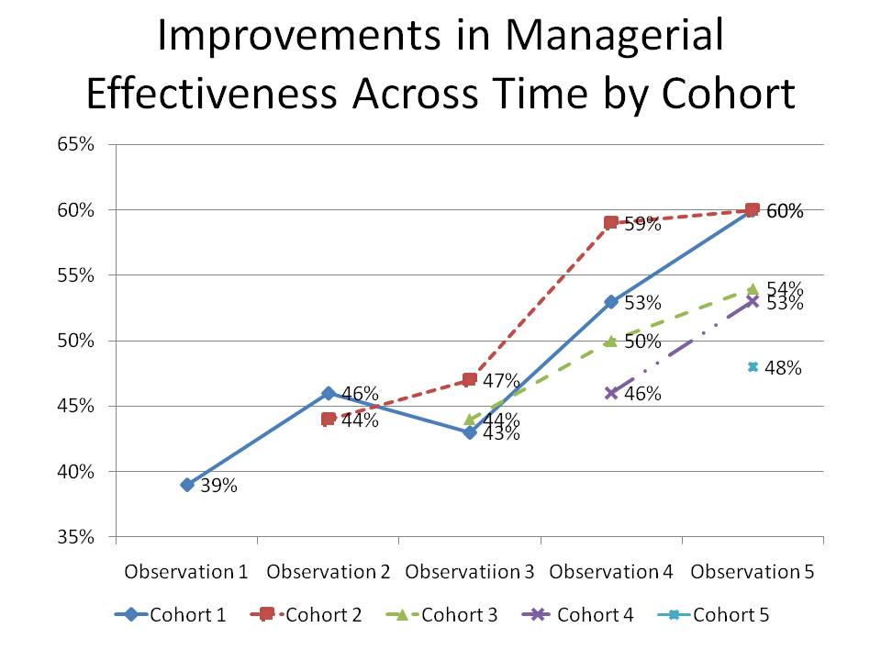

Slide 9
Time Cohort | t₁ |  | t₂ |  |  | t₃ |  | t₄ |  | t₅ | Repeated Measures MANOVA
Cohort 1 | O₁₁ | I₁₁ | O₁₂ |  | I₁₂ | O₁₃ | I₁₃ | O₁₄ | I₁₄ | O₁₅
Tests Across Observations within Cohort 1 n=54 |  | t₁₁₋₁₂= |  |  | t₁₂₋₁₃ = |  | t₁₃₋₁₄= |  | t₁₄₋₁₅= |  | F=11542
 |  | -0.998 |  |  | .431 |  | -2.068 |  | -1.29 |  | ρ≤.000
 |  | ρ ≤ N/S |  |  | ρ≤ N/S |  | ρ≤.022 |  | ρ≤ N/S
 |  |  | t₁₁₋₁₃= |  |  | t₁₂₋₁₄= |  | t₁₃₋₁₅=
 |  |  | -0.64 |  |  | -1.322 |  | -2.878
 |  |  | ρ≤ N/S |  |  | ρ≤ N/S |  | ρ≤.003
 |  |  |  |  | t₁₁₋₁₄= |  | t₁₂₋₁₅₌
 |  |  |  |  | -2.167 |  | -2.26
 |  |  |  |  | ρ≤.018 |  | ρ≤.014
 |  |  |  |  |  | t₁₁₋₁₅=
 |  |  |  |  |  | -3.001
 |  |  |  |  |  | ρ≤.002
Cohort 2 Tests Across Observations within Cohort 2 n=181 |  |  | O₂₁ |  | I₂₁ | O₂₂ | I₂₂ | O₂₃ | I₂₃ | O₂₄
 |  |  |  |  | t₂₁₋₂₂= |  | t₂₂₋₂₃= |  | t₂₃₋₂₄= |  | F=37637 ρ≤.000
 |  |  |  |  | .050 |  | -1.956 |  | -1.779
 |  |  |  |  | ρ≤ N/S |  | ρ≤.027 |  | ρ≤.039
 |  |  |  |  |  | t₂₁₋₂₃= |  | t₂₂₋₂₄=
 |  |  |  |  |  | -1.842 |  | -3.302
 |  |  |  |  |  | ρ≤.034 |  | ρ≤.001
 |  |  |  |  |  |  | t₂₁₋₂₄=
 |  |  |  |  |  |  | -3.357
 |  |  |  |  |  |  | ρ≤.027
Cohort 3 |  |  |  |  |  | O₃₁ | I₃₂ | O₃₂ | I₃₂ | O₃₃
Tests Across Observations within Cohort 3 n=752 |  |  |  |  |  |  | t₁₃₋₁₄= |  | t₁₄₋₁₅= |  | F=102,344 ρ≤.000
 |  |  |  |  |  |  | -1.118 |  | -1.985
 |  |  |  |  |  |  | ρ≤ N/S |  | ρ≤.025
 |  |  |  |  |  |  |  | t₁₃₋₁₅=
 |  |  |  |  |  |  |  | -2.806
 |  |  |  |  |  |  |  | ρ≤.003
Cohort 4 Tests Across Observations within Cohort 4 n=2659 |  |  |  |  |  |  |  | O₄₁ | I₄₁ | O₄₂
 |  |  |  |  |  |  |  |  | t₁₄₋₁₅= |  | F=267,123 ρ≤.000
 |  |  |  |  |  |  |  |  | -1.979
 |  |  |  |  |  |  |  |  | ρ≤.025
Cohort 5 |  |  |  |  |  |  |  |  |  | O₅₁
ANOVA Across Cohorts within Observations |  |  |  | t₂ |  | t₃ |  | t₄ |  | t₅
 |  |  |  | F=.048 |  | F=.670 |  | F=7.876 |  | F=11.541
 |  |  |  | N/S |  | N/S |  | ρ≤.000 |  | ρ≤.000

Slide 10
Conclusions & Implications
A single intervention of feedback with support will likely have little impact on managerial effectiveness.
Managers can become more effective if part of an ongoing 360 process.
Creating a supportive environment and activities at the local level will be more effective than centralized activities.
Improvements in the effectiveness of managers can yield improvements in productivity.

