Slide 1
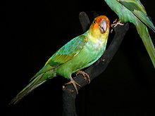
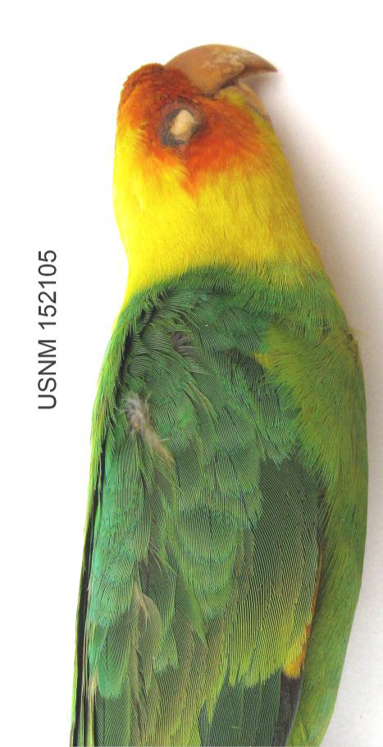
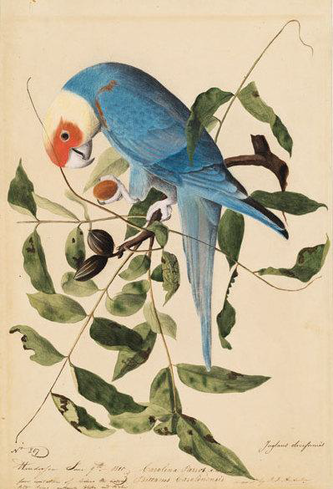
Thinking Species Extinction Locally and Globally
ENVR Senior Seminars
Fall 2013

Slide 2
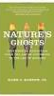
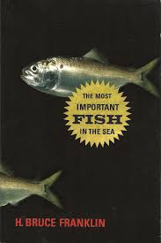
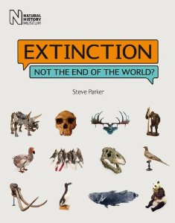
The ENVR Senior Seminar

Slide 3
Defining Species Extinction
Species do not die, only individuals do. With the extinction of a species, no further individuals of that particular living kind will be born.
Modes of extinction. a) Species; b) Sub-species; c) Extirpation; d) Functional; e) Eco-System.
Additional Vocabulary: a) Iconic; b) Critical; c) Keystone; d) Indicator
Notes:
Michael and Zane

Slide 4
The History of the Concept of Extinction
Species extinction has only been acknowledged for the last two centuries.
Heretofore Europeans considered all species to have existed from the beginning of time and that they would continue to exist until the end of time.
As species extinction events began occurring extensively in an era of European Colonization, an emerging science of global species biology struggled to make sense of this new-found phenomenon.
Islands (Dodo, Moa, Auk etc.) and the fossil record provided the first laboratories for the study of extinction.
Notes:
Mary and Sarah

Slide 5
Species Extinction is normal
Over 99% of all species that have existed are now extinct.
Species regularly emerge, even as species go extinct.
Background extinction rate: 1 extinction per year (1 extinction per million species years)
Average life span of a species is around 10,000,000 years.
Notes:
Todd and Kristin

Slide 6
Species Extinction has Many Stories: The Complexity of Extinction in the North American Context
Marsupial “Cat” of South America
Horse originates in North America
Mastodon
Passenger Pigeon
Bison
A cascading of extinction throughout the Americas with numerous species currently under threat.
Notes:
Earl and Amy

Slide 7
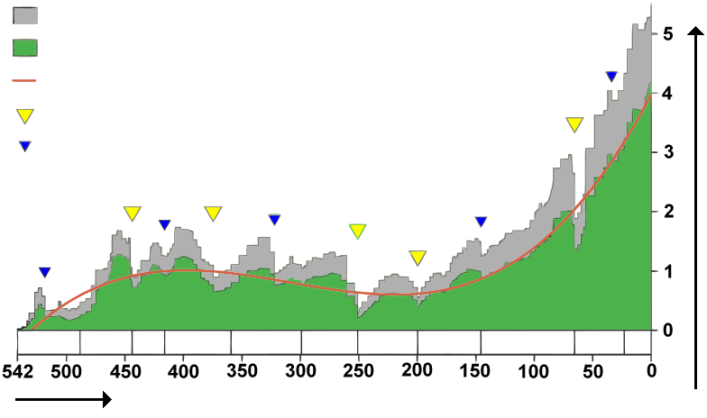
Mass Species Extinctions Events
Number of families
All Genera
Well Defined Genera
Trend Line
“Big Five” Extinction Events
Other Mass Extinction Events
Millions of Years
Notes:
Chelsea and Tom

Slide 8
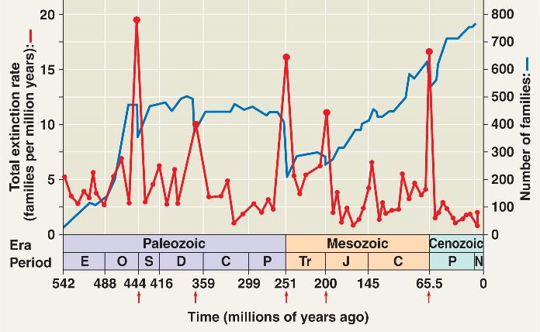
Mass Species Extinction Events
Notes:
Chelsea and Tom

Slide 9
The Anthropocene: A new Mass Species Extinction Event?
Anthropogenic (human caused) species extinction has reached geologically significant levels. Between 1,000 and 10,000 times higher than background rate.
An unparalleled terrestrial phenomenon: Heretofore a particular species did not cause the mass extinction of all other species.
Are human actions affecting the living world just another set of natural processes, or something different?
Notes:
Keyanna and Garrett

Slide 10
ICUN Efforts to Track Current Extinction Events
Notes:
Kelly and Michael

Slide 11
Identifying Species Extinction?
Why are so many mammals on the IUCN list but so few spiders? Are some species more worth conserving than others?
A third or more of all the roughly 6,300 known species of amphibians are at risk of extinction, from 25,000 to 45,000 the background extinction rate.
Notes:
Michael and Kelly

Slide 12
Why and How do Humans cause Species Extinction?
Inattentiveness to the broad range of species involved when making decisions about the welfare of an ecosystem.
Technological Lock In: dams, expensive processing and harvesting tools, etc.
Commoditization: exploiting as massively as possible a living kind as the cheapest resource for the highest immediate profit. (Mass harvesting practices/Reduction Industries).
Illusory Abundance: Thinking things are going well when they’re not.
Introduction of invasive species, diseases.
Global Warming
Habitat Destruction.
Notes:
Rocky and Ben

Slide 13
Difficult Questions
If mass species extinction is already part of the geological record, what difference more or less does yet another mass species extinction make, even if humans are causing it?
Do we have a responsibility to resist mass species extinction? How pressing is this responsibility?
Haven’t invasive species become the new norm? Can we really eradicate them? Lion fish in the Carribbean. Nile Perch in Lake Victoira. Misplaced effort?
Notes:
Lindsay and Charlotte

Slide 14
Can a species be a species if it’s become a living specimen?
Can a species be really said to have been “saved” if it only consists of specimen animals in human captivity?
In what does a species consist? Is a species merely a specific genotype reproducing itself through time. Or should the manner in which a species conducts its life through its own unique means to do so also matter?
E.O. Wilson’s suggestion for Living Genome Project.
Notes:
Gennie and Steven

Slide 15
The Ecological Significance of Species Extinction
Extinction is not just about individual species.
Extinction impacts everything connected to a species. Eco-systems are so complex in interconnections that a species extinction is never simply an isolated biological event.
Manifold and unintended consequences. The extirpation of wolves and mountain lions in Maryland leads to increased deer populations which leads to increased browsing on Turtlehead plants which leads to the extirpation of the Baltimore Checkerspot Butterfly.
Notes:
Natasha and Tori

Slide 16
The Cultural Significance of Species Extinction
The potential loss of the tuna fish sandwich (consumer catastrophe) vs the loss of the bison and the whale (cultural catastrophes).
Invasive species can serve colonial/outside interests at the expense of indigenous ones. (Cows and sheep in Australia and Nile Perch in Lake Victoria).
Notes:
Matt and Nick

Slide 17
Caring for Biodiversity
Biotic Citizenship – Aldo Leopold’s notion of a citizenship shared by humans with all living kinds that lead the land to flourish from the soil (or waters!) up.
Mass species extinction adds a new urgency to the responsibilities of biotic citizenship.
How might biotic citizenship be exercised not only locally but also in a globalized economy?
Notes:
Molly and James

Slide 18
Some Issues in Educating the Public about Species Extinction?
A regrettable history of specimen collecting: Get the evidence now before they are gone.
Obsession with a particular threatened species can be detrimental to overall efforts to address environmental damage.
Lazy Environmentalism: Clicking the Button.
Responsive witnessing. Becoming a voice speaking on the behalf of the living kinds.
What is involved in knowing a species? Many different approaches to knowing are called for.
Notes:
Meghan and Stacy

Slide 19
Student Research Projects Tuesday Section
Menhaden en route to Extinction? Mary Lewis, Zane Melbourne, Chelsea Smith
Damming up Shad. Todd Frey, Kristin Jehle, Sarah Kullman
Baltimore Checkerspot Butterfly. Thomas Flynn, Natasha Shangold, Victoria Turner
Delmarva Fox Squirrel. Molly Graham, James Koubek, Michael Scott.

Slide 20
Menhaden en route to Extinction?
Research Question: How does the movement from abundance to scarcity within the menhaden population find it’s voice within a culture?
Enhancing Biotic Citizenship:
- Public Awareness
- Newspapers, Articles, Internet Outreach, Media/Newscasts
- Outdoor Education and Gaining Experience
Individual Focus:
Biology: Assessment of the ecological importance of menhaden within the Chesapeake Bay food web
Sociology: Social attitudes towards menhaden depletion from economic and political viewpoints
Outdoor Education: Watermen’s relationship with menhaden and how to become a better biotic citizen

Slide 21
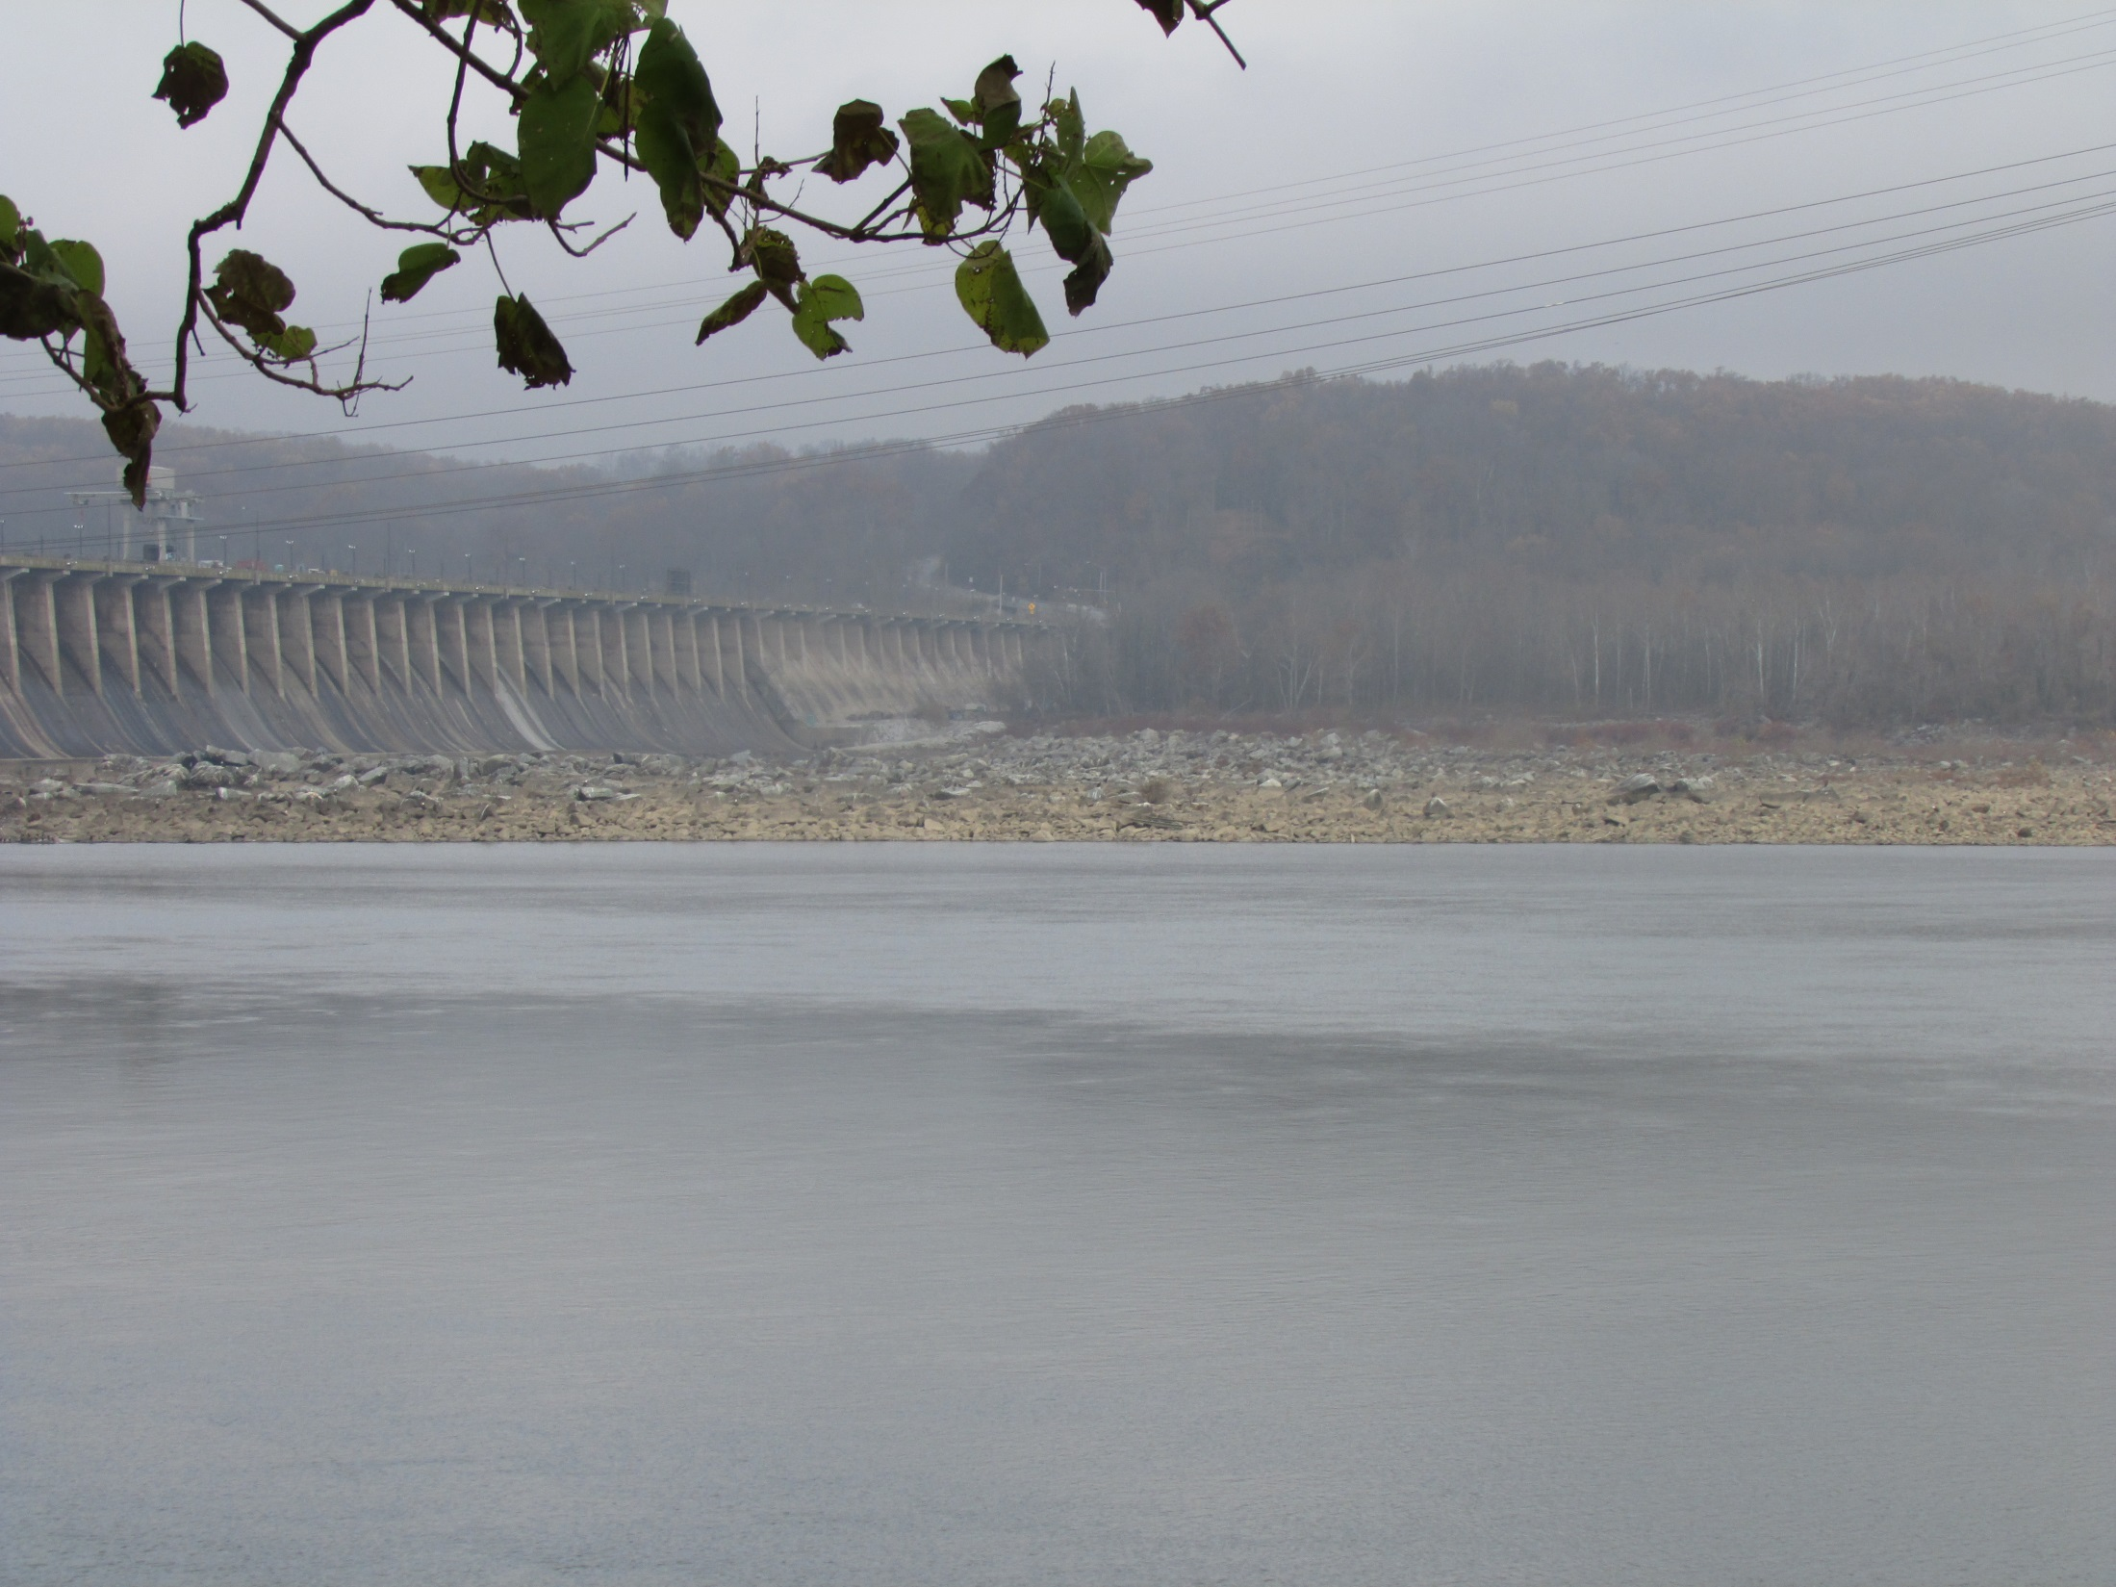
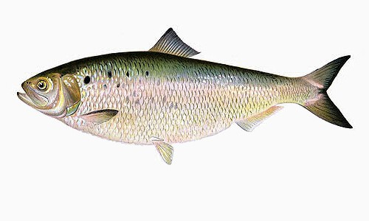
“Extinction: Damming Up Species”
How has the Conowingo Dam impacted the ecology of the Susquehanna River?
American River Shad
Regional Extinction
Conowingo Dam
Susquehanna River
Restoration Efforts
Blocked/fragmented ecosystems
Energy Flow
Undamming?
http://www.chesapeakebay.net/fieldguide/critter/american_shad

Slide 22
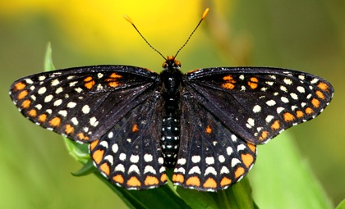
Baltimore Checkerspot Butterfly
Biology
Life history and host plants
Range and habitat
Illusionary abundance
Art
Gardening art
Radical art
Why did we plant a butterfly garden?
Flag
Chrysalis, conservation, community
Culture
Awareness survey
What do we hope to accomplish with this project?
Become better bio-citizens
Increase awareness to increase conservation
Notes:
Tom Flynn, Natasha Shangold, Torrie Turner

Slide 23
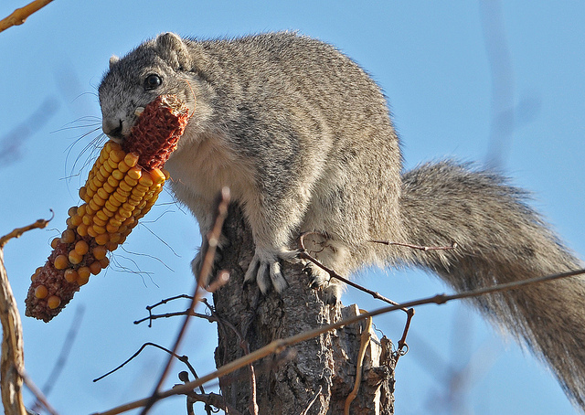
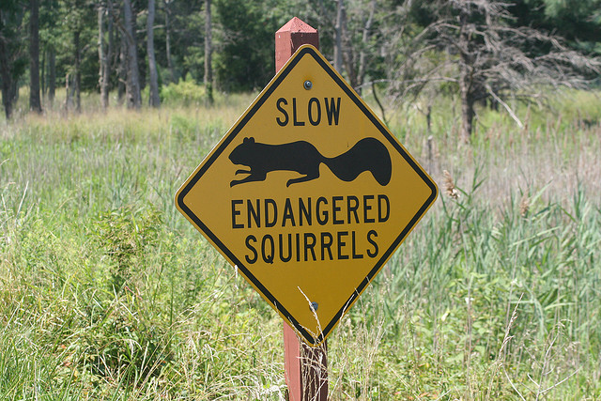
The Delmarva Fox Squirrel’s Continuing Brush with Extinction:
Slow moving and clumsy characteristics create difficulties due to fragmenting habitat
Need mature hardwood forests and open understory; uncharacteristic of Eastern Shore which is blanketed with agriculture and Loblolly Pine farms
The DFS was locally endangered and facing extreme loss of their ecosystem due to human development and habitat degradation.
Efforts were made to translocate the squirrel
Due to translocations, the squirrel population rebounded back

Slide 24
Student Research Projects: Thursday Section
Buffalo Citizenship. Amy Bennett, Michael Bengtson, Keyyana Blount
Amphibian Extinction. Garret Black, Steve Cenname, Rocky Donovan
Nile Perch and Lake Victoria. Nick Almony, Earl Dyson, Ben Fleming
Zoos and Aquariums Battling Anthropogenic Extinction. Kelly Beall, Charlotte Becquet, Gennie Francis, Matt Robson, Meagan Tkach
Extinction on the Eastern Shore. Lindsay Buckman, Stacy Helgason

Slide 25
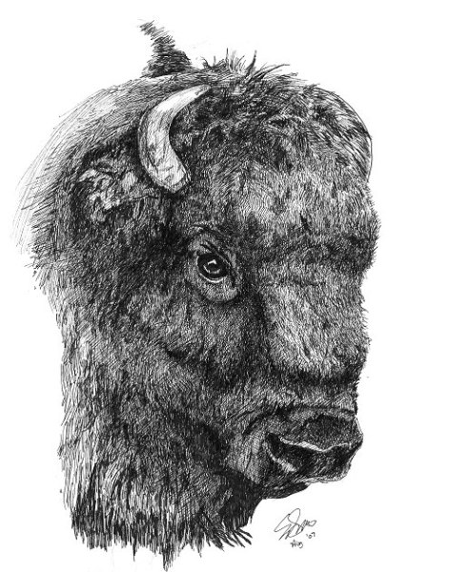
Buffalo Citizenship
What role do various stakeholders play in bison conservation efforts?
Defining Buffalo Citizenship
Recovery from extreme population decline
Biological History
Species Extinction Timeline
Different Perspectives on Buffalo Conservation
Native Americans and Buffalo
Ranchers
Conservation Efforts

Slide 26
Amphibian Extinction
Why does amphibian extinction matter, and what can be done?
Chytrid Fungus
Main cause of amphibian decline and extinctions.
Amphibian trade
Pet and food trades provide a global vector for this fungus to spread.
Legislation
ESA has little mention of amphibian species and declines in other countries has pushed some US lawmakers to act.
Why does amphibian extinction matter, and what can be done?
Amphibians play a key role in ecosystems, and also provide food for various people around the world. Some also hold compounds could be used in the medical field.

Slide 27
A Cultural, Economic and Biotic Landscape of Extinction: The Nile Perch in Lake Victoria
Historically turbulent and economically impoverished area
Largest modern vertebrate extinction event
N. perch introduced by colonial interests to increase fishing opportunities
Ecosystem is now in a state of collapse
Collapse of local culture previously dependent on the native fishery
Economic benefits as a result
Issues of social justice
Our project is a case study of the complexities of extinction
Notes:
Wicked problem – entire situation
Manegement?

Slide 28
Eastern Shore Extinction: On the Land and in the Sea
Atlantic Sturgeon- Was once abundant and supported important colonial fisheries, but then in the 19th century the demand for their caviar developed as a major U.S. commercial fishery that impacted them heavily.
We will be explaining the history of eating caviar and the relationship of caviar to extinction and endangerment and how complex their endangerment actually is, as well as tackling the task of how to go about telling caviar lovers not to eat something they love for the sake of this species’ future.
We will also be talking about how the horse shoe crab population noticed endangerment when they started becoming used by humans for medical reasons and bait. Then how regulations were put on them to control the population and kept from endangerment.
A few more key points that we will look into are:
How we can build cultural sensitivity into the living world?
Complexity of endangerment
Cascade effect between aquatic and terrestrial (horseshoe crabs & birds)
Lindsey Buckman and Stacy Helgason

Slide 29
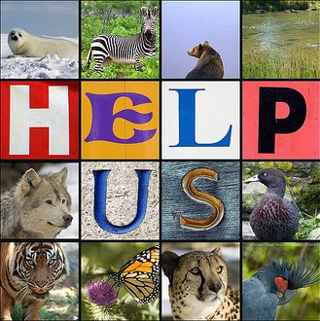
Zoos and Aquariums: Battling Anthropogenic Extinction
Research Question: What role do aquariums and zoos play in combating extinction and creating conservation efforts among threatened or endangered plant and animal species?
Our Overall Focus:
The relationship between humans and animals that is created through zoos and aquariums.
Education vs. Entertainment
Group Ethic
Do zoos and aquariums have a positive or negative impact on endangered or threatened species?
How do they aid in the overall conservation of these species?
Kelly Beall, Charlotte Becquet, Gennie Francis, Matthew Robson, Meagan Tkach

