Slide 1
Peer Reviews

Slide 2
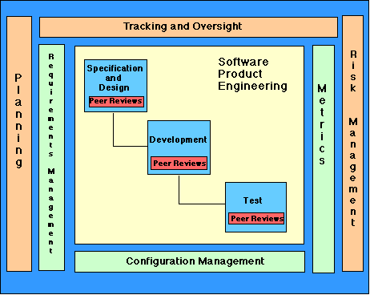
Best Software Practices

Slide 3
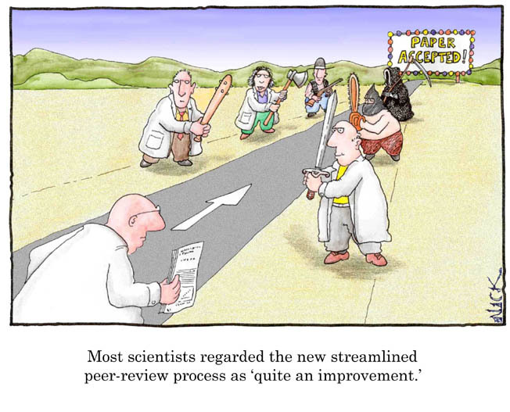
What is peer review?
A examination of the software artifacts by the producers' peers to identify defects and changes needed.
Types of peer reviews
inspections
walkthroughs
desk-checking
round-robin reviews

Slide 4
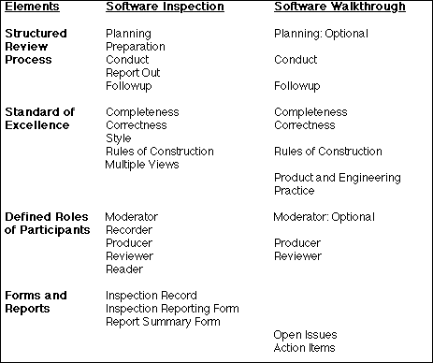
Inspections
Formal review used to verify that the software artifact complies with the standard of excellence.

Slide 5
Advantages/disadvantages:
Highest measured efficiency of any known form of defect removal
It is also the most costly and time consuming.

Slide 6
Walkthroughs
Informal review used to confirm the understanding of the producer and validate the approach being taken

Slide 7
Serve the needs of the producer
Preceded by preparing lists of items
Items not understood
Items that appear to be incorrect
Get a consensus on the approaches taken
Yield open issues and action items
Several walkthroughs in each life cycle activity
A walkthrough should never be used for performance appraisal

Slide 8
Advantages/disadvantages:
The second most efficient method for removing defects
Not as costly as full inspection

Slide 9
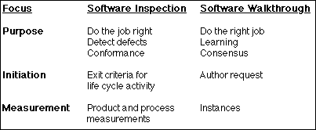
Scope of Inspections and Walkthroughs

Slide 10
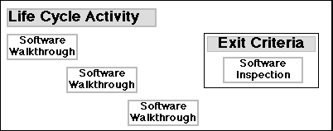
Inspections and Walkthroughs in a Life Cycle Activity

Slide 11
An inspection team members
Moderator
briefs the roles for each inspection team members
distributes inspection materials, announces time and place for the inspection session
Facilitates the interaction among the inspection team members
Intervenes as necessary to ensure an effective and efficient inspection session.
Producer
Creates the materials to be inspected
Raises issues during inspection session
Offers a technical explanation of the artifact as necessary
Plan the rework and performs the follow up actions

Slide 12
Recorder
Completes Inspection Record, Inspection Reporting Form and Report Summary Form.
Records every issue without exception
Reviewer
Raises issues and concerns about software artifacts
Refrains from proposing solutions
Directs comments at the artifacts not the producer
Reader
Reads parts of the artifact aloud so as to focus attention on a particular trouble spot
Brings any background materials

Slide 13
Desk-checking Review
Private review and debugging carried out by individual programmers with no analysts involved
Defects are identified and logged during the review
Defect resolution, status tracking and communication take place after the review
Advantages/disadvantages:
Least expensive, easy to schedule and complete
Least effective review method

Slide 14
Round-Robin Review
A process of desk-checking by multiple peers in a sequential manner
A checker reviews, identifies and logs defects, then passes the folder to the next reviewer
This continues until all the reviewers have participated and the folder is returned to the producer
Advantages/disadvantages:
More efficient than simple desk-checking
Lower cost than other review techniques
Not as efficient as inspections

Slide 15
National software Quality Experiment
1992 DOD Software Technology Strategy
Reduce software problem rates by a factor of ten by 2000
3000 participants from 60 organizations

Slide 16
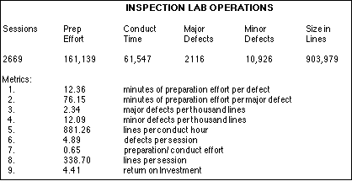

Slide 17
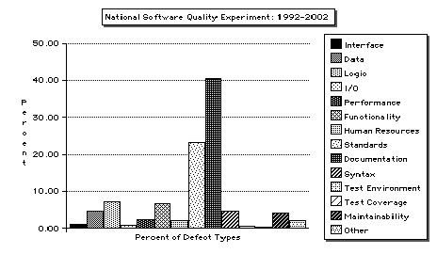
Defect Type Ranking

Slide 18
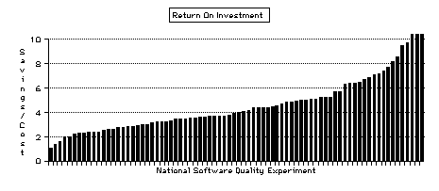
Return on Investment (Avoidance – Repair)/Detection

Slide 19
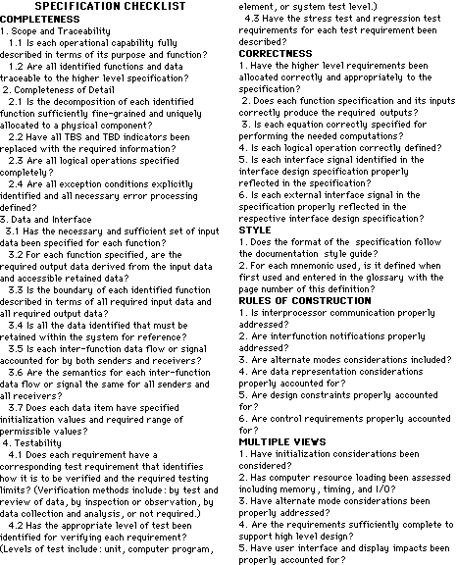

Slide 20
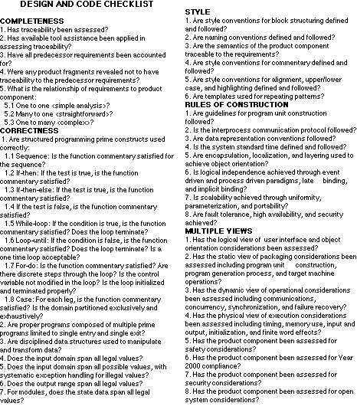

Slide 21
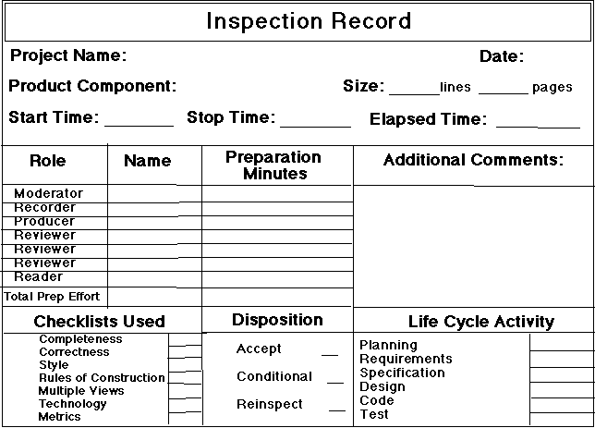

Slide 22
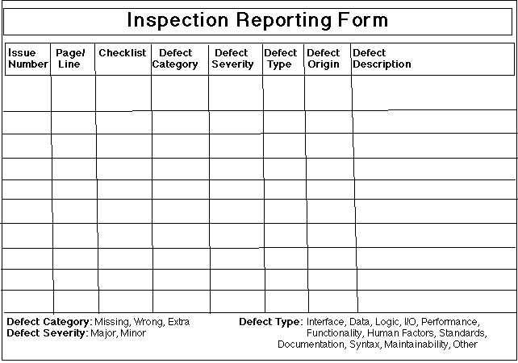

Slide 23
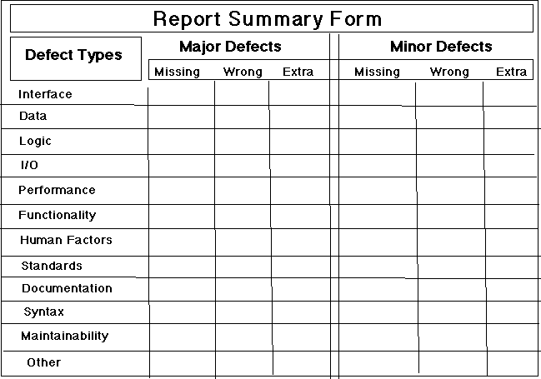

Slide 24
