Slide 1
The Façade Pattern

Slide 3
Watching the movie the hard way….
Page 256 – Head First Design Patterns

Slide 4
What needs to be done to watch a movie….

Slide 5
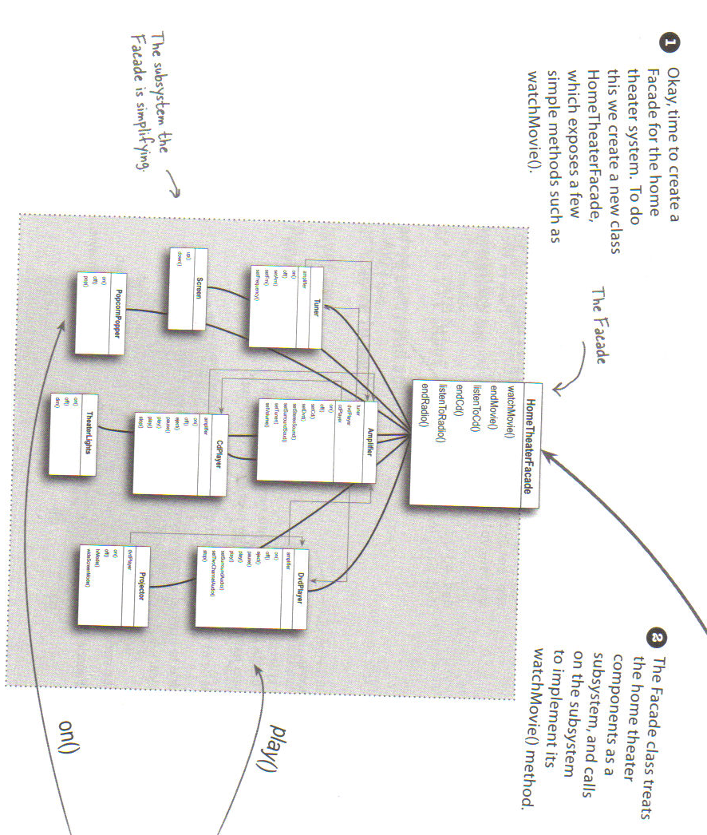

Slide 6
Façade pattern – Class Diagram

Slide 7
Façade pattern
Intent
Provide a unified interface to a set of interfaces in a
subsystem. Facade defines a higher-level interface
that makes the subsystem easier to use.
Motivation
Structuring a system into subsystems helps reduce complexity.
A common design goal is to minimize the communication and dependencies between subsystems.
Use a facade object to provide a single, simplified interface to the more general facilities of a subsystem.

Slide 8
A façade can:
make a software library easier to use and understand, since the façade has convenient methods for common tasks;
make code that uses the library more readable;
reduce dependencies of outside code on the inner workings of a library, since most code uses the façade;
wrap a poorly designed collection of APIs with a single well-designed API (as per task needs).

Slide 11
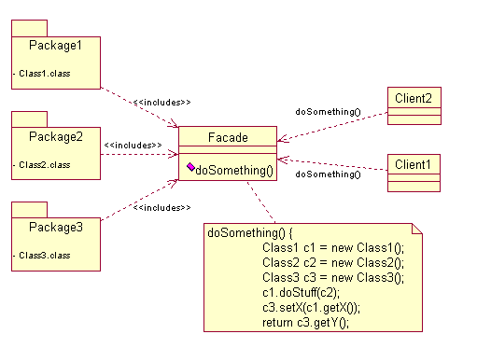
The objects using the Façade Pattern to access resources from the Packages.
The facade class interacts Packages 1, 2 & 3 with the rest of the application.
Software library / API collection accessed through the Facade Class.

Slide 12
Benefits
It shields clients from subsystem components by reducing the number of objects that clients have to deal with.
It promotes weak coupling between the subsystem and clients. Weak coupling lets you vary the subsystem component without affecting its clients.
It does not prevent clients from using subsystem if they need to.

Slide 13
Design Principle
Principle of Least Knowledge
talk only to your immediate friends
Basically this says minimize your dependencies

Slide 14
Client
The client only has
one friend – and
that is a good thing
If the subsystem
gets too complicated
One can recursively
apply the same
principle.

Slide 15
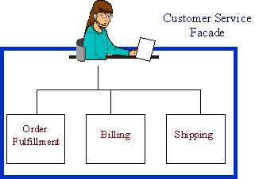
Service desk

Slide 16
E-commerce website

Slide 17
A "facade" for the legacy application

Slide 18
JDBC design
interface General {
public void accessGeneral();
}
interface Special extends General {
public void accessSpecial();
}
interface Private extends General {
public void accessPrivate();
}
class GeneralInfo implements General {
public void accessGeneral() { //... }
}
class SpecialInfo implements Special{
public void accessSpecial() { //... }
public void accessGeneral() { // ...}
}
class PrivateInfo implements Private, Special {
public void accessPrivate() { // ... }
public void accessSpecial() { //... }
public void accessGeneral() { // ... }
}
class Connection {
if (user is unauthorized) throw new Exception();
if (user is general) return new GeneralInfo();
if (user is special) return new SpecialInfo();
if (user is executive) return new PrivateInfo();
}

Slide 19
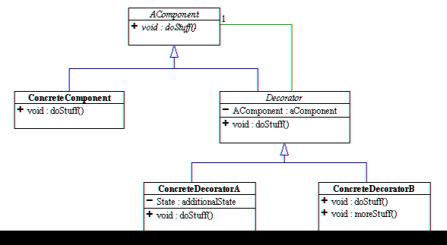
Type matching
NOT
get behaviours
void doStuff(){
aComponent.doStuff();
}

Slide 20
A little comparison
Pattern
Intent
Converts one interface
to another
Decorator
Adapter
Doesn’t alter the interface,
But adds responsibility
Facade
Makes an interface simpler

Slide 21
Summary so far..
OO Basics
Abstraction
Encapsulation
Inheritance
Polymorphism
OO Principles
Encapsulate what varies
Favor composition over inheritance
Program to interfaces not to implementations
Strive for loosely coupled designs between objects that interact
Classes should be open for extension but closed for modification.
Depend on abstracts. Do not depend on concrete classes.
Only talk to your friends

Slide 22
Summary so far…
OO Patterns
Strategy Pattern defines a family of algorithms, Encapsulates each one, and makes them interchangeable. Strategy lets the algorithm vary independently from clients that use it.
Observer Pattern defines a one-to-many dependency between objects so that when one object changes state, all of its dependents are notified and updated automatically.
Decorator Pattern – attach additional responsibilities to an object dynamically. Decorators provide a flexible alternative for sub-classing for extending functionality
Singleton Pattern – ensure a class only has one instance, and provide a global point of access to it
The Adapter Pattern converts the interface of a class into another interface the clients expect. Adapter lets classes work together that couldn’t otherwise because of incompatible interfaces.
The Façade Pattern provides a unified interface to a set of interfaces in a subsystem. Façade defines a higher level interface that makes the subsystem easier to use.

