Slide 1




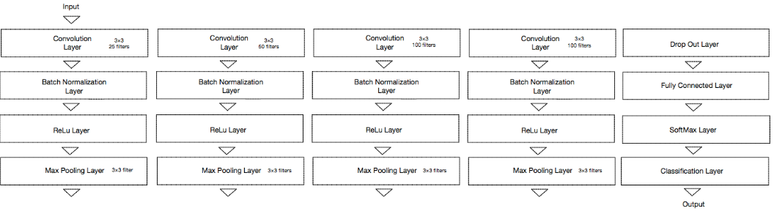
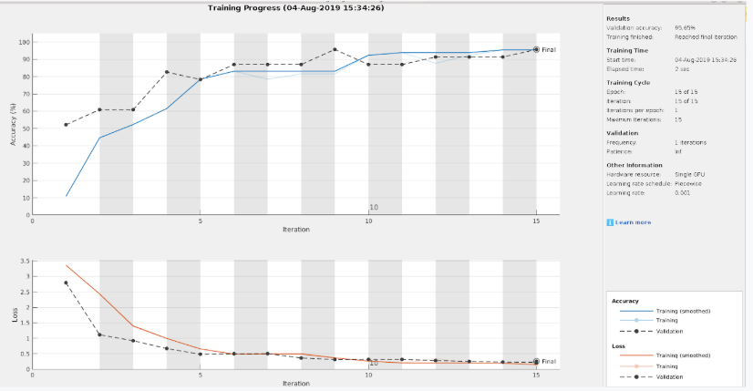
Speaker Identification Based on Speech Breathing Patterns
Yesheng Chen*, Darryl Parsons**, Dr. Jin Yuanwei**
Grinnell College* University of Maryland Eastern Shore**
ABSTRACT
METHODS
FUTURE WORK
This paper details methods of speaker identification using MATLAB. Particularly focused on using Convolutional Neural Networks (CNN), and I-Vectors as the benchmark method. We want to validate previous research by showing intra-speech breath can be used for speaker identification. Then to prove that intra-speech breath can help to better identify speakers, when speech is indistinguishable between speakers. We have thus far shown that CNN speaker identification can be done on MATLAB with 92% accuracy with 40 unique speakers. Difficulty comes from struggles to find a Voice Activity Detection (VAD) system that can separate breathing and speech into individual audio files. The other issue stems from the lack of clarity in research papers describing the actions needed to create I-Vectors.
We gathered the original audio data from the Spoken Wikipedia Corpora (SWC)[2]. The data is the readings of English Wikipedia pages by total of 395 speakers. In order to get the breathing inside the recordings, we went through audio files to extract the intra-breathing sounds from the audio files using Audacity [3]. At the end we were able to process audio data for 5 speakers, a total of 109 audio files, each to be 2 seconds long. The data is separated into 60% for training, 20% for validation, and 20% for testing. This separation of data help us to prevent overfitting, and by using cross-validation we can select network parameters.
Our Convolutional Neural Network have the following parameter: There are a total of 4 convolution layers, each followed by a batch normalization layer, then a ReLU layer, and lastly a max pooling layer. The first convolution layer has 25 filters, the second one has 50 filters, the third and fourth each have 100 filters. Filters in both convolution layers and max pooling layers are 3by3. Max pooling stride is 2by1, and there are paddings for both convolution and max pooling layers. After the feature finding layers, we have a drop-out layer with a 0.2% drop-out rate, a softmax layer, a fully connected layer, and a classification layer. Fig 1 shows the overview of the network. The network is implemented using MATLAB’s Deep Learning ToolBox. For training we used Adam adaptive learning rate optimization algorithm [4], with an initial learning rate of 0.003, mini batch size of 128, and learning rate drop factor of 0.1. The training process stops after 15 epochs.
Further study into how I-vectors are created and used within speaker identification can be done within this project. A major struggle came from the documentation involving the subject never gave clarity to the process beyond the overview steps.
Another aspect that can be improved upon is the extraction of breathing sounds within sound files. A program called CMUSphinx can do this, but because of time constraints we weren’t able to learn the program and instead resorted to manually extracting the sounds.
REFERENCES
[1] Zhao, W., Gao, Y., & Singh, R. (2017). Speaker identification from the sound of the human breath. arXiv preprint arXiv:1712.00171.J. Clerk Maxwell, A Treatise on Electricity and Magnetism, 3rd ed., vol. 2. Oxford: Clarendon, 1892, pp.68–73.
[2] Baumann, T., Köhn, A., & Hennig, F. (2019). The Spoken Wikipedia Corpus collection: Harvesting, alignment and an application to hyperlistening. Language Resources and Evaluation, 53(2), 303-329.
[3] Crowder, M. (2015). Audacity.
[4] Kingma, D. P., & Ba, J. (2014). Adam: A method for stochastic optimization. arXiv preprint arXiv:1412.6980.
INTRODUCTION
Speaker recognition is the process of understanding the identity of a given speaker. There are two subdivisions within speaker recognition: speaker verification, and speaker identification. Speaker verification is the binary process of determining if a given speaker is who they claim to be, while speaker identification is making an educated guess of who is speaking given a list of speakers. Previous research [1] has shown that intra-speech breathing can be used for speaker identification because of its person specific features. Our goal was to replicate their results with a simpler deep learning model. In addition, we are looking to incorporate intra-speech breathing with the rest of the speech. Yet, making it weighs more than other features during the training process of neural network to increase the accuracy of speaker identification over the entire section of the speech. We hope this could help to distinguish the difference between people who have similar speech characteristics such as twins, or impersonator who try to mimic others.
ACKNOWLEDGEMENTS
The This work is funded by the National Science Foundation under the Research Experience for Undergraduates Program CNS1757017 grant.
Fig. 1 CNN Model
RESULTS
Using this network the accuracy on the testing set data come out to be 100%. The accuracy for the training set and validation set are 100% and 95.65% accordingly. This CNN network achieved incredibly high accuracy rate, and proved that we are able to perform speaker identification based on only intra-breathing sounds. Fig 2 shows the training process for intra-breathing speaker identification
Fig. 2 Training Results
As discussed before, we want to explore the effect of intra-speech breathing on the result of speaker identification when it is a part of the speech. We used the same CNN from the previous model, since it does also pick up features of normal speech. Also, in order to see a clearer result, we generated three types of artificial audio data sets.
In all three different audio datasets, the audios contain segments of speech from one speaker, but the segment of breathing are from different speakers. For example, in the first type dataset, one audio file would contain the 2 seconds of speech by speaker A, followed by 2 seconds of breathing by speaker B, then another speech segment of speaker A, new breathing of B and it repeats. While another audio in this dataset, would have 2 seconds of same speech by speaker A, but the 2 second breathing is from speaker C. This way we can ensure that the only feature that’s different between the audios or artificial speakers are the intra-speech breathings. The only difference between the types are the length of the speech segments. For the second type, the speech segments are 9 seconds long, and the third type, the speech segments are 11 seconds long, but the breathing segments are all 2 seconds long.
Type/Input Size | Input Size: 5s | Input Size: Speech segment +1s of breathing | Input Size: Speech segment and all breathing
Type 1 | 100% | -- | --
Type 2 | 68.8% | 87.5% | 100%
Type 3 | 65% | 87.5% | 100%

