Slide 1
Motherboards, Power Supplies, Cases

Slide 2
Computer Cases

Slide 3
Types of Cases
Theres three main types of cases
Desktop
Classic
Slimline
All-in-one
Tower
Mini-sized
Mid-sized
Full-sized
Portable

Slide 4
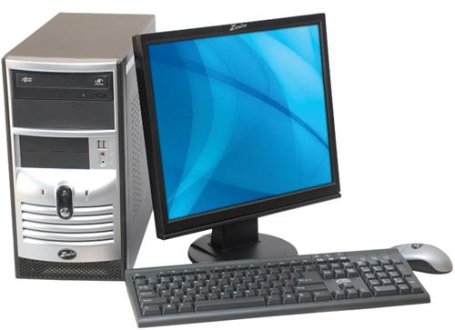
Desktop-Classic
Classic design
Conserves space
Commonly used in businesses
Typically positioned horizontally on desk with monitor normally sitting on top

Slide 5
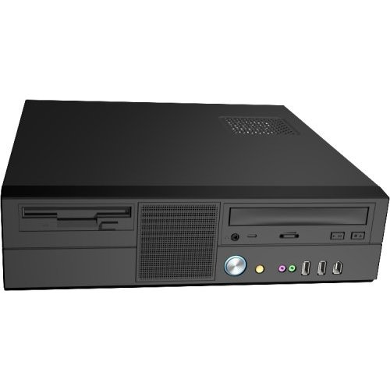
Desktop-Slimline
Advantages: Workstations in large companies. Great computer for a low budget PC. Great for small workspaces.
Disadvantages: Generally little or no room for adding additional peripherals. Usually require an LPX motherboard.

Slide 6
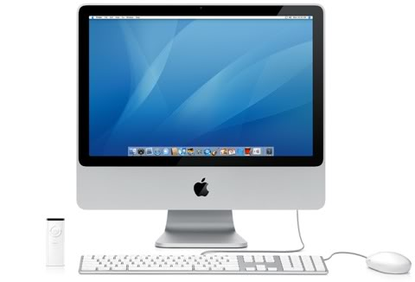
All-in-one Desktop
Pros
Maximizes Desk Space
Cons
Expensive

Slide 7
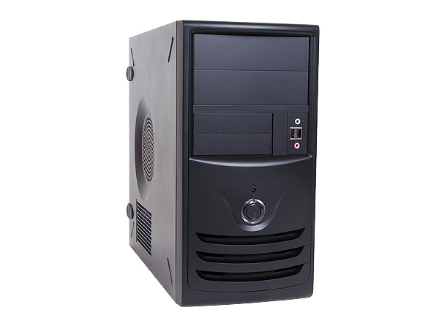
Mini Towers
Typically 12-18” tall
3 Internal drive bays
Limited room for upgrading

Slide 8
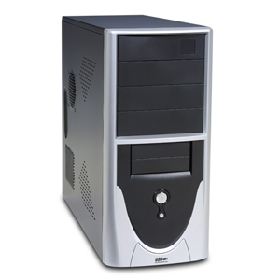
Mid-Towers
Typically 24” tall
4 internal drive bays
Most common case used worldwide
Can be placed above or below computer desk
Used for simple, business, and advanced systems

Slide 9
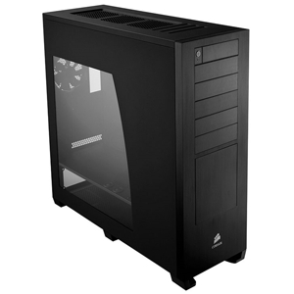
Full-Tower
30” or taller
6-10 internal drive bays
Many external drives
Spacious inside
Typically seen in servers, mainframes, and advanced workstations

Slide 10
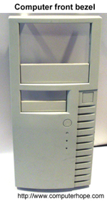
Front Panel/Bezel
Removable plastic panel
Covers any empty drive bays
Appealing look
Power Button/Reboot

Slide 11
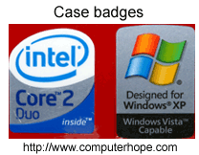
Case Badges
Sticker often found on the front of the computer
Identifies hardware or software installed
Can be purchased and placed on computer cases.

Slide 12
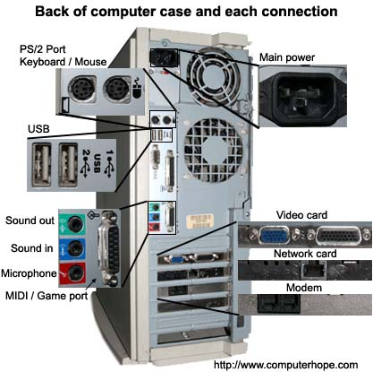
Back Panel

Slide 13
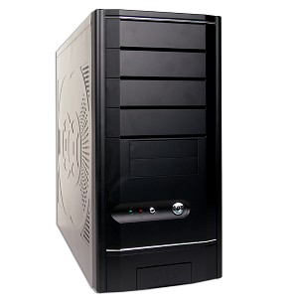
What does the inside of the case look like?
???
???
???
???

Slide 14
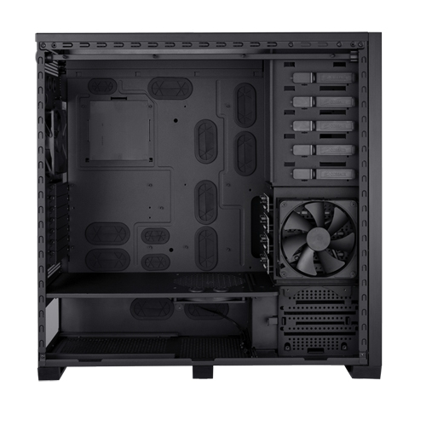
Before Adding components…

Slide 15
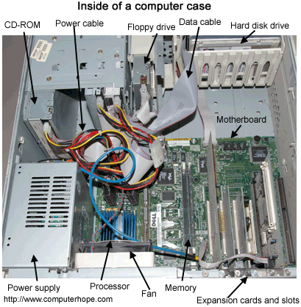
After adding components

Slide 16
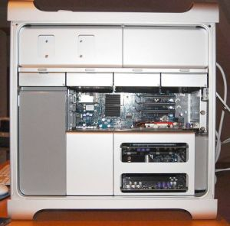
Customization
Upgrading
Video Card
RAM
Hard Drives
Expansion bays

Slide 17
System Cooling
Prevents Computer from overheating
Two Types
Fans
Liquid cooling

Slide 18
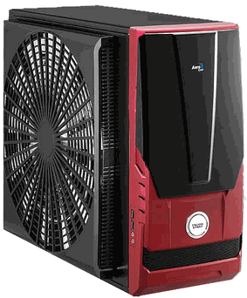
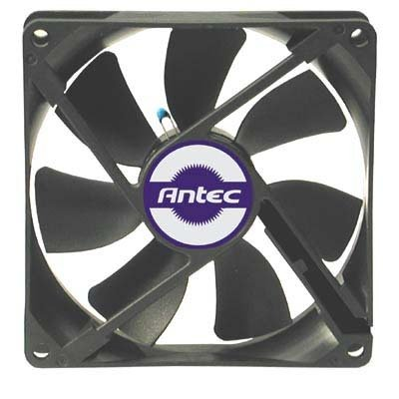
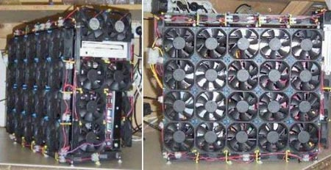
Fans
Traditional
Inexpensive
Multiple in each case

Slide 19
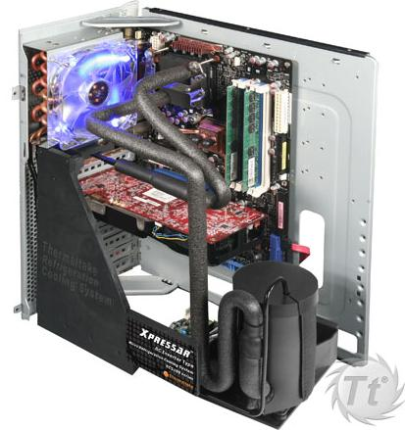
Liquid Cooling Systems
Cooler internal temperature
Quieter

Slide 20
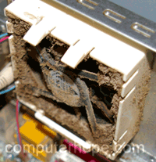
Cleaning
Eliminates germs
Removes dust from air intakes
Speeds up computer

Slide 21
How often should I clean my computer case?
Take this short quiz to find out!!

Slide 22
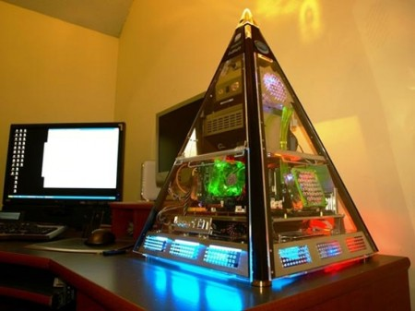
Case Modding
Fun
Contests
Gives a personlized touch
Get creative with your mod!

Slide 23
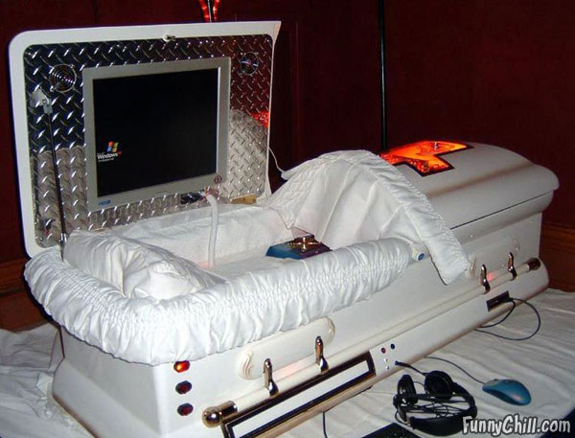
Really bizarre!

Slide 24
Power Supplies
Part 1: Electricity

Slide 25
Measures of Electricity
Volt
A measure of electrical “pressure” differential
Amp or Ampere
A measure of electrical current
Ohm
A measure of resistance to electricity
Watt
A measure of electrical power

Slide 26
AC vs DC
AC
Alternating Current
Goes back and forth (oscillates)
Voltage alternates from +110 V to -110 V
DC
Direct Current
Travels in one direction
The type of current most electronic devices require

Slide 27
Two Electronic Components
Capacitor
Diode
An electronic device that can hold an electrical charge for a period of time
Can smooth the uneven flow of electricity through a circuit
Inside the power supply
A semiconductor device that allows electricity to flow in only one direction
Used in various configurations, can convert AC to DC

Slide 28
Power Supplies
Part 2: Common Connectors

Slide 29
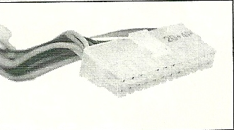
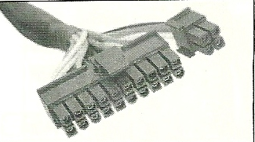
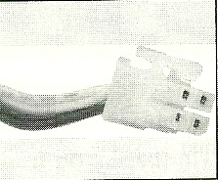
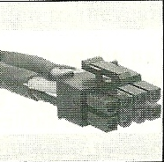
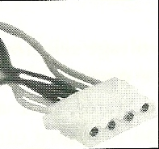
P1 20+4 pin connector is the main motherboard power connector (can also have four pins removed to fit 20-pin P1 connector)
4-pin 12 V auxiliary motherboard connector used for extra power to the processor
8-pin 12 V auxiliary motherboard connector used for extra power to the processor
Molex 4-pin connector used for IDE drives

Slide 30
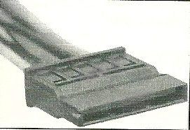
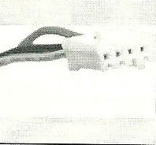
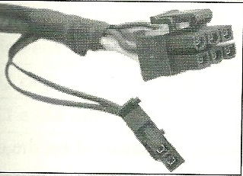
SATA connector used for SATA drives and has 15 pins.
Floppy drive connector
6-pin plus 2-pin +12 V connector (used by high-end video cards using PCIe x16 clots)

Slide 32
Power Supplies
Part 3: Things to consider

Slide 33
1) The form factor will determine what size power supply and the placement of the screw holes
2) Different cables are needed for different computer setups
3) Some power supplies have voltage selector switch. In the U.S., ensure the switch is set to 115 V
4) Look at the wattage ratings, found on the side of the power supply and in the documentation
5) Consider the warranty and quality

Slide 34
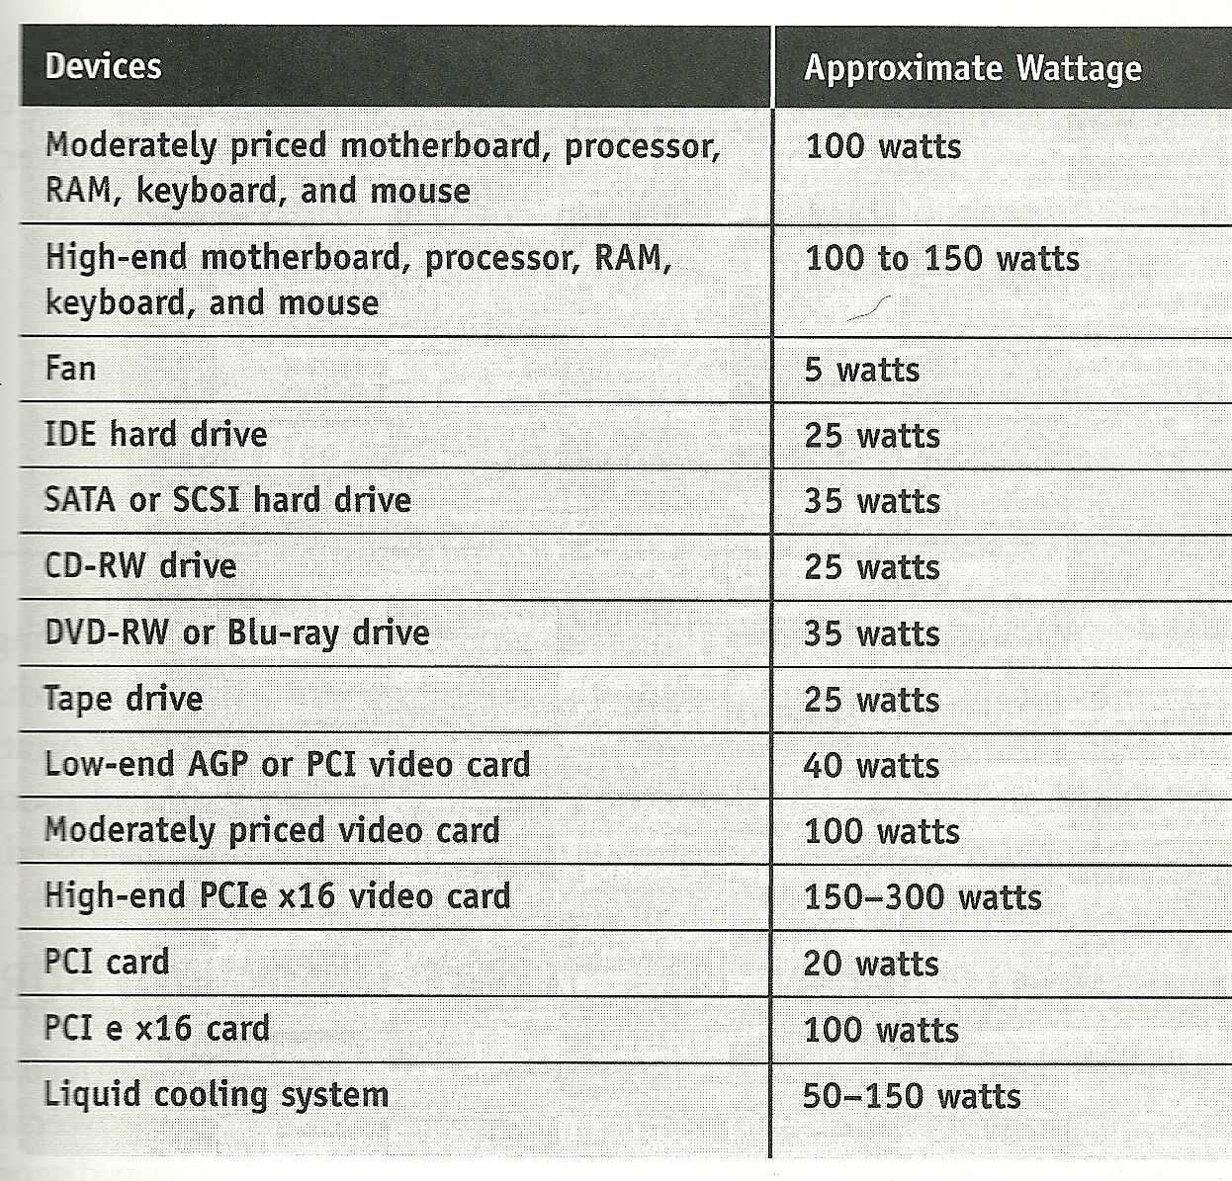

Slide 35
Two Examples
A regular desktop system with a moderately priced motherboard using socket LGA775 for Intel processors or an AMD2 socket for AMD processors, one moderately priced video card, two SATA hard drives, a DVD-RW drive, and two fans needs a power supply rated at about 300 to 350 watts
A gaming system with a high-end motherboard using socket LGA775 for Intel processors or an AMD2 socket for AMD processors, two high-end video cards, two SATA hard drives, a Blue-ray drive, and four fans needs a power supply rated at about 800 watts
1000 if a liquid cooling system used for overclocking is installed

Slide 36
Modular Power Supply
Advantages
Disadvantages
Unused connectors can be removed
Without the clutter, air flow is improved
Modular cables add electrical resistance
This resistance could affect performance of the power supply, and the rest of the computer in turn

Slide 37
Uninterruptible Power Supply
Provides backup power in the event that the AC fails completely
Provides power long enough for you to save your work and shut down the computer during a blackout
Has several outlets which to plug the system into

Slide 38
Interesting Side Notes
A computer power supply changes and conditions the house electrical current in several ways, functioning as both a transformer and a rectifier
It steps down the voltage from the 110-volt house current to 3.3, 5, and 12 volts

Slide 39
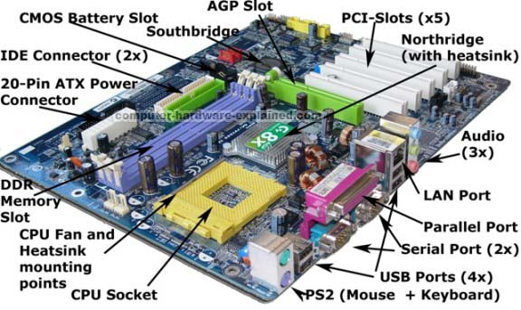
Motherboards

Slide 40
Motherboard

Slide 41
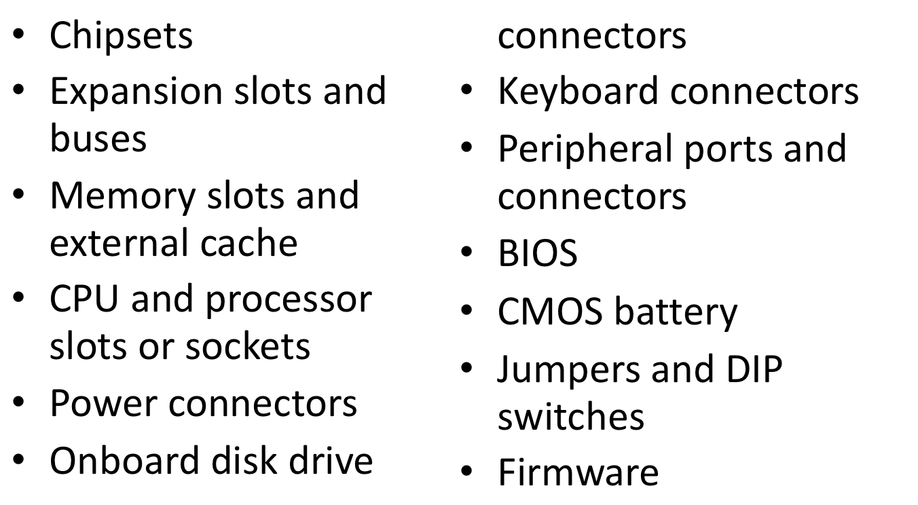
Components

Slide 42
Chipsets
Northbridge
Used to be the MCC, Memory Controller Chip
Instead of acting just as the interconnection between the RAM and the CPU as previous
It was given extra power to act as the interconnection between the CPU and other devices on the PC
Thus given the name Northbridge because it acts as the primary bridge between the CPU and the rest of the PC

Slide 43
Chipsets
Southbridge
Created to lessen the load on the Northbridge, thus allowing for more performance
This allows for the Northbridge to handle high-speed interfaces such as the connection to the video card and RAM
Which means that the Southbridge works with the lower speed devices such as the USB controller and the Hard Drive controller

Slide 44
Chipsets
Northbridge and Southbridge are sold as pairs to Motherboard manufacturers called Chipsets
The terms Northbridge and Southbridge are rarely used anymore because modern chipsets consist of only two or three chips but techs still continue to use the terms

Slide 45
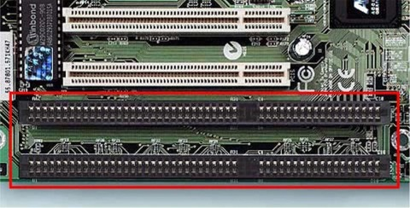
Expansion Slots and Buses
Expansion slot was the term given by to the slots built into the motherboard by IBM
Now they are called the Expansion Bus
PC Bus – 8 bits wide, 7MHz speed, Manual configuration
ISA Bus – 16 bits wide, 7MHz speed, Manual configuration

Slide 46
Modern Expansion Buses
PCI – Peripheral Component Interconnect
32 bits wide, 33 MHz speed, Self configuring
AGP – Accelerated Graphics Port
32 bits wide, 66 MHz speed, Self configuring
Replaced ISA
PCI-X – Peripheral Component Interconnect Extended
Found in Macintosh G5
64 bits wide, 66 MHz speed, 133 MHz speed, 266 MHz speed, 533 MHz speed

Slide 47
Modern Expansion Buses
Mini PCI – Used in laptops because it was designed to lie flat
PCI Express – Latest and fastest
Has a direct connection to the Northbridge
32 bits wide

Slide 48
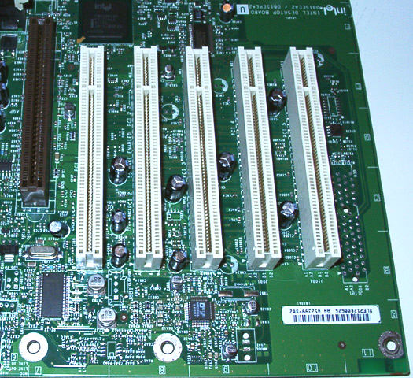
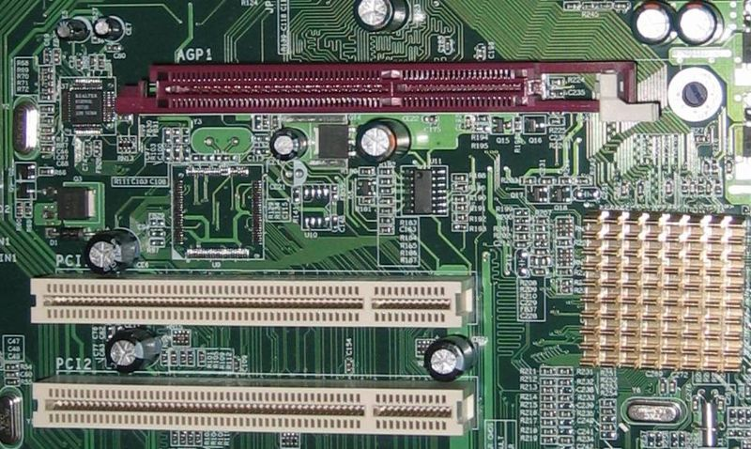
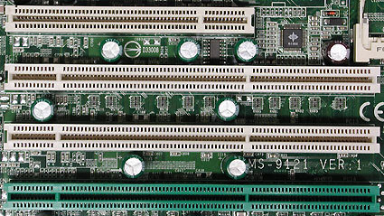
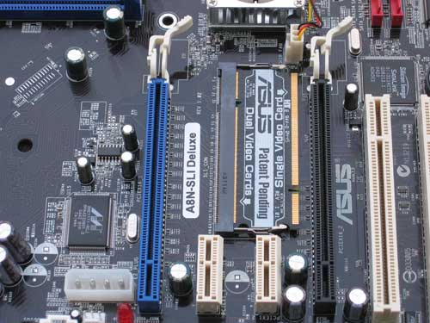
Modern Expansion Buses

Slide 49
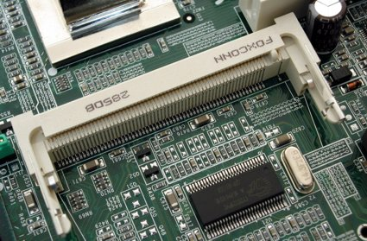
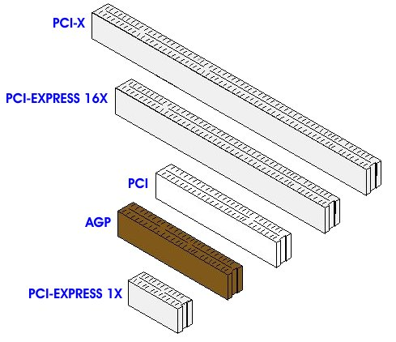
Modern Expansion Buses

Slide 50
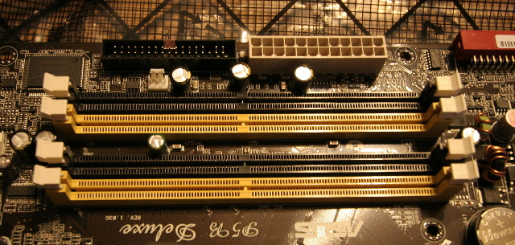
Memory Slots
Number of pins can range from 100 to 240
Types
DRAM – Dynamic Random Access Memory
SDRAM - Synchronous DRAM
DDR – Double Data Rate, DDR2, DDR3

Slide 51
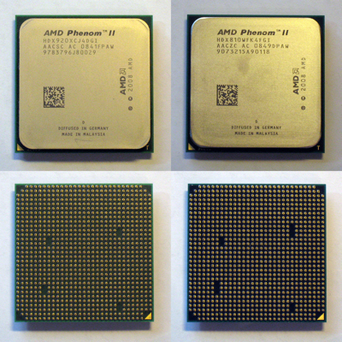
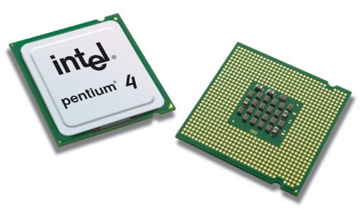
CPU Sockets
PGA – Pin Grid Array
LGA – Land Grid Array
Socket number determines how many pins
AM3 = 941 pins
AM2 = 940 pins

Slide 52
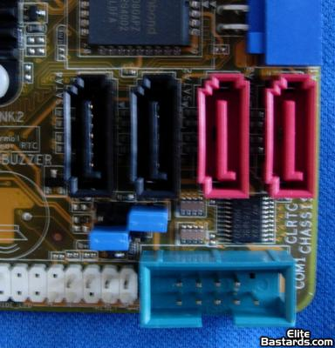
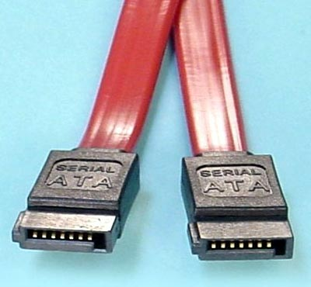
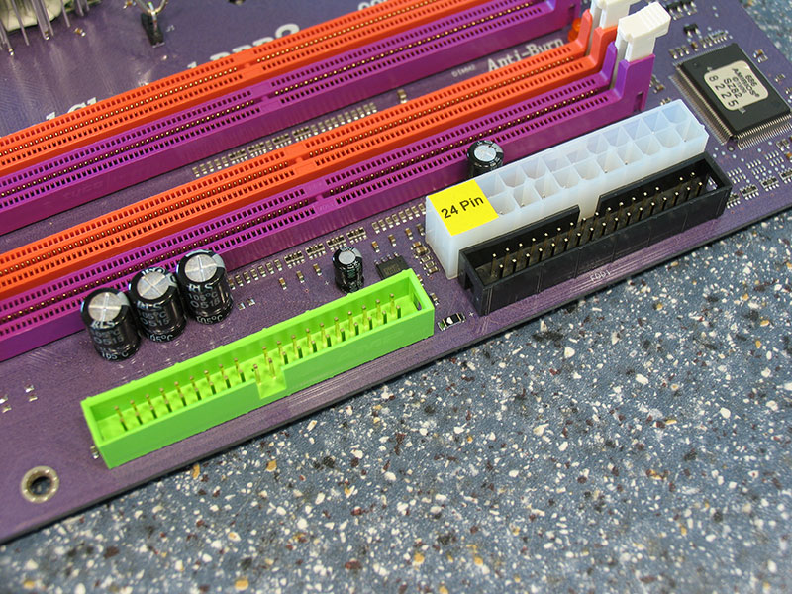
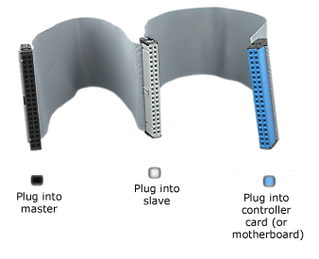
Onboard Disk Drive Connectors
PATA (Parallel Advanced Technology Attachment)– 16, 33, 66, 100, 133 MB per second
SATA (Serial Advanced Technology Attachment)- 1.5, 3.0, 6.0 Gb per second

Slide 53
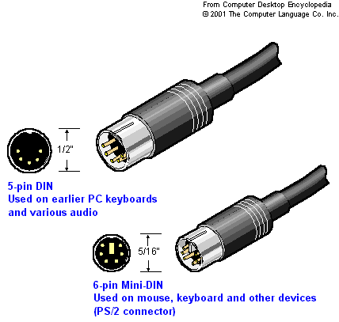
Keyboard Connectors
Two main types of wired keyboard connectors
PS/2 style - popular
AT connector – all but extinct
The PS/2 style connector remains popular, but is quickly being replaced by USB- attached keyboards.

Slide 54
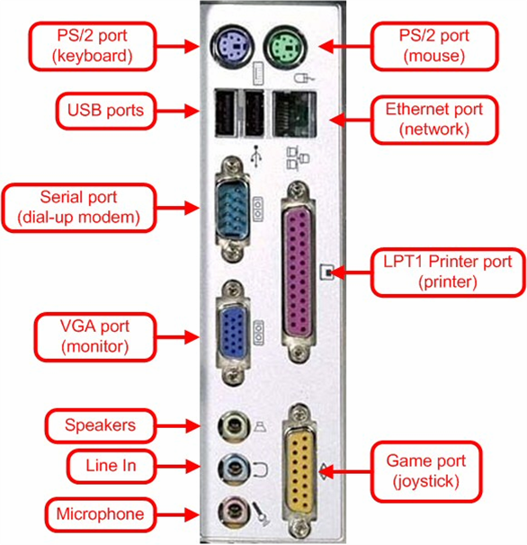
Peripheral ports and connectors
In order for computers to be useful and have the most functionality, there needs to be a way to get data into and out.
Many ports are available for this purpose as you can see on the right.

Slide 55
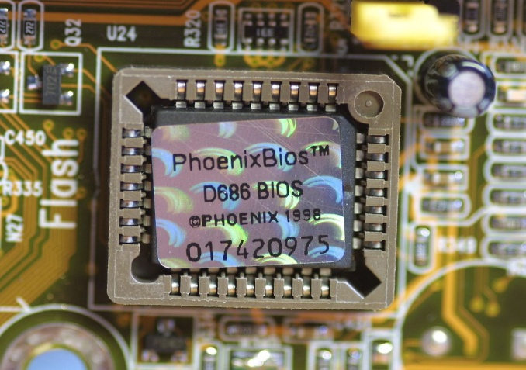
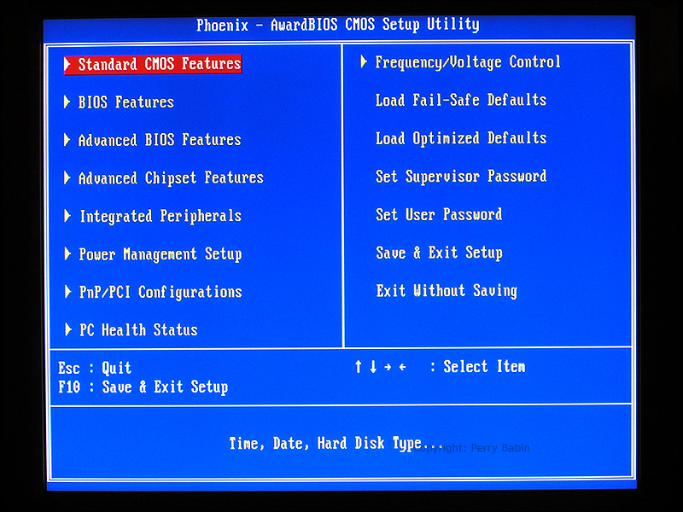
BIOS
Basic Input/ Output System chip
The initial function of the BIOS is to identify, test, and initialize system devices such as the video display card, hard disk, floppy disk and other hardware.
The BIOS sets the machine hardware into a known state, so that software stored on compatible media can be loaded, executed, and given control of the PC

Slide 56
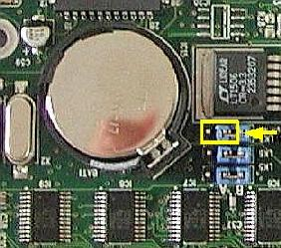
CMOS Battery
Your PC has to keep certain settings when it’s turned off, and its power cord is unplugged. Settings such as:
Date
Time
Hard Drive configuration
Memory
Integrated ports
Boot sequence
Power management

Slide 57
CMOS battery continued
Your PC keeps these setting in a memory chip called the complementary metal oxide semiconductor.
CMOS memory is usually not upgradable in capacity.
To keep its settings circuit based memory must have power constantly.
To prevent CMOS from losing important information, motherboard manufacturers include a small battery called the CMOS battery.

Slide 58
Jumpers and DIP switches
Jumpers allow the computer to close an electrical circuit allowing the electricity to flow throughout certain sections of the circuit board. Generally, the jumpers consist of a set small pins which can be covered with a small plastic box. This box connects the two pins together allowing the electricity to flow freely between the two pins.
Jumpers are used to configure computer peripherals such as Hard Drives, Modems, Sound Cards, and various other components.
Dip switches are designed with the same intentions as jumpers. However, instead of having to remove the jumper block and placing it over separate pins, dip switches are actual small switches which can be turned to the ON or OFF position.

Slide 59
Jumpers and DIP switches
Many of the motherboard settings that were set using jumpers and DIP switches are now either automatically detected or set manually in the BIOS setup program.

Slide 60
Firmware
Firmware is programming that's written to the read-only memory (ROM) of a computing device. Firmware, which is added at the time of manufacturing, is used to run user programs on the device.

Slide 62
Resources
http://searchcio-midmarket.techtarget.com/sDefinition/0,,sid183_gci212127,00.html
http://www.wikipedia.org/
Docter, Quentin. CompTIA A+ complete study guide (exams 220-701/220-702). Indianapolis: Wiley Technology Pub., 2009. Print.

Slide 63
Resources
http://www.topbits.com/types-of-computer-cases.html
http://www.computerhope.com/jargon/c/chassis.htm
Michael Meyers: A+ Certification All-in-One Exam Guide, Seventh Edition , Mc Graw Hill. 2010

