Slide 1
COSC 120: Computer Science I Module 2
Instructors:
Dr. Xiaohong (Sophie) Wang (xswang@salisbury.edu)
Department of Mathematics & Computer Science
Salisbury University
Spring 2023

Slide 2
Module 2: Decisions, Loops and Files
Relational operators
Logical operators
Conditional statement
Variable scope
while loop
do-while loop
for loop
Using Files for Data Storage
Partial contents of this note refer to https://www.pearson.com/us/
Copyright 2018, 2015, 2012, 2009 Pearson Education, Inc., All rights reserved
Dissemination or sale of any part of this note is NOT permitted

Slide 3
1. Relational Operators
Used to compare numbers to determine relative order
Operators:
> | Greater than | Higher precedence than == and !=
< | Less than
>= | Greater than or equal to
<= | Less than or equal to
== | Equal to | Lower precedence than the above four
!= | Not equal to

Slide 4
Relational Expressions
Relational expression use relational operator to determine the relationship of two operands
As known as Boolean expressions
The value can only be true or false
Examples:
12 > 5 is true
7 <= 5 is false
if x is 10, then
x == 10 is true,
x != 8 is true, and
x == 8 is false

Slide 5
In-class practice
Define
int a=2, b=3, c=6;
What is the result of following expressions?
(a == 5)
(a*b >= c)
(b+4 > a*c)
((b=2) == a)
False
True
False
True
Notes:
(a == 5) // evaluates to false, since a is not equal to 5
(a*b >= c) // evaluates to true, since (2*3 >= 6) is true
(b+4 > a*c) // evaluates to false, since (3+4 > 2*6) is false
((b=2) == a) // evaluates to true
__ http://www.cplusplus.com/doc/tutorial/operators/

Slide 6
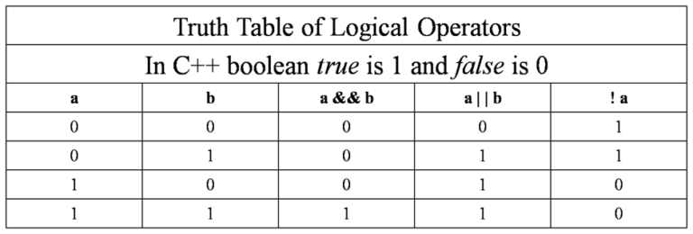
2. Logical Operators
Used to connect two relational expressions or reverse the value of a relational expression
&& | AND | New expression is true if both expressions are true
|| | OR | New expression is true if either expression is true
! | NOT | Reverse the value of an expression
https://www.startertutorials.com/blog/c-basics.html/cpp-logicalops-truth-tables

Slide 7
Example
int x = 12, y = 5, z = -4;
(x > y) && (y > z) | true
(x > y) && (z > y) | false
(x <= z) || (y == z) | false
(x <= z) || (y != z) | true
!(x >= z) | false
Note: ! has highest precedence, followed by &&, then ||

Slide 8
3. Conditional statement
Some conditions in our daily life
if it is sunny, I will play tennis
if my answer of this question is right, I will do the next question;
otherwise, I will do this question again.
The children whose age is less than 4 (age < 4), please go to room 1;
the children whose age satisfies 4 <= age < 8, please go to room 2;
all the remaining children please go to room 3.
if statement
if/else statement
if/else if statement

Slide 9
3.1 if statement
Syntax:
if (expression)
{ statements }// or code block
If the expression is true, then statements are executed.
If the expression is false, then statements are skipped.
If there is only one statement, { } is not necessary.
if (number % 2 == 0)
cout << number << " is even. \n";

Slide 10
3.2 if/else statement
Syntax:
if (expression)
{statements1} // or code block1
else
{statement2} // or code block2
Provides two possible paths of execution
Performs block1 if the expression is true, otherwise performs block2.

Slide 11
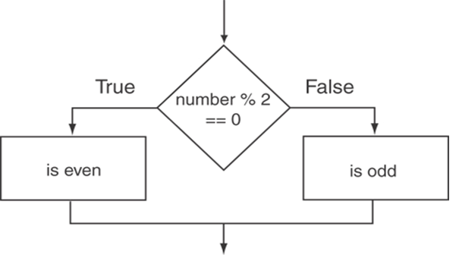
Example
int number;
cout << "Enter an integer:";
cin >> number;
if (number % 2 == 0){
cout << number << " is even. \n";}
Else {
cout << number << " is odd. \n";}
if/else statement logic

Slide 12
Nested if Statements
An if statement that is nested inside another if statement
Nested if statements can be used to test more than one condition
if (Month >= 1){
if (Month <= 12)
cout << "Valid";
else
cout << "Invalid";
}
else {
cout << "Invalid";
}

Slide 13
3.3 if/else if Statement
Tests a series of conditions until one is found to be true
Simpler than using nested if/else statements
Syntax:
if (expression1)
{ statements1 } // or block1
else if (expression2)
{ statements2 } // or block2
.
. // other else ifs .
else
{ statementsn } // or blockn
Trailing else is optional. This statement/block are executed if none of the expressions above are true.

Slide 14
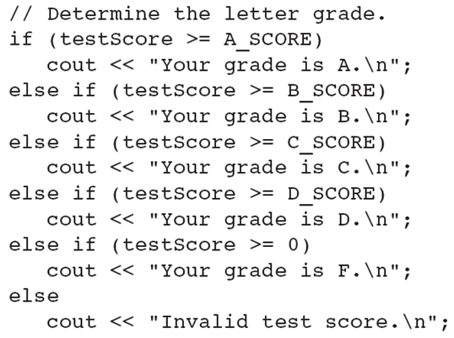
Using a Trailing else to Catch Errors
const: used to define a constant variable – a named memory location, the value in which can be initialized but cannot be changed later.
const int A_SCORE = 90,
B_SCORE = 80,
C_SCORE = 70,
D_SCORE = 60;
This trailing else catches invalid test scores

Slide 15
Practice of conditional statements
How many code block will be executed here?
if (A)
{code block 1}
else
{code block 2}
if (A)
{code block 1}
if (B)
{code block 2}
1 code block will be executed
0 or 1 or 2 code block will be executed
if (A)
{code block 1}
else if (B)
{code block 2}
else if (C)
{code block 3}
if (A)
{code block 1}
else if (B)
{code block 2}
else
code block 3
0 or 1 code block will be executed
1 code block will be executed

Slide 16
In-class practice
Ask a user to input an integer into a variable named Month
If the value of Month is between 1 and 12 (include 1 and 12), print "Valid"; otherwise print "Invalid".
Test the code
Reference code:Month.cpp

Slide 17
In-class practice
Ask a user to input his/her age, then print the park ticket price.
Park ticket price:
age < 2: $0
2 <= age <5: $2
5 <= age < 10: $4
10 <= age: $5

Slide 18
3.4 Conditional operator
Can use to create short if/else statements
Format: expr1 ? expr2 : expr3;
The value of a conditional expression is
expr2 if expr1 is true
expr3 if expr1 is false
x<0 ? y=10 : z=20;
First Expression:
Expression to be
tested
2nd Expression:
Executes if first
expression is true
3rd Expression:
Executes if the first
expression is false

Slide 19
In-class practice
What is the output?
int a = 3, b = 4, c;
c = a > b ? ++a : ++b;
cout << a << ", " << b << ", " << c << endl;
c = a - b ? a + b : a - 3 ? b : a;
cout << a << ", " << b << ", " << c << endl;
Output:
3, 5, 5
3, 5, 8
Note: Conditional expressions have right-to-left associativity.
C++ Basic Textbook. Tsinghua University Press

Slide 20
3.5 switch Statement
Used to select among statements from several alternatives
In some cases, can be used instead of if/else if statements
switch (expression) //integer
{
case value1: statements1
break;
case value2: statements2
break;
...
case valuen: statementsn
break;
default: statementsn+1
}

Slide 21
How it Works
1) expression is evaluated
The value of expression is compared against value1 through valuen.
If expression matches value valuei, the program branches to the statements following valuei then encounter a break and jump to the end of the switch
If no matching value is found, the program branches to the statements after default:

Slide 22
Example
int x = 2;
switch (x)
{
case 1:
cout << "Choice is 1\n";
break;
case 2:
cout << "Choice is 2\n";
break;
case 3:
cout << "Choice is 3\n";
break;
default:
cout << "Choice other than 1, 2 and 3\n";
break;
}
The break statement in the default section is optional
Output:
Choice is 2
https://www.geeksforgeeks.org/switch-statement-cc/

Slide 23
break Statement
Used to exit a switch statement
If it is left out, the program "falls through" the remaining statements within the switch statement

Slide 24
Example
int x = 2;
switch (x)
{
case 1:
cout << "Choice is 1\n";
case 2:
cout << "Choice is 2\n";
case 3:
cout << "Choice is 3\n";
default:
cout << "Choice other than 1, 2 and 3\n";
}
Output:
Choice is 2
Choice is 3
Choice other than 1, 2 and 3
https://www.geeksforgeeks.org/switch-statement-cc/

Slide 25
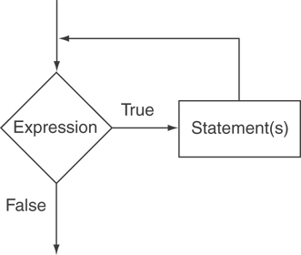
5. while Loop
Loop: a control structure that causes a statement or code block to repeat
while (expression)
{statements } // or block
Body of the loop
expression is evaluated
if true, then statements or block is executed, and expression is evaluated again
if false, then the loop is finished
Often used when you know when to stop (maybe do not know how many iterations)

Slide 26
Example
int number = 0;
while (number < 5)
{
cout << "Hello\n";
number++;
}
Output:
Hello
Hello
Hello
Hello
Hello

Slide 27
In-class practice
Input a positive integer n, use a while loop to calculate and output the sum of 1,2,...,n
Reference code: Sum.cpp

Slide 28
Infinite Loops
The loop must contain code to make expression become false eventually
Otherwise, the loop is an infinite loop, because it will repeat execution of its body infinite number of times
Is possible for a while loop to execute ZERO time?
If yes, when does that happen?
If not, why not?
int number = 1; while (number <= 5) { cout << "Hello\n"; }

Slide 29
6. do-while Loop
do-while: a posttest loop – execute the loop, then test the expression
General Format:
do {
statements // or block in { }
}while (expression);
Note that a semicolon is required after (expression)

Slide 30
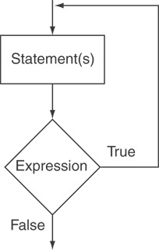
The Logic of a do-while Loop
Loop always executes at least once
Execution continues as long as expression is true, stops repetition when expression becomes false

Slide 31
In-class practice
Input a positive integer n, use a do-while loop to calculate and output the sum of 1,2,...,n
Is possible for a do- while loop to execute ZERO time?
If yes, when does that happen?
If not, why not?
What is the minimum number of times for do-while loop to execute?
Reference code: Sum2.cpp

Slide 32
7. for Loop
Useful for counter-controlled loop
Often used when you know how many iterations
General Format:
for(initialization; test; update)
{statements} // or block in { }
No semicolon after the update expression or after the )

Slide 33
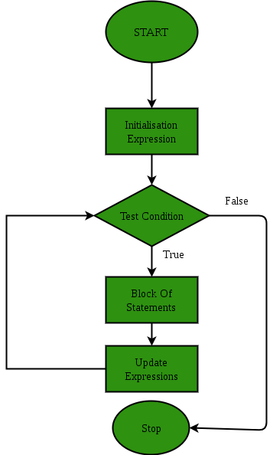
for Loop - Mechanics
for(initialization; test; update)
{statements} // or block
Perform initialization
Evaluate test expression
If true, execute statement
If false, terminate loop execution
Execute update, then re-evaluate test expression

Slide 34
for Loop - Example
int count;
for (count = 1; count <= 5; count++){
cout << "Hello" << endl;
}
Output:
Hello
Hello
Hello
Hello
Hello

Slide 35
for Loop - Modifications
You can have multiple statements in the initialization expression int x, y; for (x=1, y=1; x <= 5; x++){ cout << (x+y) << endl; }
You can define a counter variable in the initialization expression
for (int num = MIN_NUM; num <= MAX_NUM; num++)
cout << num << endl;
Initialization Expression
Define a counter variable

Slide 36
In-class practice
Input a positive integer n, use a for loop to calculate and output the sum of 1,2,...,n
Reference code: Sum3.cpp

Slide 37
Nested Loops
A nested loop is a loop inside the body of another loop
Inner (inside), outer (outside) loops:
for (int row=1; row<=3; row++){ //outer
for (int col=1; col<=3; col++){//inner
cout << row * col << endl;
}// end of inner loop
}// end of outter loop

Slide 38
Nested Loops
Inner loop goes through all repetitions for each repetition of outer loop
Total number of repetitions for body of inner loop is product of number of repetitions of the two loops.
for (int row=1; row<=3; row++){ //outer
for (int col=1; col<=3; col++){//inner
cout << row * col << endl;
}// end of inner loop
}// end of outter loop

Slide 39
break and continue
Two statements to interrupt the normal flow
break takes control out of the loop it is in
continue skips the rest of the current iteration
https://www.geeksforgeeks.org/break-statement-cc/

Slide 40
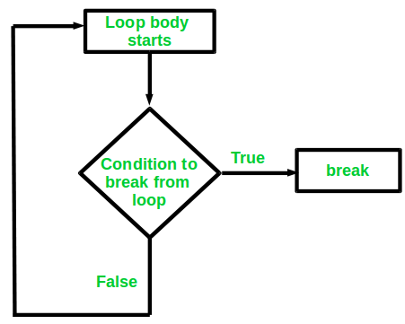
Loop control
Breaking Out of a Loop
Can use break to terminate execution of a loop (often used together with condition statement)
Use sparingly – makes code harder to understand and debug
When used in an inner loop, terminates that loop only and goes back to outer loop
https://www.geeksforgeeks.org/break-statement-cc/

Slide 41
Example
int i = 0;
while (i < 10) {
cout << i << "\n";
i++;
if (i == 4) {
break;
}
}
Output:
0
1
2
3
https://www.w3schools.com/cpp/showcpp.asp?filename=demo_break_while

Slide 42
Loop control
The continue Statement
Can use continue to skip the rest of the current iteration to go to end of loop and prepare for next repetition
while, do-while loops: go to test, repeat loop if test passes
for loop: perform update step, then test, then repeat loop if test passes
Use sparingly – like break, can make program logic hard to follow

Slide 43
Example
int i = 0;
while (i < 10) {
if (i == 4) {
i++;
continue;
}
cout << i << "\n";
i++;
}
Output:
0
1
2
3
5
6
7
8
9
https://www.w3schools.com/cpp/showcpp.asp?filename=demo_continue_while

Slide 44
Thanks

Slide 45
Reading textbook
Chapter 4, 5

Slide 46
Where to find resources/help?
Required textbook:
Starting Out with C++: From Control Structures through Objects, by Tony Gaddis, Pearson (9th Edition)
Instructor’s web page for the course:
Dr. Sophie Wang: http://faculty.Salisbury.edu/~xswang/cosc120.htm
SU myClass Canvas:
https://www.salisbury.edu/administration/academic-affairs/instructional-design-delivery/cms/
Course policy, lecture ppts/videos, labs, assignments, quizzes, projects, etc.
Department tutoring program (free!):
https://www.salisbury.edu/academic-offices/science-and-technology/math-and-computer-science/tutoring-center.aspx
Dr. Shuangquan (Peter) Wang (spwang@salisbury.edu)

Slide 47
How to be successful?
Show up
Read textbook/lecture notes before and after each class
Many small pieces of information that may not be covered in class
Start early to work on your projects
Experiment & practice
Try and find out what will happen. Why?
Ask for help

