Slide 1
Binary Tree
A binary tree is a tree data structure in which each node has at most two children.
Typically the child nodes are called left child and right child.
Binary trees are commonly used to implement binary search trees and heaps.

Slide 2
Binary Tree
Balanced Binary Tree

Slide 3
Binary Tree
Unbalanced Binary Tree

Slide 4
Binary Search Tree
Binary search tree – a binary tree with binary-search-tree property.
Binary-Search-Tree Property
  Let x be a node in a binary search tree.
  If y is a node in the left subtree of x then key(y) ≤ key(x).
  If y is a node in the right subtree of x, then key(x) ≤ key(y).

Slide 5
Binary Search Tree
7
2
8
1
4
14
3
5
9
16

Slide 6
Binary Search Tree
2
Unbalanced Binary Tree
1
3
7
9
8

Slide 7
Operations on Binary Search Tree
Binary Search Tree Operations
  Inorder walk
  Preorder walk
  Postorder walk
  Search Tree
  Insert a element to the Tree
  Delete a element form the Tree

Slide 8
Operations on Binary Search Tree
(Inorder, Preorder, Postorder)
The binary-search-tree property allows us to print out all the keys in a binary search tree in sorted order by a simple recursive algorithm, called an inorder tree walk.
Running Time T(n) = 2T(n/2) + 1 = O(n)
Inorder_Tree_Walk(x)
{
1 If x ≠ NIL
{
2 Inorder_Tree_Walk(x→leftchild);
3 print x → key
4 Inorder_Tree_Walk(x → rightchild);
}
}

Slide 9
Operations on Binary Search Tree
(Inorder, Preorder, Postorder)
Preorder_Tree_Walk(x)
{
1 If x ≠ NIL
{
2 Print x → key;
3 Inorder_Tree_Walk(x→leftchild);
4 Inorder_Tree_Walk(x → rightchild);
}
}
Postorder_Tree_Walk(x)
{
1 If x ≠ NIL
{
2 Inorder_Tree_Walk(x→leftchild);
3 Inorder_Tree_Walk(x → rightchild);
4 Print x → key;
}
}

Slide 10
Operations on Binary Search Tree
(Inorder, Preorder, Postorder)
Inorder_Tree_Walk(x)
{
1 If x ≠ NIL
{
2 Inorder_Tree_Walk(x→leftchild);
3 print x → key
4 Inorder_Tree_Walk(x → rightchild);
}
}
7
2
8
1
4
14
3
5
9
16
1
2
3
4
5
7
8
9
14
16

Slide 11
Operations on Binary Search Tree
(Inorder, Preorder, Postorder)
Preorder_Tree_Walk(x)
{
1 If x ≠ NIL
{
2 print x → key;
3 Inorder_Tree_Walk(x→leftchild);
4 Inorder_Tree_Walk(x → rightchild);
}
}
7
2
8
1
4
14
3
5
9
16
7
2
1
4
3
5
8
14
9
16

Slide 12
Operations on Binary Search Tree
(Inorder, Preorder, Postorder)
Postorder_Tree_Walk(x)
{
1 If x ≠ NIL
{
2 Inorder_Tree_Walk(x→leftchild);
3 Inorder_Tree_Walk(x → rightchild);
4 Print x → key;
}
}
7
2
8
1
4
14
3
5
9
16
5
4
2
16
14
8
7
1
3
9

Slide 13
Operations on Binary Search Tree
(Search an Element)
Searching a binary search tree for a specific value can be a recursive or iterative process.
We begin by examining the root node. If the tree is null, the value we are searching for does not exist in the tree. Otherwise, if the value equals the root, the search is successful. If the value is less than the root, search the left sub-tree.
If it is greater than the root, search the right subtree. This process is repeated until the value is found or the indicated sub-tree is null. If the searched value is not found before a null sub-tree is reached, then the item must not be present in the tree.

Slide 14
Operations on Binary Search Tree
(Search an Element)
Searching
Input: pointer to the root of the tree and a key k,
Output: returns a pointer to a node with key k if one exists; otherwise return NIL.
T(n) = T(n/2) + 1 = O(log n) if a binary tree is balanced
T(n)= T(n-1) + 1 = O(n) if a binary tree is not balanced
Tree_Search (x, k)
{
1 if x == NIL or k == x → key
return x;
2 if k < x → key
3 return Tree_Search (x → leftchild, k);
4 else
5 return Tree_Search(x → rightchild, k);
}

Slide 15
Operations on Binary Search Tree
(Search an Element)
Search (x, 14)
x
14 = 5 or 14> 5 or 14 < 5 ?
5
3
13
10
14
11
12

Slide 16
Operations on Binary Search Tree
(Search an Element)
Search (x, 14)
x
14= 13 or 14> 13 or 14 < 13 ?
13
10
14
14= 14 or 14> 14 or 14 < 14 ?
11
12

Slide 17
Operations on Binary Search Tree
(Search an Element)
Searching a binary search tree for a specific value can be a recursive or iterative process. Following shows the iterative version of tree search
Tree_Search_II(x, k)
{
1 y = x; //better not modify pointer x
2 while y ≠ NIL and k ≠ y → key
{
3 if k < y → key
4 y = y → leftchild;
5 else
6 y = y → rightchild;
}
7 return y;
}

Slide 18
Operations on Binary Search Tree
(Search an Element)
15
Search (x, 14)
14 = 5 or 14> 5 or 14 < 5 ?
x
16
5
3
13
20
10
14
18
23
11
12

Slide 19
Operations on Binary Search Tree
(Search an Element)
15
Search (x, 14)
14 = 12 or 14> 12 or 14 < 12 ?
5
16
14 = 13 or 14> 13 or 14 < 13 ?
3
x
13
20
10
14
18
23
11
12

Slide 20
Operations on Binary Search Tree
(Insert a New Node)
Insertion begins as a search would begin; if the root is not NIL, we search the left or right sub-trees as before.
Eventually, we will reach an external node and add the value as its right or left child, depending on the node's value.

Slide 21
Operations on Binary Search Tree
(Insert a New Node)
// T is point to root of binary tree z is point to new node
Tree_Insert (T, z)
{
1 y = NIL;
2 x = T;
//while loop find out the location for new node
3 while x ≠ NIL
{
4 y = x;
5 if z → key < x → key
6 x = x → leftchild;
7 else
8 x = x → rightchild;
}
9 z → parent = y;
10 if y = NIL; // means there is any node in the BST
11 T = z; //new node become root
12 else if z → key < y → key
13 y → leftchild = z; // insert new node as a left child o y
14 else
15 y → rightchild = z; //insert new node as a right child of y
}

Slide 22
Operations on Binary Search Tree
(Insert a New Node)
7
2
8
14
9
4
1
16
3
5

Slide 23
Operations on Binary Search Tree
(Insert a New Node)
7
2
8
14
9
4
1
16
3
5

Slide 24
Operations on Binary Search Tree
(Insert a New Node)
7
2<7 or 2 >7 ?
2
8
14
9
4
1
16
3
5

Slide 25
Operations on Binary Search Tree
(Insert a New Node)
7
2
8
14
9
4
1
16
3
5

Slide 26
Operations on Binary Search Tree
(Insert a New Node)
7
8<7 or 8 >7 ?
2
8
14
9
4
1
16
3
5

Slide 27
Operations on Binary Search Tree
(Insert a New Node)
7
2
8
14
9
4
1
16
3
5

Slide 28
Operations on Binary Search Tree
(Insert a New Node)
7
14<7 or 14 >7 ?
2
8
14
9
4
1
16
3
5

Slide 29
Operations on Binary Search Tree
(Insert a New Node)
7
14<8 or 14 >8 ?
2
8
14
9
4
1
16
3
5

Slide 30
Operations on Binary Search Tree
(Insert a New Node)
7
2
8
14
9
4
1
16
3
5

Slide 31
Operations on Binary Search Tree
(Insert a New Node)
7
9<7 or 9 >7 ?
2
8
14
9
4
1
16
3
5

Slide 32
Operations on Binary Search Tree
(Insert a New Node)
7
9<8 or 9 >8 ?
2
8
14
9
4
1
16
3
5

Slide 33
Operations on Binary Search Tree
(Insert a New Node)
7
9<14 or 9 >14 ?
2
8
14
9
4
1
16
3
5

Slide 34
Operations on Binary Search Tree
(Insert a New Node)
7
2
8
14
9
4
1
16
3
5

Slide 35
Operations on Binary Search Tree
(Insert a New Node)
7
4<7 or 4 >7 ?
2
8
14
9
4
1
16
3
5

Slide 36
Operations on Binary Search Tree
(Insert a New Node)
7
4<2 or 4 >2 ?
2
8
14
9
4
1
16
3
5

Slide 37
Operations on Binary Search Tree
(Insert a New Node)
7
2
8
4
14
9
1
16
3
5

Slide 38
Operations on Binary Search Tree
(Insert a New Node)
7
1<7 or1 >7 ?
2
8
4
14
9
1
16
3
5

Slide 39
Operations on Binary Search Tree
(Insert a New Node)
7
1<2 or 1 >2 ?
2
8
4
14
9
1
16
3
5

Slide 40
Operations on Binary Search Tree
(Insert a New Node)
7
2
8
1
4
14
9
16
3
5

Slide 41
Operations on Binary Search Tree
(Insert a New Node)
7
16<7 or 16 >7 ?
2
8
1
4
14
9
16
3
5

Slide 42
Operations on Binary Search Tree
(Insert a New Node)
7
16<8 or 16 >8 ?
2
8
1
4
14
9
16
3
5

Slide 43
Operations on Binary Search Tree
(Insert a New Node)
7
16<14 or 16 >14 ?
2
8
1
4
14
9
16
3
5

Slide 44
Operations on Binary Search Tree
(Insert a New Node)
7
2
8
1
4
14
9
16
3
5

Slide 45
Operations on Binary Search Tree
(Insert a New Node)
7
3<7 or 3 >7 ?
2
8
1
4
14
9
16
3
5

Slide 46
Operations on Binary Search Tree
(Insert a New Node)
7
3<2 or 3 >2 ?
2
8
1
4
14
9
16
3
5

Slide 47
Operations on Binary Search Tree
(Insert a New Node)
7
3<4 or 3 >4 ?
2
8
1
4
14
9
16
3
5

Slide 48
Operations on Binary Search Tree
(Insert a New Node)
7
2
8
1
4
14
3
9
16
5

Slide 49
Operations on Binary Search Tree
(Insert a New Node)
7
5<7 or 5 >7 ?
2
8
1
4
14
3
9
16
5

Slide 50
Operations on Binary Search Tree
(Insert a New Node)
7
5<2 or 5 >2 ?
2
8
1
4
14
3
9
16
5

Slide 51
Operations on Binary Search Tree
(Insert a New Node)
7
5<4 or 5 >4 ?
2
8
1
4
14
3
9
16
5

Slide 52
Operations on Binary Search Tree
(Insert a New Node)
7
2
8
1
4
14
3
5
9
16

Slide 53
Operations on Binary Search Tree
(Minimum Element)
Minimum
An element in a binary search tree whose key is a minimum can always be found by leftmost child.
T(n) = O(log₂ n) or possible worst case O(n)
Tree_Minimum(x)
{
0 y = x;
1 while y → leftchild ≠ NIL
2 y = y → leftchild;
3 return y;
}

Slide 54
Operations on Binary Search Tree
(Maximum Element)
Maximum
An element in a binary search tree whose key is a maximum can always be founded by rightmost child.
T(n) = O( log₂ n)
Tree_Maximum(x)
{
0 y = x;
1 while y → rightchild ≠ NIL
2 y = y → rightchild;
3 return y;
}

Slide 55
Operations on Binary Search Tree
(Successor of a Node)
The successor of a node x is the node with the smallest key greater than x->key
We need to concern two cases
  If the right subtree of x is not empty, then the successor of x is the minimum of right subtree.
  If the right subtree of x is empty and x has a successor y, then y is the lowest ancestor of x whose left child is also an ancestor of x.

Slide 56
Operations on Binary Search Tree
(Successor of a Node)
15
6
18
3
7
17
20
2
4
13
9
Ex) successor of node 15 is 17 (min of right subtree)
Ex) successor of node 13 is 15.

Slide 57
Operations on Binary Search Tree
(Successor of a Node)
Tree_Successor (x)
{
1 if x → rightchild ≠ NIL
return Tree_Minimum(x → rightchild);
2 else
{
3 y = x → parent;
// if x is y’s leftchild then y is successor of x
4 while y ≠ NIL and x ==y → rightchild
{
5 x = y;
6 y = y → parent;
}
7 return y;
}
}

Slide 58
Operations on Binary Search Tree
(Predecessor of a Node)
The predecessor of a node x is the node with the largest key smaller than key(x)
We need to concern two cases
  If the left subtree of x is not empty, then the predecessor of x is the maximum of right subtree.
  If the left subtree of x is empty and x has a predecessor y, then y is the lowest ancestor of x whose right child is also an ancestor of x.

Slide 59
Operations on Binary Search Tree
(Predecessor of a Node)
15
6
18
3
7
17
20
2
4
13
9
Ex) Predecessor of node 15 is 13 (Maximum of left subtree)
Ex) Predecessor of node 9 is 7.

Slide 60
Operations on Binary Search Tree
(Predecessor of a Node)
Tree_Predecessor (x)
{
1 if x → leftchild ≠ NIL
return Tree_Maximum(x → leftchild)
2 else
{
3 y = x → parent
// if x is y’s rightchild then y is predecessor of x
4 while y ≠ NIL and x ==y → leftchild
{
5 x = y
6 y = y → parent
}
7 return y
}
}

Slide 61
Operations on Binary Search Tree
(Delete a Node)
There are three cases needed to be concern in binary tree deletion.
A deleting node has no children (deleting node is a leaf)
A deleting node has one children.
A deleting node has two children.
  If successor of deleting node is a leaf
  If successor of deleting node is not a leaf

Slide 62
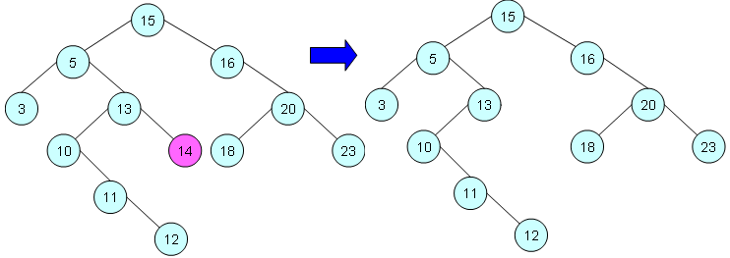
Operations on Binary Search Tree
(Delete a Node)
Case 1) Delete Leaf Node

Slide 63
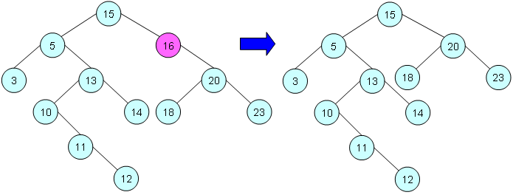
Operations on Binary Search Tree
(Delete a Node)
Case 2) Delete a Node with one child

Slide 64
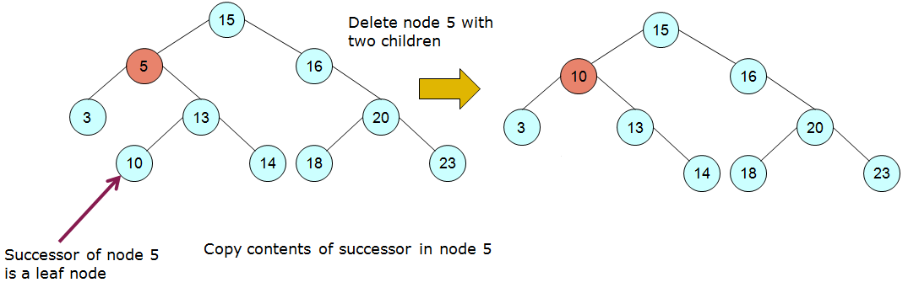
Operations on Binary Search Tree
(Delete a Node)
Case 3a) Delete a Node with two children and its successor is a leaf

Slide 65
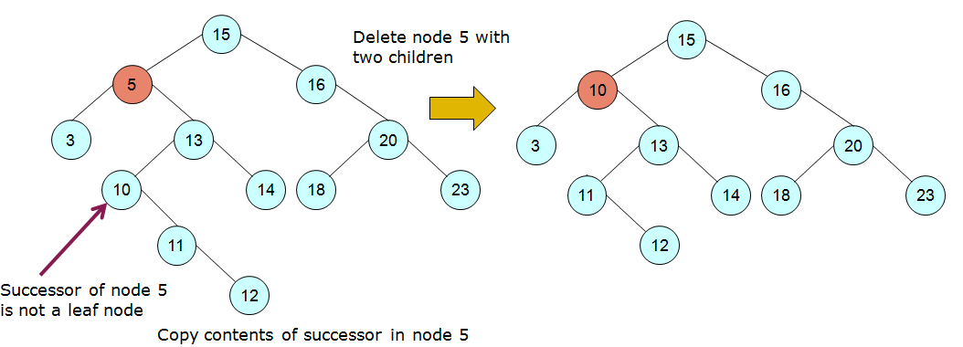
Operations on Binary Search Tree
(Delete a Node)
Case 3b) Delete a Node with two children & it successor is not a leaf

Slide 66
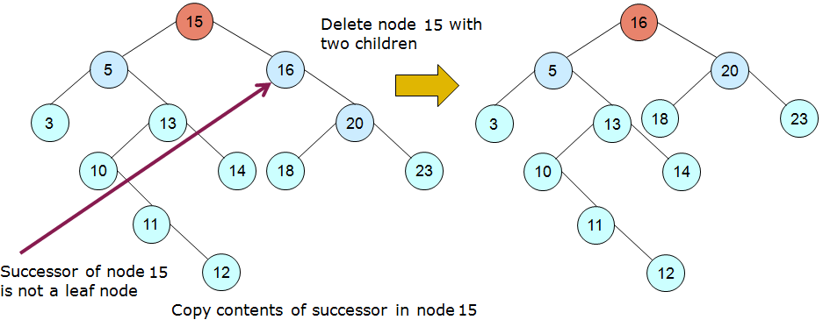
Operations on Binary Search Tree
(Delete a Node)

Slide 67
Binary Search Tree
(Delete a node)
Tree_Delete (T, z)
{
if z →leftchild == NIL or z → rightchild == NIL // case 1 & 2
y = z // y is the actual node to be deleted
else
y = Tree_Successor(z) // case 3
if y → leftchild ≠ NIL
x = y → leftchild
else
x = y → rightchild
if x ≠ NIL
x → parent = y → parent
if y → parent == NIL
T → root = x
else if y == y → parent → left
y → parent → leftchild = x
else
y → parent → rightchild = x
if y ≠ z
z → key =y → key
delete y
}

Slide 68
Binary Search Tree
(Delete a node)
Tree_Delete (T, z)
{
if z →leftchild == NIL or z → rightchild == NIL // case 1 & 2
y = z // case 1 & 2
else
y = Tree_Successor(z) // case 3
if y → leftchild ≠ NIL
x = y → leftchild
else
x = y → rightchild
if x ≠ NIL
x → parent = y → parent
if y → parent == NIL
T → root = x
else if y == y → parent → left
y → parent → leftchild = x
else
y → parent → rightchild = x
if y ≠ z
z → key =y → key
delete y
}

Slide 69
Operations on Binary Search Tree
(Delete a Node)
Case 1) Delete Leaf Node
y
if z →leftchild == NIL or z → rightchild == NIL
y = z
else
y = Tree_Successor(z)

Slide 70
Operations on Binary Search Tree
(Delete a Node)
Case 2) Delete a Node with one child
y
if z →leftchild == NIL or z → rightchild == NIL
y = z
else
y = Tree_Successor(z)

Slide 71
Operations on Binary Search Tree
(Delete a Node)
Case 3a) Delete a Node with two children and its successor is a leaf
y
if z →leftchild == NIL or z → rightchild == NIL
y = z
else
y = Tree_Successor(z)

Slide 72
Operations on Binary Search Tree
(Delete a Node)
Case 3b) Delete a Node with two children & it successor is not a leaf
y
if z →leftchild == NIL or z → rightchild == NIL
y = z
else
y = Tree_Successor(z)

Slide 73
Operations on Binary Search Tree
(Delete a Node)
y
if z →leftchild == NIL or z → rightchild == NIL
y = z
else
y = Tree_Successor(z)

Slide 74
Binary Search Tree
(Delete a node)
Tree_Delete (T, z)
{
if z →leftchild == NIL or z → rightchild == NIL // case 1 & 2
y = z
else
y = Tree_Successor(z) // case 3
if y → leftchild ≠ NIL
x = y → leftchild // x is the node to replace y
else
x = y → rightchild
if x ≠ NIL
x → parent = y → parent
if y → parent == NIL
T → root = x
else if y == y → parent → left
y → parent → leftchild = x
else
y → parent → rightchild = x
if y ≠ z
z → key =y → key
delete y
}

Slide 75
Operations on Binary Search Tree
(Delete a Node)
Case 1) Delete Leaf Node
y
x=NIL
if y → leftchild ≠ NIL
x = y → leftchild
else
x = y → rightchild

Slide 76
Operations on Binary Search Tree
(Delete a Node)
Case 2) Delete a Node with one child
y
x
if y → leftchild ≠ NIL
x = y → leftchild
else
x = y → rightchild

Slide 77
Operations on Binary Search Tree
(Delete a Node)
Case 3a) Delete a Node with two children and its successor is a leaf
y
x=NIL
if y → leftchild ≠ NIL
x = y → leftchild
else
x = y → rightchild

Slide 78
Operations on Binary Search Tree
(Delete a Node)
Case 3b) Delete a Node with two children & it successor is not a leaf
y
x
if y → leftchild ≠ NIL
x = y → leftchild
else
x = y → rightchild

Slide 79
Operations on Binary Search Tree
(Delete a Node)
y
x
if y → leftchild ≠ NIL
x = y → leftchild
else
x = y → rightchild

Slide 80
Binary Search Tree
(Delete a node)
Tree_Delete (T, z)
{
if z →leftchild == NIL or z → rightchild == NIL // case 1 & 2
y = z // case 1 & 2
else
y = Tree_Successor(z) // case 3
if y → leftchild ≠ NIL
x = y → leftchild
else
x = y → rightchild
if x ≠ NIL
x → parent = y → parent
if y → parent == NIL
T → root = x
else if y == y → parent → left
y → parent → leftchild = x
else
y → parent → rightchild = x
if y ≠ z
z → key =y → key
delete y
}

Slide 81
Operations on Binary Search Tree
(Delete a Node)
Case 1) Delete Leaf Node
y
x=NIL
if x ≠ NIL
x → parent = y → parent

Slide 82
Operations on Binary Search Tree
(Delete a Node)
Case 2) Delete a Node with one child
y
x
if x ≠ NIL
x → parent = y → parent

Slide 83
Operations on Binary Search Tree
(Delete a Node)
Case 3a) Delete a Node with two children and its successor is a leaf
y
x=NIL
if x ≠ NIL
x → parent = y → parent

Slide 84
Operations on Binary Search Tree
(Delete a Node)
Case 3b) Delete a Node with two children & it successor is not a leaf
y
x
if x ≠ NIL
x → parent = y → parent

Slide 85
Operations on Binary Search Tree
(Delete a Node)
y
x
if x ≠ NIL
x → parent = y → parent

Slide 86
Binary Search Tree
(Delete a node)
Tree_Delete (T, z)
{
if z →leftchild == NIL or z → rightchild == NIL // case 1 & 2
y = z // case 1 & 2
else
y = Tree_Successor(z) // case 3
if y → leftchild ≠ NIL
x = y → leftchild
else
x = y → rightchild
if x ≠ NIL
x → parent = y → parent
if y → parent == NIL
T → root = x
else if y == y → parent → left
y → parent → leftchild = x
else
y → parent → rightchild = x
if y ≠ z
z → key =y → key
delete y
}

Slide 87
Operations on Binary Search Tree
(Delete a Node)
Case 1) Delete Leaf Node
y
x=NIL
if y → parent == NIL
T → root = x
else if y == y → parent → left
y → parent → leftchild = x
else
y → parent → rightchild = x

Slide 88
Operations on Binary Search Tree
(Delete a Node)
Case 2) Delete a Node with one child
y
x
if y → parent == NIL
T → root = x
else if y == y → parent → left
y → parent → leftchild = x
else
y → parent → rightchild = x

Slide 89
Operations on Binary Search Tree
(Delete a Node)
Case 3a) Delete a Node with two children and its successor is a leaf
y
x=NIL
if y → parent == NIL
T → root = x
else if y == y → parent → left
y → parent → leftchild = x
else
y → parent → rightchild = x

Slide 90
Operations on Binary Search Tree
(Delete a Node)
Case 3b) Delete a Node with two children & it successor is not a leaf
y
x
if y → parent == NIL
T → root = x
else if y == y → parent → left
y → parent → leftchild = x
else
y → parent → rightchild = x

Slide 91
Operations on Binary Search Tree
(Delete a Node)
y
x
if y → parent == NIL
T → root = x
else if y == y → parent → left
y → parent → leftchild = x
else
y → parent → rightchild = x

Slide 92
Operations on Binary Search Tree
(Delete a Node)
y
x
if y → parent == NIL
T → root = x
else if y == y → parent → left
y → parent → leftchild = x
else
y → parent → rightchild = x

Slide 93
Binary Search Tree
(Delete a node)
Tree_Delete (T, z)
{
if z →leftchild == NIL or z → rightchild == NIL // case 1 & 2
y = z // case 1 & 2
else
y = Tree_Successor(z) // case 3
if y → leftchild ≠ NIL
x = y → leftchild
else
x = y → rightchild
if x ≠ NIL
x → parent = y → parent
if y → parent == NIL
T → root = x
else if y == y → parent → left
y → parent → leftchild = x
else
y → parent → rightchild = x
if y ≠ z
z → key =y → key
delete y
}

