Slide 1
Preview
Sorting and Order
  Basic soring algorithms
    Selection Sort
    Insertion Sort
    Bubble Sort
    Shell Sort
  Divide and conquer
    Merge Sort
    Quick Sort
    Heap Sort
  Linear Time Sorting
    Counting Sort
    Radix Sort
    Bucket Sort

Slide 2
Basic Sorting Algorithms
(Selection Sort)
For each iteration, a minimum is found in the sub list and it is placed into right position in sorted sub list.
1 Selection sort (A)
2 {
3 for j = 0 |A|-2 do
4 {
5 Min = j
6 for k= j+1 to |A|-1
7 {
8 if A[k] <A[Min] then
9 Min = k
10 }
11 If Min ≠ j
12 Swap (A[j], A[Min])
13 }
14 }
C₁
C₂
C₃
C₄
C₅
C₆
C₇

Slide 3
Basic Sorting Algorithms
(Selection Sort)
Input: A sequence of n numbers <a₁, a₂, a₃, … a_{n}>
Output: Permutation <a’₁, a’₂, a’₃, … a’_{n}> of input sequence such that a’₁ ≤ a’₂ ≤ a’₃ ≤ … ≤ a’_{n}
Swap(A[0], A[2])
Min = 1
6
3
1
4
2
5
Unsorted sub list
Swap(A[1], A[4])
Sorted sub list
Min = 2
1
3
6
4
2
5
Swap(A[2], A[4])
Min = 3
1
2
6
4
3
5
Don’t need swap
Min = 4
1
2
3
4
6
5
Swap(A[4], A[5])
Min = 5
1
2
3
4
6
5
1
2
3
4
5
6

Slide 4



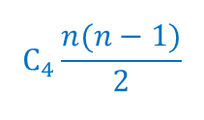

Basic Sorting Algorithms
(Selection Sort Analysis for Best Case)
For each iteration, a minimum is found in the sub list and it is placed into right position in sorted sub list.
1 Selection sort (A)
2 {
3 for j = 0 |A|-2 do
4 {
5 Min = j
6 for k= j+1 to |A|-1
7 {
8 if A{k} <A[Min] then
9 Min = k
10 }
11 If Min ≠ j
12 Swap (A[j], A[Min])
13 }
14 }
$$C_{1}n$$
$$C_{2}(n−1)$$
$$C_{3}(n−1)$$
$$C_{4}\frac{n(n−1)}{2}$$
$$C_{6}(n−1)$$

Slide 5

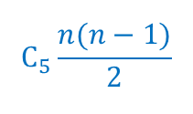
Basic Sorting Algorithms
(Selection Sort Analysis for Worst Case)
For each iteration, a minimum is found in the sub list and it is placed into right position in sorted sub list.
1 Selection sort (A)
2 {
3 for j = 0 |A|-2 do
4 {
5 Min = j
6 for k= j+1 to |A|-1
7 {
8 if A{k} <A[Min] then
9 Min = k
10 }
11 If Min ≠ j
12 Swap (A[j], A[Min])
13 }
14 }
$$C_{1}n$$
$$C_{2}(n−1)$$
$$C_{3}(n−1)$$
$$C_{4}\frac{n(n−1)}{2}$$
$$C_{5}\frac{n(n−1)}{2}$$
$$C_{6}(n−1)$$
$$C_{6}(n−1)$$

Slide 6
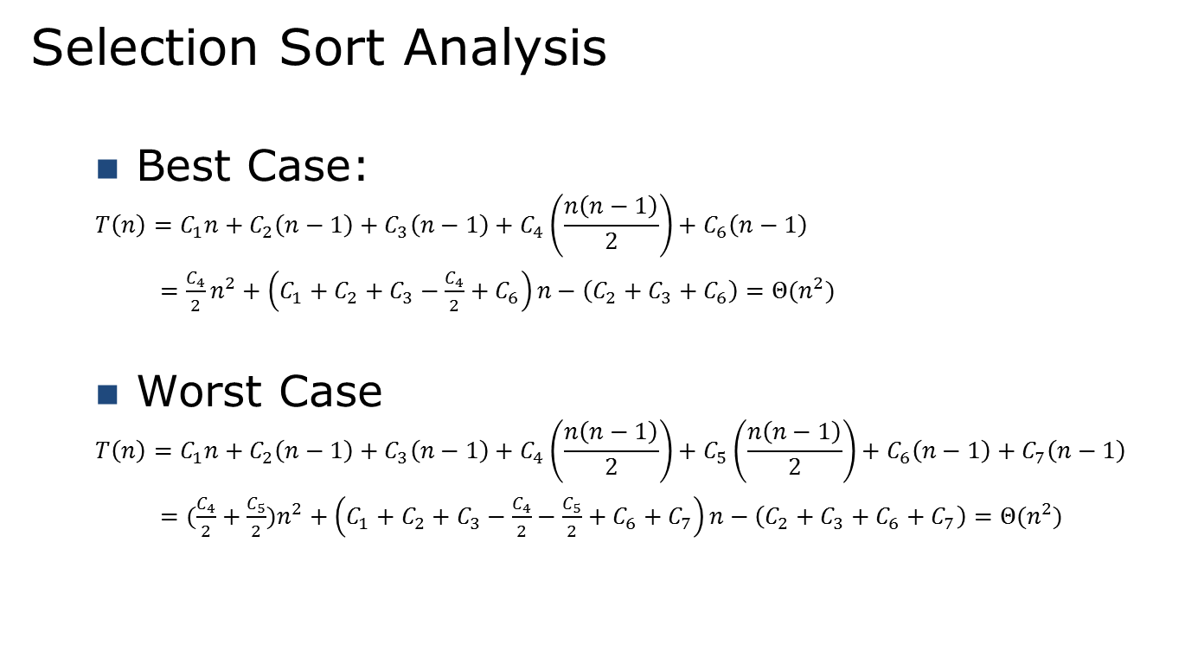
Basic Sorting Algorithms
(Selection Sort Analysis )
Selection Sort Analysis
  Best Case:
  $$T\left(n\right)=C_{1}n+C_{2}\left(n−1\right)+C_{3}\left(n−1\right)+C_{4}\left(\frac{n\left(n−1\right)}{2}\right)+C_{6}\left(n−1\right)$$
  $=\frac{C_{4}}{2}n^{2}+\left(C_{1}+C_{2}+C_{3}−\frac{C_{4}}{2}+C_{6}\right)n−\left(C_{2}+C_{3}+C_{6}\right)=Θ(n^{2})$
  Worst Case
  $$T\left(n\right)=C_{1}n+C_{2}\left(n−1\right)+C_{3}\left(n−1\right)+C_{4}\left(\frac{n\left(n−1\right)}{2}\right)+C_{5}\left(\frac{n\left(n−1\right)}{2}\right)+C_{6}\left(n−1\right)+C_{7}\left(n−1\right)$$
  $=(\frac{C_{4}}{2}+\frac{C_{5}}{2})n^{2}+\left(C_{1}+C_{2}+C_{3}−\frac{C_{4}}{2}−\frac{C_{5}}{2}+C_{6}+C_{7}\right)n−\left(C_{2}+C_{3}+C_{6}+C_{7}\right)=Θ(n^{2})$

Slide 7
Basic Sorting Algorithms
(Insertion Sort)
Input: A sequence of n numbers <a₁, a₂, a₃, … a_{n}>
Output: Permutation <a’₁, a’₂, a’₃, … a’_{n}> of input sequence such that a’₁ ≤ a’₂ ≤ a’₃ ≤ … ≤ a’_{n}
Insert 3
6
3
1
4
2
5
Insert 1
3
6
1
4
2
5
Insert 4
1
3
6
4
2
5
Insert 2
1
3
4
6
2
5
Insert 5
1
2
3
4
6
5
1
2
3
4
5
6

Slide 8
Basic Sorting Algorithms
(Insertion Sort)
For each iteration, a element is placed into right position in sorted sub list.
1 Insertion sort (A)
2 {
3 for j = 2 to length of array A do
4 {
5 key = A[j]
6 i = j – 1
7 while i > 0 and A[i] >key do
8 {
9 A[i +1] = A[i]
10 i = i –1
11 }
12 A[i +1] = key
13 }
14 }
C₁
C₂
C₃
C₄
C₅
C₆
C₇

Slide 9
Basic Sorting Algorithms
(Insertion Sort Analysis for Best Case)
Insert 2
1
2
3
4
5
6
Insert 3
1
2
3
4
5
6
Insert 4
1
2
3
4
5
6
Insert 5
1
2
3
4
5
6
Insert 6
1
2
3
4
5
6
1
2
3
4
5
6

Slide 10
Basic Sorting Algorithms
(Insertion Sort Analysis for Best Case)
1 Insertion sort (A)
2 {
3 for j = 2 to length of array A do
4 {
5 key = A[j]
6 i = j – 1
7 while i > 0 and A[i] >key do
8 {
9 A[i +1] = A[i]
10 i = i –1
11 }
12 A[i +1] = key
13 }
14 }
C₁(n – 1)
C₂(n – 1)
C₃(n – 1)
C₄(n – 1)
C₇(n – 1)
T(n) = c₁n + c₂(n –1) + c₃(n – 1) + c₄(n –1) + c₇(n –1)
= (c₁ + c₂ + c₃ + c₄ + c₇)n - (c₂ + c₃ + c₄ + c₇)

Slide 11
Basic Sorting Algorithms
(Insertion Sort Analysis for Worst Case)
Insert 5
6
5
4
3
2
1
Insert 4
5
6
4
3
2
1
Insert 3
4
5
6
3
2
1
Insert 2
3
4
5
6
2
1
Insert 1
2
3
4
5
6
1
1
2
3
4
5
6

Slide 12







Basic Sorting Algorithms
(Insertion Sort Analysis for Worst Case)
1 Insertion sort (A)
2 {
3 for j = 2 to length of array A do
4 {
5 key = A[j]
6 i = j – 1
7 while i > 0 and A[i] >key do
8 {
9 A[i +1] = A[i]
10 i = i –1
11 }
12 A[i +1] = key
13 }
14 }
$$C_{1}(n−1)$$
$$C_{2}(n−1)$$
$$C_{3}(n−1)$$
$$C_{4}(\frac{n(n+1)}{2} −1)$$
$$C_{5}(\frac{n(n−1)}{2})$$
$$C_{6}(\frac{n(n−1)}{2})$$
$$C_{7}(n−1)$$

Slide 13
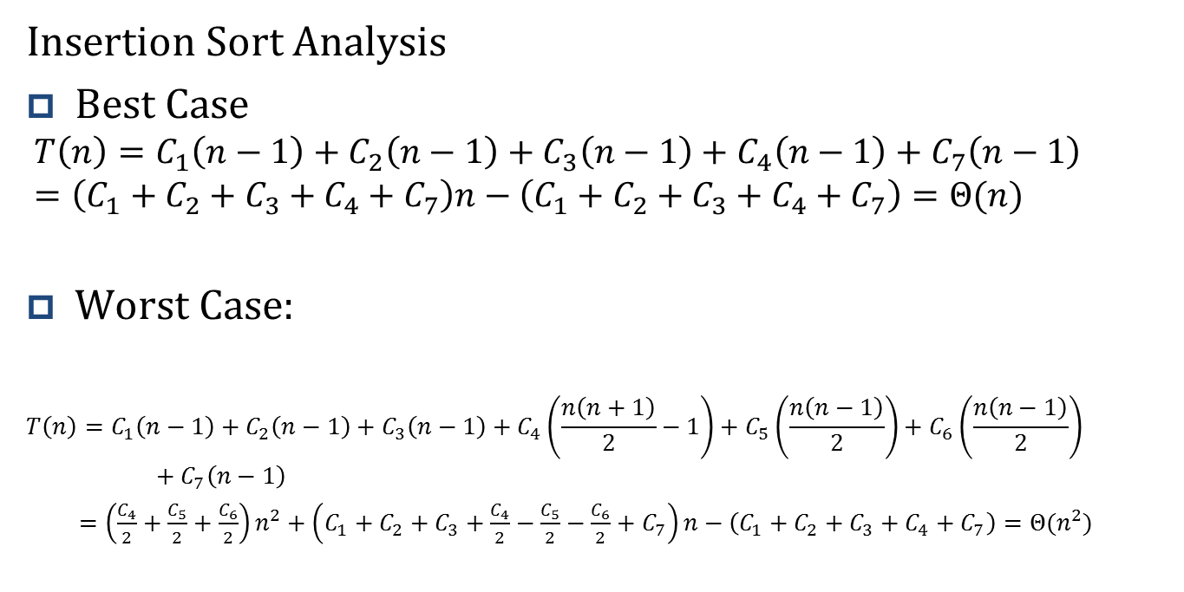
Basic Sorting Algorithms
(Insertion Sort Analysis)
Insertion Sort Analysis
Best Case
$$T\left(n\right)=C_{1}\left(n−1\right)+C_{2}\left(n−1\right)+C_{3}\left(n−1\right)+C_{4}\left(n−1\right)+C_{7}\left(n−1\right)$$
$$=\left(C_{1}+C_{2}+C_{3}+C_{4}+C_{7}\right)n−\left(C_{1}+C_{2}+C_{3}+C_{4}+C_{7}\right)=Θ(n)$$
Worst Case:
$$T\left(n\right)=C_{1}\left(n−1\right)+C_{2}\left(n−1\right)+C_{3}\left(n−1\right)+C_{4}\left(\frac{n\left(n+1\right)}{2}−1\right)+C_{5}\left(\frac{n\left(n−1\right)}{2}\right)+C_{6}\left(\frac{n\left(n−1\right)}{2}\right)+C_{7}\left(n−1\right)$$
$=\left(\frac{C_{4}}{2}+\frac{C_{5}}{2}+\frac{C_{6}}{2}\right)n^{2}+\left(C_{1}+C_{2}+C_{3}+\frac{C_{4}}{2}−\frac{C_{5}}{2}−\frac{C_{6}}{2}+C_{7}\right)n−\left(C_{1}+C_{2}+C_{3}+C_{4}+C_{7}\right)=Θ(n^{2})$

Slide 14
Basic Sorting Algorithms
(Bubble Sort)
Input: A sequence of n numbers <a₁, a₂, a₃, … a_{n}>
Output: Permutation <a’₁, a’₂, a’₃, … a’_{n}> of input sequence such that a’₁ ≤ a’₂ ≤ a’₃ ≤ … ≤ a’_{n}
Bubble up
6
3
1
4
2
5
Bubble up
3
1
4
2
5
6
Bubble up
1
3
2
4
5
6
Bubble up
1
2
3
4
5
6
Bubble up
1
2
3
4
5
6
1
2
3
4
5
6

Slide 15
Basic Sorting Algorithms
(Bubble Sort)
For each iteration, larger element move up (or smaller element move down).
1 BubbleSort(A)
2 {
3 for j = |A|-1 down to 0 do
4 {
5 for k=2 to j do
6 {
7 If A[k-1] > A[k]
8 Swap (A[k-1], A[k])
9 }
10 }
11 }
C₁
C₂
C₃
C₄

Slide 16


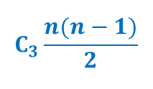
Basic Sorting Algorithms
(Bubble Sort Analysis for Best Case)
For each iteration, larger element move up (or smaller element move down).
1 BubbleSort(A)
2 {
3 for j = |A|-1 down to 0 do
4 {
5 for k=2 to j do
6 {
7 If A[k-1] > A[k]
8 Swap (A[k-1], A[k])
9 }
10 }
11 }
$$C_{1}n$$
$$C_{2}(n−1)$$
$$C_{3}\frac{n(n−1)}{2}$$

Slide 17
Basic Sorting Algorithms
(Bubble Sort Analysis for Best Case)
Bubble up
1
2
3
4
5
6
Bubble up
1
2
3
4
5
6
Bubble up
1
2
3
4
5
6
Bubble up
1
2
3
4
5
6
Bubble up
1
2
3
4
5
6
1
2
3
4
5
6

Slide 18
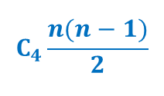
Basic Sorting Algorithms
(Bubble Sort Analysis for Worst Case)
For each iteration, larger element move up (or smaller element move down).
1 BubbleSort(A)
2 {
3 for j = |A|-1 down to 0 do
4 {
5 for k=2 to j do
6 {
7 If A[k-1] > A[k]
8 Swap (A[k-1], A[k])
9 }
10 }
11 }
$$C_{1}n$$
$$C_{2}(n−1)$$
$$C_{3}\frac{n(n−1)}{2}$$
$$C_{4}\frac{n(n−1)}{2}$$

Slide 19
Basic Sorting Algorithms
(Bubble Sort Analysis for Worst Case)
Bubble up
6
5
4
3
2
1
Bubble up
5
4
3
2
1
6
Bubble up
4
3
2
1
5
6
Bubble up
3
2
1
4
5
6
Bubble up
2
1
3
4
5
6
1
2
3
4
5
6

Slide 20
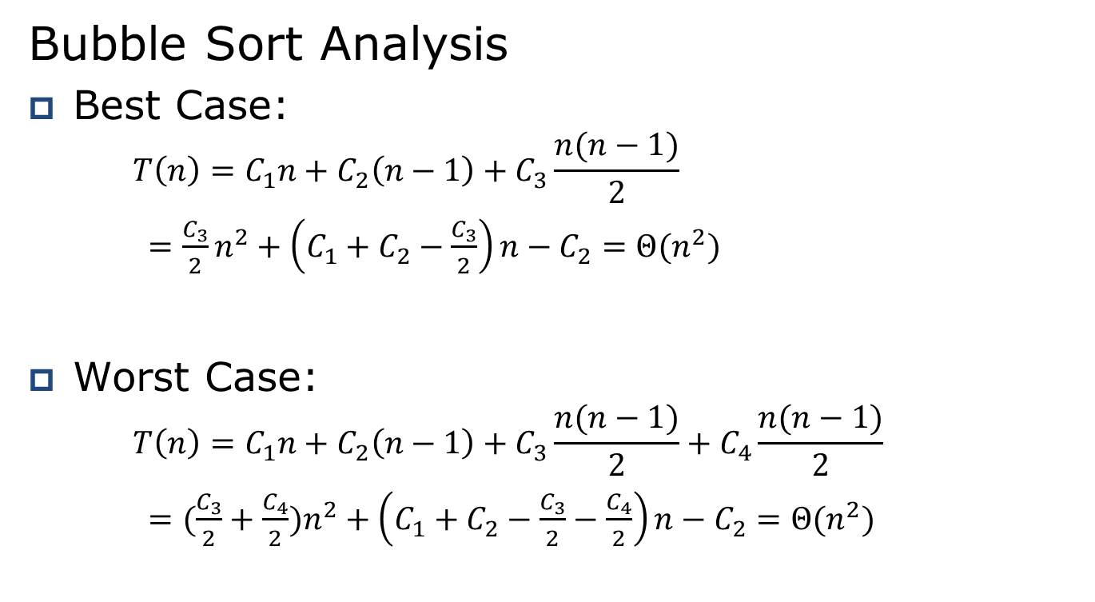
Basic Sorting Algorithms
(Bubble Sort Analysis for Worst Case)
Bubble Sort Analysis
Best Case:
    $$T\left(n\right)=C_{1}n+C_{2}\left(n−1\right)+C_{3}\frac{n(n−1)}{2}$$
    $=\frac{C_{3}}{2}n^{2}+\left(C_{1}+C_{2}−\frac{C_{3}}{2}\right)n−C_{2}=Θ(n^{2})$
Worst Case:
    $$T\left(n\right)=C_{1}n+C_{2}\left(n−1\right)+C_{3}\frac{n(n−1)}{2}+C_{4}\frac{n(n−1)}{2}$$
    $=(\frac{C_{3}}{2}+\frac{C_{4}}{2})n^{2}+\left(C_{1}+C_{2}−\frac{C_{3}}{2}−\frac{C_{4}}{2}\right)n−C_{2}=Θ(n^{2})$

Slide 21
Elementary Sorting Algorithms
(Shell Sort)
Founded by Donald Shell and named the sorting algorithm after himself in 1959.
1st algorithm to break the quadratic time barrier but few years later, a sub quadratic time bound was proven
Shell sort improves on the efficiency of insertion sort by quickly shifting values to their destination.

Slide 22
Elementary Sorting Algorithms
(Shell Sort)
Shell sort is a simple extension of insertion sort that gains speed by allowing exchanges of elements that are far apart.
Shell sort works by comparing elements that are far rather than adjacent elements
The speed of shell sort is depending on the chose of sequence of h (sequence of apart)

Slide 23
Shellsort
Shell sort uses a sequence h₁, h₂, …, h_{t} called the increment sequence.
Any increment sequence is fine as long as h₁ = 1 and some other choices are better than others.
Shell sort makes multiple passes through a list and sorts a number of equally sized sets using the insertion sort.

Slide 24
Shellsort
Shell sort is also known as diminishing increment sort.
The distance between comparisons decreases as the sorting algorithm runs until the last phase in which adjacent elements are compared
Click here to see movie

Slide 25
Elementary Sorting Algorithms
(Shell Sort)
H = 4
9
9
12
3
3
1
7
7
4
2
2
2
12
12
9
1
1
5
4
4
7
11
11
10
6
6
6
5
5
3
8
8
8
10
10
11
9
9
12
3
3
1
7
7
4
2
2
2
12
12
6
1
1
5
4
4
7
11
11
10
6
6
9
5
5
3
8
8
8
10
10
11
9
9
6
3
3
1
7
7
4
2
2
2
12
12
12
1
1
5
4
4
7
11
11
10
6
6
9
5
5
3
8
8
8
10
10
11
9
9
6
3
3
1
7
7
4
2
2
2
12
12
12
1
1
3
4
4
7
11
11
10
6
6
9
5
5
5
8
8
8
10
10
11

Slide 26
Elementary Sorting Algorithms
(Shell Sort)
H = 2
6
4
1
1
4
6
2
2
9
7
3
3
7
8
10
5
12
9
5
10
8
12
11
11

Slide 27
Elementary Sorting Algorithms
(Shell Sort)
H = 1
4
1
1
2
6
3
2
4
7
5
3
6
8
7
5
8
9
9
10
10
12
11
11
12

Slide 28
Elementary Sorting Algorithms
(Shell Sort Original Version)
int j, p, gap;
int tmp;
for (gap = n/2; gap > 0; gap = gap/2)
  for ( p = gap; p < n ; p++) {
    tmp = a[p];
    for (j = p; j >= gap && tmp < a[j- gap]; j = j - gap)
    a[j] = a[j-gap];
    a[j] = tmp;
  }
}

Slide 29
Any sequence that begins at 1 and always increases will do
Shell's original: N/2 , N/4 , ..., 1 (repeatedly divide by 2);
Hibbard's : 1, 3, 7, ..., 2^{k} - 1 ;
Knuth's: 1, 4, 13, ..., (3^{k} - 1) / 2 ;
Sedgewick's: 1, 5, 19, 41, 109, ....

Slide 30
Elementary Sorting Algorithms
(Shell Sort)
The speed of shell sort is depending on the chose of sequence of h
The running time of Shell sort is O(n^{3/2}) for the increments of h 1, 4, 13, 40, 121, 364, 1093, 3280, 9841, …).
The running time of Shell sort is O(n^{4/3}) for the increments of h 1, 8, 23, 77, 281, 1073, 4193, 16577, 9841, …).

Slide 31
Sorting with Recursion
(Quick Sort)
Description of Quicksort
Quick sort is based on the divided-and-conquer paradigm.
The three step divide-and-conquer process for sorting a typical subarray A[p .. r]

Slide 32
Sorting with Recursion
(Quick Sort)
The three step for Quicksort:
Divide: The array A[p .. r] is partitioned into two nonempty sub-arrays A[p .. q] and A[q+1 .. r] based on a pivot: elements in A[p .. q] are less than the pivot and each element of A[q+1 .. r] are greater or equal to pivot.
Conquer: The two sub-arrays A[p .. q] and A[q+1 .. r] are sorted by recursive call to quick sort.
Combine: Since the sub-arrays are sorted in place, no work is needed to combine them: the entire array A[p .. r] is now sorted.

Slide 33
Sorting with Recursion
(Quick Sort)
The key to the Quick Sort is Partition which rearranges the sub-array.
    QUICKSORT(A, p, r)
    {
    If p < r
    q = Partition(A, p, r)
    QUICKSORT(A, p, q)
    QUICKSORT(A, q+1, r)
    }

Slide 34
Sorting with Recursion
(Quick Sort: Partition1)
Partition(A, p, r)
1 {
2 x = A[r]; // A[r] used as a pivot
3 i = p -1
4 for j = p to r -1
{
5 if A[j] ≤ x
{
6 i = i + 1;
7 Swap(A[i], A[j]);
}
}
8 Swap(A[i + 1], A[r]);
9 Return i + 1;
}

Slide 35
Sorting with Recursion
(Quick Sort: Partition1)
Partition(A, p, r)
1 {
2 x = A[r]; // A[r] used as a pivot
3 i = p -1
4 for j = p to r -1
{
5 if A[j] ≤ x
{
6 i = i + 1;
7 Swap(A[i], A[j]);
}
}
8 Swap(A[i + 1], A[r]);
9 Return i + 1;
}
Partition(A, 0, 7)
p=0 r=7
x=A[7]=4
Initially i = - 1
0 1 2 3 4 5 6 7
A
2
8
7
1
3
5
6
4
initial array input
A
2
8
7
1
3
5
6
4
i = j=0 where A[j] ≤4
Since A[0]≤4
i = i + 1 =>0
Since i= j =1
Swap (A[0], A[0]) does not change array

Slide 36
Sorting with Recursion
(Quick Sort: Partition1)
Partition(A, p, r)
1 {
2 x = A[r]; // A[r] used as a pivot
3 i = p -1
4 for j = p to r -1
{
5 if A[j] ≤ x
{
6 i = i + 1;
7 Swap(A[i], A[j]);
}
}
8 Swap(A[i + 1], A[r]);
9 Return i + 1;
}
Partition(A, 0, 7)
p=0 r=7
x=A[7]=4
Initially i = - 1
0 1 2 3 4 5 6 7
A
2
8
7
1
3
5
6
4
initial array input
A
2
8
7
1
3
5
6
4
i = 1
j=3 where A[j] ≤4
Since A[3]≤4
i = i + 1 =1
Swap (A[1], A[3]) does change array

Slide 37
Sorting with Recursion
(Quick Sort: Partition1)
Partition(A, p, r)
1 {
2 x = A[r]; // A[r] used as a pivot
3 i = p -1
4 for j = p to r -1
{
5 if A[j] ≤ x
{
6 i = i + 1;
7 Swap(A[i], A[j]);
}
}
8 Swap(A[i + 1], A[r]);
9 Return i + 1;
}
Partition(A, 0, 7)
p=0 r=7
x=A[7]=4
Initially i = - 1
0 1 2 3 4 5 6 7
A
2
8
7
1
3
5
6
4
initial array input
A
2
1
7
8
3
5
6
4
i = 2
j=4 where A[j] ≤4
Since A[4]≤4
i = i + 1 =2
Swap (A[2], A[4]) does not change array

Slide 38
Sorting with Recursion
(Quick Sort: Partition1)
Partition(A, p, r)
1 {
2 x = A[r]; // A[r] used as a pivot
3 i = p -1
4 for j = p to r -1
{
5 if A[j] ≤ x
{
6 i = i + 1;
7 Swap(A[i], A[j]);
}
}
8 Swap(A[i + 1], A[r]);
9 Return i + 1;
}
Partition(A, 0, 7)
p=0 r=7
x=A[7]=4
Initially i = - 1
0 1 2 3 4 5 6 7
A
2
8
7
1
3
5
6
4
initial array input
A
2
1
3
4
7
5
6
8
i +1= 3
j=r-1
Now j = r-1 and no more A[j]≤4
Swap (A[i+1], A[r]) ≡ Swap(A[3], A[7]) and return 3

Slide 39
Sorting with Recursion
(Quick Sort: Partition1)
Partition(A, p, r)
1 {
2 x = A[r]; // A[r] used as a pivot
3 i = p -1
4 for j = p to r -1
{
5 if A[j] ≤ x
{
6 i = i + 1;
7 Swap(A[i], A[j]);
}
}
8 Swap(A[i + 1], A[r]);
9 Return i + 1;
}
Partition(A, 0, 7)
p=0 r=7
x=A[7]=4
Initially i = - 1
0 1 2 3 4 5 6 7
A
2
8
7
1
3
5
6
4
initial array input
A
2
1
3
4
7
5
6
8
Return i + 1 = 3

Slide 40
Sorting with Recursion
(Quick Sort: Partition2)
Partition(A, p, r)
{
1 Pivot = A[p];
2 i = p –1;
3 j = r + 1;
4 While true do {
5 j = j – 1;
6 while A[j] > Pivot do
7 j = j – 1;
8 i = i + 1
9 while A[i] < Pivot do
10 i = i + 1
11 if i < j
12 Swap(A[i], A[j])
13 else
14 return (j)
15 }//end of while
}

Slide 41
Sorting with Recursion
(Quick Sort: Partition2)
Partition(A, p, r)
{
1 Pivot = A[p];
2 i = p –1;
3 j = r + 1;
4 while true do {
5 j = j – 1;
6 while A[j] ≥ Pivot do
7 j = j – 1;
8 i = i + 1
9 while A[i] < Pivot do
10 i = i + 1
11 if i < j
12 Swap(A[i], A[j])
13 else
14 return (j)
15 }//end of while
}
Partition(A, 0, 7)
p=0 r=7
Pivot=A[0]=4
Initially i = - 1, j=8
0 1 2 3 4 5 6 7
A
4
8
7
1
3
5
2
6
i = -1
j = 8
A
4
8
7
1
3
5
2
6
i = 0
j = 6
A
2
8
7
1
3
5
4
6
j reduction will stop with j = 6 Since A[6]< Pivot
i’s increase will stop with i = 0 since A[0]= Pivot
Since i < j Swap (A[0], A[6])
i = 0
j = 6

Slide 42
Sorting with Recursion
(Quick Sort: Partition2)
Partition(A, p, r)
{
1 Pivot = A[p];
2 i = p –1;
3 j = r + 1;
4 while true do {
5 j = j – 1;
6 while A[j] ≥ Pivot do
7 j = j – 1;
8 i = i + 1
9 while A[i] < Pivot do
10 i = i + 1
11 if i < j
12 Swap(A[i], A[j])
13 else
14 return (j)
15 }//end of while
}
Partition(A, 0, 7)
p=0 r=7
Pivot=A[0]=4
0 1 2 3 4 5 6 7
A
2
8
7
1
3
5
4
6
i = 0
j = 6
A
2
8
7
1
3
5
4
6
i = 1
j = 4
A
2
3
7
1
8
5
4
6
j reduction will stop with j = 4 Since A[4]< Pivot
i’s increase will stop with i = 1 since A[1]> Pivot
Since i < j Swap (A[1], A[4])
i = 1
j = 4

Slide 43
Sorting with Recursion
(Quick Sort: Partition2)
Partition(A, p, r)
{
1 Pivot = A[p];
2 i = p –1;
3 j = r + 1;
4 while true do {
5 j = j – 1;
6 while A[j] ≥ Pivot do
7 j = j – 1;
8 i = i + 1
9 while A[i] < Pivot do
10 i = i + 1
11 if i < j
12 Swap(A[i], A[j])
13 else
14 return (j)
15 }//end of while
}
Partition(A, 0, 7)
p=0 r=7
Pivot=A[0]=4
0 1 2 3 4 5 6 7
A
2
3
7
1
8
5
4
6
i = 1
j = 4
A
2
3
7
1
8
5
4
6
i = 2
j = 3
A
2
3
1
7
8
5
4
6
j reduction will stop with j = 3 Since A[3]< Pivot
i’s increase will stop with i = 2 since A[2]> Pivot
Since i < j Swap (A[2], A[3])
i = 2
j = 3

Slide 44
Sorting with Recursion
(Quick Sort: Partition2)
Partition(A, p, r)
{
1 Pivot = A[p];
2 i = p –1;
3 j = r + 1;
4 while true do {
5 j = j – 1;
6 while A[j] ≥ Pivot do
7 j = j – 1;
8 i = i + 1
9 while A[i] < Pivot do
10 i = i + 1
11 if i < j
12 Swap(A[i], A[j])
13 else
14 return (j)
15 }//end of while
}
Partition(A, 0, 7)
p=0 r=7
Pivot=A[0]=4
0 1 2 3 4 5 6 7
A
2
3
1
7
8
5
4
6
j = 2
i = 3
A
2
3
1
7
8
5
4
6
Return j = 2
j reduction will stop with j = 2 Since A[2]< Pivot
i’s increase will stop with i = 3 since A[3]> Pivot
Since i > j return j

Slide 45
Sorting with Recursion
(Quick Sort: Partition Run time Analysis)
Partition(A, p, r)
1 {
2 x = A[r]; // A[r] used as a pivot
3 i = p -1
4 for j = p to r -1
{
5 if A[j] ≤ x
{
6 i = i + 1;
7 Swap(A[i],A[j]);
}
}
8 Swap(A[i + 1], A[r]);
9 Return i + 1;
}
Partition(A, p, r)
{
1 Pivot = A[p];
2 i = p –1;
3 j = r + 1;
4 while true do {
5 j = j – 1;
6 while A[j] ≥ Pivot do
7 j = j – 1;
8 i = i + 1
9 while A[i] < Pivot do
10 i = i + 1
11 if i < j
12 Swap(A[i], A[j])
13 else
14 return (j)
15 }//end of while
}
Both version of Partition take Θ(n)

Slide 46
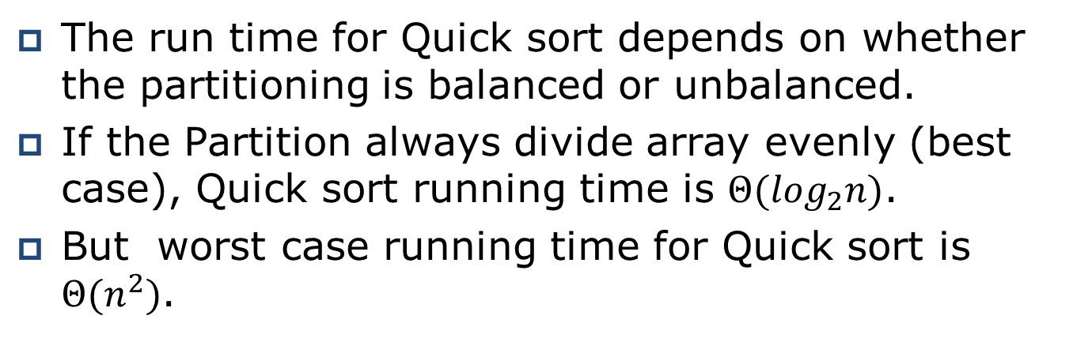
Sorting with Recursion
(Quick Sort: Run time Analysis)
The run time for Quick sort depends on whether the partitioning is balanced or unbalanced.
If the Partition always divide array evenly (best case), Quick sort running time is $Θ(\log_{2}n)$.
But worst case running time for Quick sort is $Θ(n^{2})$.
    QUICKSORT(A, p, r)
    {
    If p < r
    q = Partition(A, p, r)
    QUICKSORT(A, p, q)
    QUICKSORT(A, q+1, r)
    }

Slide 47
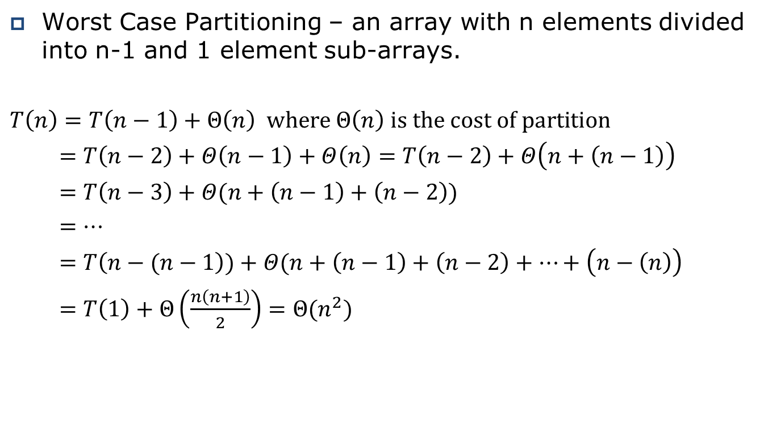
Sorting with Recursion
(Quick Sort: Best Case Run time Analysis)
Worst Case Partitioning – an array with n elements divided into n-1 and 1 element sub-arrays.
$$T\left(n\right)=T\left(n−1\right)+Θ\left(n\right) where Θ\left(n\right) is the cost of partition$$
$=T\left(n−2\right)+Θ\left(n−1\right)+Θ\left(n\right)=T\left(n−2\right)+Θ\left(n+\left(n−1\right)\right)$
$=T\left(n−3\right)+Θ(n+\left(n−1\right)+\left(n−2\right))$
$=…$
$=T\left(n−(n−1\right))+Θ(n+\left(n−1\right)+\left(n−2\right)+…+\left(n−\left(n\right)\right)$
$=T\left(1\right)+Θ\left(\frac{n\left(n+1\right)}{2}\right)=Θ(n^{2})$

Slide 48
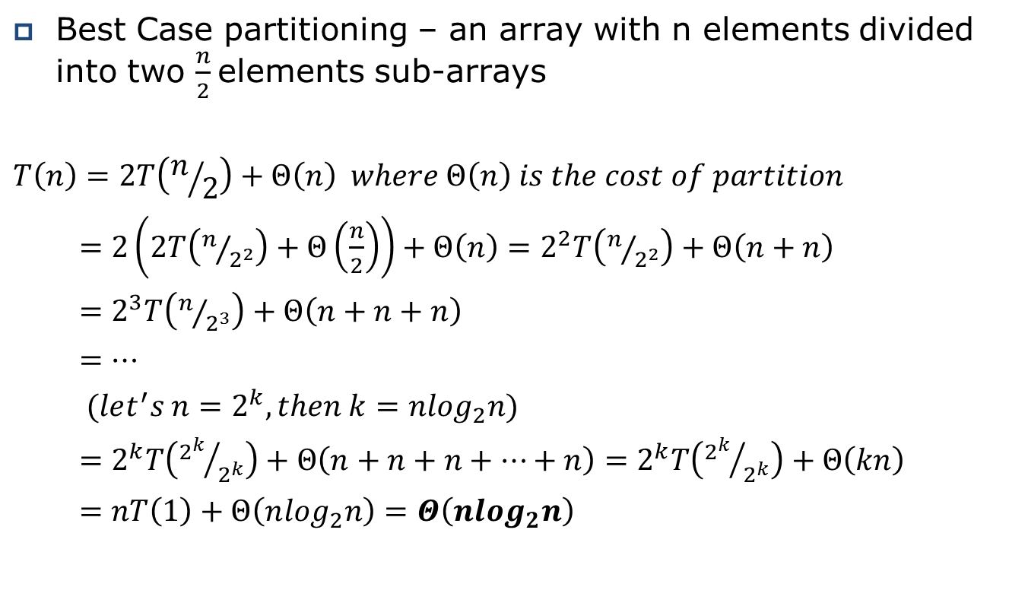
Sorting with Recursion
(Quick Sort: Worst Case Run time Analysis)
Best Case partitioning – an array with n elements divided into two $\frac{n}{2}$elements sub-arrays
$$T\left(n\right)=2T\left(n/2\right)+Θ\left(n\right) where Θ\left(n\right) is the cost of partition$$
$=2\left(2T\left(n/{2^{2}}\right)+Θ\left(\frac{n}{2}\right)\right)+Θ\left(n\right)=2^{2}T\left(n/{2^{2}}\right)+Θ\left(n+n\right)$
$=2^{3}T\left(n/{2^{3}}\right)+Θ\left(n+n+n\right)$
$=…$
$(let^{′}s n=2^{k}, then k=n\log_{2}n)$
$=2^{k}T\left({2^{k}}/{2^{k}}\right)+Θ\left(n+n+n+…+n\right)=2^{k}T\left({2^{k}}/{2^{k}}\right)+Θ\left(kn\right)$
$=nT\left(1\right)+Θ\left(n\log_{2}n\right)=Θ\left(n\log_{2}n\right)$

