Slide 1
Preview
Sorting in Linear Time
  Counting Sort
  Radix Sort
  Bucket Sort

Slide 2
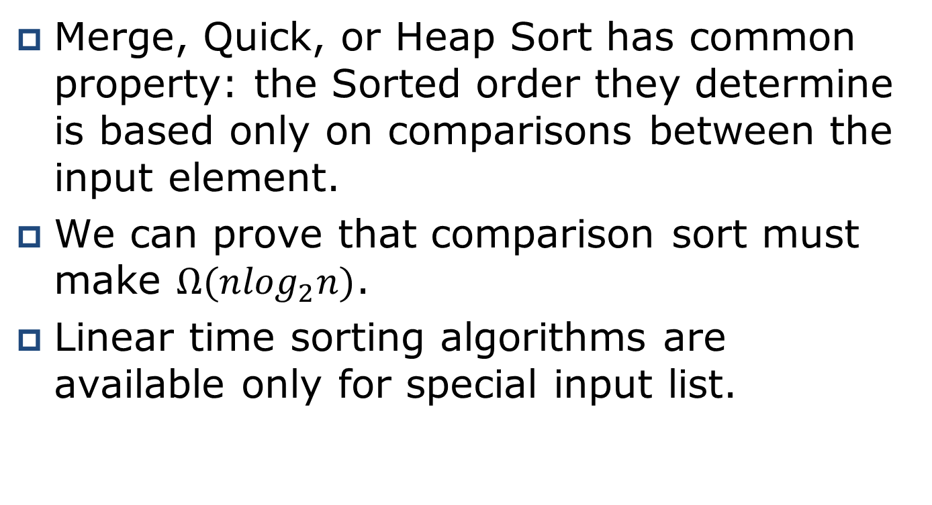
Sorting in Linear Time
Merge, Quick, or Heap Sort has common property: the Sorted order they determine is based only on comparisons between the input element.
We can prove that comparison sort must make $Ω(n\log_{2}n)$.
Linear time sorting algorithms are available only for special input list.

Slide 3
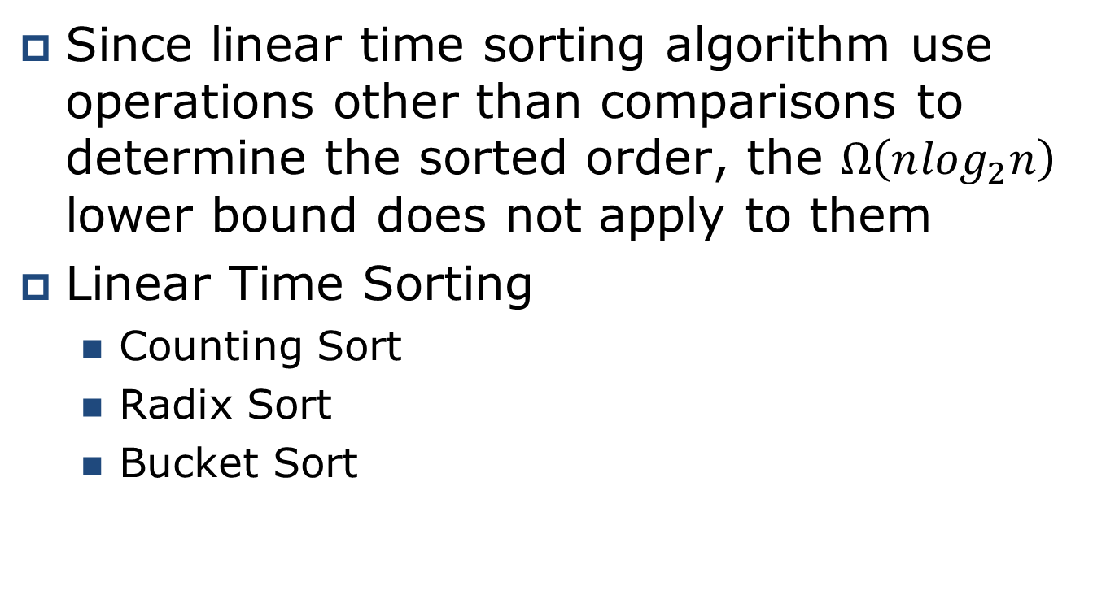
Sorting in Linear Time
Since linear time sorting algorithm use operations other than comparisons to determine the sorted order, the $Ω\left(n\log_{2}n\right)$ lower bound does not apply to them
Linear Time Sorting
  Counting Sort
  Radix Sort
  Bucket Sort

Slide 4
Sorting in Linear Time
(Counting Sort)
Counting sort assumes that each of the n input elements is an integer in the range 0 to k, for some integer k.
With k=O(n), the running time of counting sort is Θ(n).
For each input element x, counting sort count the number of elements less than x.
Counting sort use this counting information to place element x directly into its position in the output array.
Ex) if there are 17 elements less than x, the index of element x must be 18th location in the array.

Slide 5
Sorting in Linear Time
(Counting Sort)
Input list
n input elements is an integer in the range 0 to k for some input integer k.
If size of k = O(n), running time for counting sort takes O(n).
We need two other arrays:
  B[1 .. n] – hold output
  C[0 .. k] – hold the counting information

Slide 6
Sorting in Linear Time
(Counting Sort)
CountingSort(A, B, k)
{
1 for i= 0 to k // array C is used for counting number of
2 C[i] = 0; // ith in the list
3 for j = 1 to |A| do // count the number of i
4 C[A[j]] = C[A[j]] + 1;
5 for i = 1 to k
6 C[i] = C[i] + C[i-1]
7 for j =|A| down to 1
{
8 B[C[A[j]] = A[j]
9 C[A[j]] = C[A[j]] – 1
}
}

Slide 7


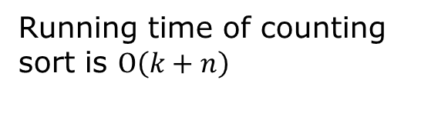

Sorting in Linear Time
(Running Time of Counting Sort)
CountingSort(A, B, k)
{
1 for i= 0 to k
2 C[i] = 0;
3 for j = 1 to |A| do
4 C[A[j]] = C[A[j]] + 1;
5 for i = 1 to k
6 C[i] = C[i] + C[i-1];
7 for j =|A| down to 1
{
8 B[C[A[j]] = A[j];
9 C[A[j]] = C[A[j]] – 1;
}
}
$$O(k)$$
$$O(n)$$
$$O(k)$$
$$O(n)$$
Running time of counting sort is $O\left(k+n\right)$

Slide 8
Sorting in Linear Time
(Counting Sort)
CountingSort(A, B, k)
{
1 for i= 0 to k
2 C[i] = 0;
3 for j = 1 to |A| do
4 C[A[j]] = C[A[j]] + 1;
5 for i = 1 to k
6 C[i] = C[i] + C[i-1];
7 for j =|A| down to 1
{
8 B[C[A[j]] = A[j];
9 C[A[j]] = C[A[j]] – 1;
}
}
CoutingSort(A, B, 6)
1 2 3 4 5 6 7 8 9 10
A
2
0
3
2
5
4
3
6
1
0
0 1 2 3 4 5 6
C
0
0
0
0
0
0
0
1 2 3 4 5 6 7 8 9 10
B

Slide 9
Sorting in Linear Time
(Counting Sort)
CountingSort(A, B, k)
{
1 for i= 0 to k
2 C[i] = 0;
3 for j = 1 to |A| do
4 C[A[j]] = C[A[j]] + 1;
5 for i = 1 to k
6 C[i] = C[i] + C[i-1];
7 for j =|A| down to 1
{
8 B[C[A[j]] = A[j];
9 C[A[j]] = C[A[j]] – 1;
}
}
CountingSort(A, B, 6)
1 2 3 4 5 6 7 8 9 10
A
2
0
3
2
5
4
3
6
1
0
0 1 2 3 4 5 6
C
2
1
2
2
1
1
1
1 2 3 4 5 6 7 8 9 10
B

Slide 10
Sorting in Linear Time
(Counting Sort)
CountingSort(A, B, k)
{
1 for i= 0 to k
2 C[i] = 0;
3 for j = 1 to |A| do
4 C[A[j]] = C[A[j]] + 1;
5 for i = 1 to k
6 C[i] = C[i] + C[i-1];
7 for j =|A| down to 1
{
8 B[C[A[j]] = A[j];
9 C[A[j]] = C[A[j]] – 1;
}
}
CountingSort(A, B, 6)
1 2 3 4 5 6 7 8 9 10
A
2
0
3
2
5
4
3
6
1
0
0 1 2 3 4 5 6
2
3
5
7
8
9
10
C
2
1
2
2
1
1
1
1 2 3 4 5 6 7 8 9 10
B

Slide 11
Sorting in Linear Time
(Counting Sort)
CountingSort(A, B, k)
{
1 for i= 0 to k
2 C[i] = 0;
3 for j = 1 to |A| do
4 C[A[j]] = C[A[j]] + 1;
5 for i = 1 to k
6 C[i] = C[i] + C[i-1];
7 for j =|A| down to 1
{
8 B[C[A[j]] = A[j];
9 C[A[j]] = C[A[j]] – 1;
}
}
CountingSort(A, B, 6)
j
1 2 3 4 5 6 7 8 9 10
0
A
2
0
3
2
5
4
3
6
1
0
0 1 2 3 4 5 6
2
C
1
3
5
7
8
9
10
1 2 3 4 5 6 7 8 9 10
B

Slide 12
Sorting in Linear Time
(Counting Sort)
CountingSort(A, B, k)
{
1 for i= 0 to k
2 C[i] = 0;
3 for j = 1 to |A| do
4 C[A[j]] = C[A[j]] + 1;
5 for i = 1 to k
6 C[i] = C[i] + C[i-1];
7 for j =|A| down to 1
{
8 B[C[A[j]] = A[j];
9 C[A[j]] = C[A[j]] – 1;
}
}
CountingSort(A, B, 6)
j
1 2 3 4 5 6 7 8 9 10
A
2
0
3
2
5
4
3
6
1
0
1
0 1 2 3 4 5 6
1
2
C
3
5
7
8
9
10
1 2 3 4 5 6 7 8 9 10
B
0

Slide 13
Sorting in Linear Time
(Counting Sort)
CountingSort(A, B, k)
{
1 for i= 0 to k
2 C[i] = 0;
3 for j = 1 to |A| do
4 C[A[j]] = C[A[j]] + 1;
5 for i = 1 to k
6 C[i] = C[i] + C[i-1];
7 for j =|A| down to 1
{
8 B[C[A[j]] = A[j];
9 C[A[j]] = C[A[j]] – 1;
}
}
CountingSort(A, B, 6)
j
1 2 3 4 5 6 7 8 9 10
A
2
0
3
2
5
4
3
6
1
0
6
1
0 1 2 3 4 5 6
1
2
5
7
8
9
9
C
10
1 2 3 4 5 6 7 8 9 10
B
0
1

Slide 14
Sorting in Linear Time
(Counting Sort)
CountingSort(A, B, k)
{
1 for i= 0 to k
2 C[i] = 0;
3 for j = 1 to |A| do
4 C[A[j]] = C[A[j]] + 1;
5 for i = 1 to k
6 C[i] = C[i] + C[i-1];
7 for j =|A| down to 1
{
8 B[C[A[j]] = A[j];
9 C[A[j]] = C[A[j]] – 1;
}
}
CountingSort(A, B, 6)
j
1 2 3 4 5 6 7 8 9 10
A
2
0
3
2
5
4
3
6
1
0
3
0 1 2 3 4 5 6
1
2
5
7
C
6
8
9
9
1 2 3 4 5 6 7 8 9 10
B
0
1
6

Slide 15
Sorting in Linear Time
(Counting Sort)
CountingSort(A, B, k)
{
1 for i= 0 to k
2 C[i] = 0;
3 for j = 1 to |A| do
4 C[A[j]] = C[A[j]] + 1;
5 for i = 1 to k
6 C[i] = C[i] + C[i-1];
7 for j =|A| down to 1
{
8 B[C[A[j]] = A[j];
9 C[A[j]] = C[A[j]] – 1;
}
}
CountingSort(A, B, 6)
j
1 2 3 4 5 6 7 8 9 10
A
2
0
3
2
5
4
3
6
1
0
4
0 1 2 3 4 5 6
1
2
5
6
7
C
8
9
9
1 2 3 4 5 6 7 8 9 10
B
0
1
3
6

Slide 16
Sorting in Linear Time
(Counting Sort)
CountingSort(A, B, k)
{
1 for i= 0 to k
2 C[i] = 0;
3 for j = 1 to |A| do
4 C[A[j]] = C[A[j]] + 1;
5 for i = 1 to k
6 C[i] = C[i] + C[i-1];
7 for j =|A| down to 1
{
8 B[C[A[j]] = A[j];
9 C[A[j]] = C[A[j]] – 1;
}
}
CountingSort(A, B, 6)
j
1 2 3 4 5 6 7 8 9 10
A
2
0
3
2
5
4
3
6
1
0
5
0 1 2 3 4 5 6
1
2
5
6
7
8
C
9
9
1 2 3 4 5 6 7 8 9 10
B
0
1
3
4
6

Slide 17
Sorting in Linear Time
(Counting Sort)
CountingSort(A, B, k)
{
1 for i= 0 to k
2 C[i] = 0;
3 for j = 1 to |A| do
4 C[A[j]] = C[A[j]] + 1;
5 for i = 1 to k
6 C[i] = C[i] + C[i-1];
7 for j =|A| down to 1
{
8 B[C[A[j]] = A[j];
9 C[A[j]] = C[A[j]] – 1;
}
}
CountingSort(A, B, 6)
j
1 2 3 4 5 6 7 8 9 10
A
2
0
3
2
5
4
3
6
1
0
2
0 1 2 3 4 5 6
1
2
4
C
5
6
7
8
9
1 2 3 4 5 6 7 8 9 10
B
0
1
3
4
5
6

Slide 18
Sorting in Linear Time
(Counting Sort)
CountingSort(A, B, k)
{
1 for i= 0 to k
2 C[i] = 0;
3 for j = 1 to |A| do
4 C[A[j]] = C[A[j]] + 1;
5 for i = 1 to k
6 C[i] = C[i] + C[i-1];
7 for j =|A| down to 1
{
8 B[C[A[j]] = A[j];
9 C[A[j]] = C[A[j]] – 1;
}
}
CountingSort(A, B, 6)
j
1 2 3 4 5 6 7 8 9 10
A
2
0
3
2
5
4
3
6
1
0
3
2
0 1 2 3 4 5 6
1
2
4
5
C
6
7
8
9
1 2 3 4 5 6 7 8 9 10
B
0
1
2
3
4
5
6

Slide 19
Sorting in Linear Time
(Counting Sort)
CountingSort(A, B, k)
{
1 for i= 0 to k
2 C[i] = 0;
3 for j = 1 to |A| do
4 C[A[j]] = C[A[j]] + 1;
5 for i = 1 to k
6 C[i] = C[i] + C[i-1];
7 for j =|A| down to 1
{
8 B[C[A[j]] = A[j];
9 C[A[j]] = C[A[j]] – 1;
}
}
CountingSort(A, B, 6)
j
1 2 3 4 5 6 7 8 9 10
A
2
0
3
2
5
4
3
6
1
0
0
2
0 1 2 3 4 5 6
0
C
1
2
4
5
7
8
9
1 2 3 4 5 6 7 8 9 10
B
0
1
2
3
3
4
5
6

Slide 20
Sorting in Linear Time
(Counting Sort)
CountingSort(A, B, k)
{
1 for i= 0 to k
2 C[i] = 0;
3 for j = 1 to |A| do
4 C[A[j]] = C[A[j]] + 1;
5 for i = 1 to k
6 C[i] = C[i] + C[i-1];
7 for j =|A| down to 1
{
8 B[C[A[j]] = A[j];
9 C[A[j]] = C[A[j]] – 1;
}
}
CountingSort(A, B, 6)
j
1 2 3 4 5 6 7 8 9 10
A
2
0
3
2
5
4
3
6
1
0
2
2
0 1 2 3 4 5 6
0
1
2
3
C
4
5
7
8
9
1 2 3 4 5 6 7 8 9 10
B
0
0
1
2
3
3
4
5
6

Slide 21
Sorting in Linear Time
(Counting Sort: Version II)
CountingSortII(A, k)
{
1 for i= 0 to k
2 C[i] = 0;
3 for j = 1 to |A| do
4 C[A[j]] = C[A[j]] + 1;
5 i=1;
6 for j =0 to k
{
7 m=C[j];
8 while m > 0 do
{
9 A[i] = j;
10 i++;
11 m=m-1;
}
}
}

Slide 22
Sorting in Linear Time
(Counting Sort: Version II)
CountingSortII(A, k)
{
1 for i= 0 to k
2 C[i] = 0;
3 for j = 1 to |A| do
4 C[A[j]] = C[A[j]] + 1;
5 i=1;
6 for j =0 to k
{
7 m=C[j];
8 while m > 0 do
{
9 A[i] = j;
10 i++;
11 m=m-1;
}
}
}
CoutingSort(A, B, 6)
1 2 3 4 5 6 7 8 9 10
A
2
0
3
2
5
4
3
6
1
0
0 1 2 3 4 5 6
C
0
0
0
0
0
0
0

Slide 23
Sorting in Linear Time
(Counting Sort: Version II)
CountingSortII(A, k)
{
1 for i= 0 to k
2 C[i] = 0;
3 for j = 1 to |A| do
4 C[A[j]] = C[A[j]] + 1;
5 i=1;
6 for j =0 to k
{
7 m=C[j];
8 while m > 0 do
{
9 A[i] = j;
10 i++;
11 m=m-1;
}
}
}
CountingSort(A, B, 6)
1 2 3 4 5 6 7 8 9 10
2
0
A
0
0
3
2
5
4
3
6
1
0
0 1 2 3 4 5 6
C
2
1
2
2
1
1
1

Slide 24
Sorting in Linear Time
(Counting Sort: Version II)
CountingSortII(A, k)
{
1 for i= 0 to k
2 C[i] = 0;
3 for j = 1 to |A| do
4 C[A[j]] = C[A[j]] + 1;
5 i=1;
6 for j =0 to k
{
7 m=C[j];
8 while m > 0 do
{
9 A[i] = j;
10 i++;
11 m=m-1;
}
}
}
CountingSort(A, B, 6)
i=3
i=2
i=1
1 2 3 4 5 6 7 8 9 10
2
0
A
0
0
3
2
5
4
3
6
1
0
0 1 2 3 4 5 6
0
1
C
2
1
2
2
1
1
1
J=0

Slide 25
Sorting in Linear Time
(Counting Sort: Version II)
CountingSortII(A, k)
{
1 for i= 0 to k
2 C[i] = 0;
3 for j = 1 to |A| do
4 C[A[j]] = C[A[j]] + 1;
5 i=1;
6 for j =0 to k
{
7 m=C[j];
8 while m > 0 do
{
9 A[i] = j;
10 i++;
11 m=m-1;
}
}
}
CountingSort(A, B, 6)
i=4
i=3
1 2 3 4 5 6 7 8 9 10
A
0
0
1
3
2
5
4
3
6
1
0
0 1 2 3 4 5 6
0
0
C
1
2
2
1
1
1
J=1

Slide 26
Sorting in Linear Time
(Counting Sort: Version II)
CountingSortII(A, k)
{
1 for i= 0 to k
2 C[i] = 0;
3 for j = 1 to |A| do
4 C[A[j]] = C[A[j]] + 1;
5 i=1;
6 for j =0 to k
{
7 m=C[j];
8 while m > 0 do
{
9 A[i] = j;
10 i++;
11 m=m-1;
}
}
}
CountingSort(A, B, 6)
i=5
i=6
i=4
1 2 3 4 5 6 7 8 9 10
A
0
0
1
2
2
2
5
4
3
6
1
0
0 1 2 3 4 5 6
0
1
C
0
0
2
2
1
1
1
J=2

Slide 27
Sorting in Linear Time
(Counting Sort: Version II)
CountingSortII(A, k)
{
1 for i= 0 to k
2 C[i] = 0;
3 for j = 1 to |A| do
4 C[A[j]] = C[A[j]] + 1;
5 i=1;
6 for j =0 to k
{
7 m=C[j];
8 while m > 0 do
{
9 A[i] = j;
10 i++;
11 m=m-1;
}
}
}
CountingSort(A, B, 6)
i=8
i=7
i=6
1 2 3 4 5 6 7 8 9 10
A
0
0
1
2
2
3
3
4
3
6
1
0
0 1 2 3 4 5 6
0
0
0
0
1
C
2
1
1
1
J=3

Slide 28
Sorting in Linear Time
(Counting Sort: Version II)
CountingSortII(A, k)
{
1 for i= 0 to k
2 C[i] = 0;
3 for j = 1 to |A| do
4 C[A[j]] = C[A[j]] + 1;
5 i=1;
6 for j =0 to k
{
7 m=C[j];
8 while m > 0 do
{
9 A[i] = j;
10 i++;
11 m=m-1;
}
}
}
CountingSort(A, B, 6)
i=9
i=8
1 2 3 4 5 6 7 8 9 10
A
0
0
1
2
2
3
3
4
6
1
0
0 1 2 3 4 5 6
0
0
0
0
0
C
1
1
1
J=4

Slide 29
Sorting in Linear Time
(Counting Sort: Version II)
CountingSortII(A, k)
{
1 for i= 0 to k
2 C[i] = 0;
3 for j = 1 to |A| do
4 C[A[j]] = C[A[j]] + 1;
5 i=1;
6 for j =0 to k
{
7 m=C[j];
8 while m > 0 do
{
9 A[i] = j;
10 i++;
11 m=m-1;
}
}
}
CountingSort(A, B, 6)
i=9
i=10
1 2 3 4 5 6 7 8 9 10
A
0
0
1
2
2
3
3
4
5
1
0
0 1 2 3 4 5 6
0
0
0
0
0
0
C
1
1
J=5

Slide 30
Sorting in Linear Time
(Counting Sort: Version II)
CountingSortII(A, k)
{
1 for i= 0 to k
2 C[i] = 0;
3 for j = 1 to |A| do
4 C[A[j]] = C[A[j]] + 1;
5 i=1;
6 for j =0 to k
{
7 m=C[j];
8 while m > 0 do
{
9 A[i] = j;
10 i++;
11 m=m-1;
}
}
}
CountingSort(A, B, 6)
i=10
1 2 3 4 5 6 7 8 9 10
1
2
2
3
3
4
5
6
A
0
0
0
0 1 2 3 4 5 6
0
0
0
0
0
0
0
C
1
J=6

Slide 31
Sorting in Linear Time
(Counting Sort: Version II)
CountingSortII(A, k)
{
1 for i= 0 to k
2 C[i] = 0;
3 for j = 1 to |A| do
4 C[A[j]] = C[A[j]] + 1;
5 i=1;
6 for j =0 to k
{
7 m=C[j];
8 while m > 0 do
{
9 A[i] = j;
10 i++;
11 m=m-1;
}
}
}
CountingSort(A, B, 6)
1 2 3 4 5 6 7 8 9 10
A
2
0
3
2
5
4
3
6
1
0
1 2 3 4 5 6 7 8 9 10
A
0
0
1
2
2
3
3
4
5
6

Slide 32
Sorting in Linear Time
(Radix Sort)
Radix sort is the algorithm used by the card-sorting machines, which you can find only in the computer museum.
The cards are organized into 80 columns, and in each column a hole can be punched in one of 12 places.
The sorter can be mechanically programmed to examine a given column of each card in a deck and distribute the card into one of 12 bins depending on which place has been punched.

Slide 33
Sorting in Linear Time
(Radix Sort)
IBM 80-column punched card
This IBM card format had rectangular holes, 80 columns with 12 punch locations each, one character to each column.
The lower ten positions represented (from top to bottom) the digits 0 through 9.
The top two positions of a column were called zone punches, 12 (top) and 11.
Only numeric information was punched, with 1 punch per column indicating the digit.
The zone punches was used for characters or symbols.

Slide 34
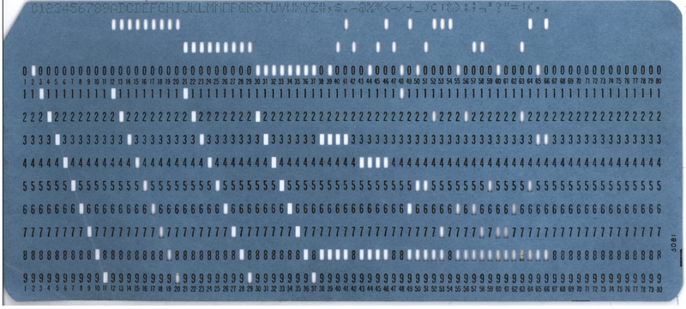
Sorting in Linear Time
(Radix Sort)
IBM 80-column punched card

Slide 35
Sorting in Linear Time
(Radix Sort)
A d-digit number occupy a field of d column.
Since the card sorter can look at only one column at a time the problem of sorting n cards on d-digit number used radix sort.
The Radix Sort sorts numbers digit by digit from the least significant digit to the most significant digit.
The digit sorts must be stable in order for radix sort to work correctly.

Slide 36
Sorting in Linear Time
(Radix Sort)
1329
4720
4720
1329
1329
5457
1355
1329
1355
1355
2657
5436
5436
5436
2657
3839
5457
3839
5457
3839
5436
2657
1355
2657
4720
4720
1329
5457
4720
5436
1355
3839
2657
3839
5457
Sort by 1st digit
Sort by 2nd digit
Sort by 3rd digit
Sort by 4th digit

Slide 37
Sorting in Linear Time
(Radix Sort)
Order ten 2 digit numbers in 10 bins from smallest number to largest number. Requires 2 calls to the sort Algorithm.
Initial Sequence: 91 6 85 15 92 35 30 22 39
Pass 0: Distribute the cards into bins according to the 1's digit (10⁰).

Slide 38
Sorting in Linear Time
(Radix Sort)
Final Sequence: 91 6 85 15 92 35 30 22 39
Pass 1: Take the new sequence and distribute the cards into bins determined by the 10's digit (10¹).

Slide 39
Sorting in Linear Time
(Radix Sort)
void distribute(const vector<int> &v, queue<int> digitQUe[ ], int power){
for (int i=0; i<v.size();i++)
digitQue[(v[i]/power])%10].push(v[i]);
}
void collect(queue<int> digitQUe[ ], vector<int> &v){
int i = 0;
for (int digit = 0; digit< 10; digit++)
while(!digitQueue[digit].empty()){
v[i] = digitQueue[digit].front();
digitQue[digit].pop();
i++;
}
}

Slide 40
Sorting in Linear Time
(Radix Sort)
Void radixSort(vector<int>& v, int d) {
int power = 1;
queue<int> digitQue[10];
for (int i=0; i<d; i++){
distribute(v, digitQue, power);
collect(digitQue,v);
power = power * 10;
}
}

Slide 41
Sorting in Linear Time
(Radix Sort)
The analysis of running time depends on the stable sort used as the intermediate sorting algorithm.
Each pass: n enqueue operations
n dequeue operations
# of passes is d (a known constant)
Radix sort T(n) = 2n*d.
Time requirement: O(n)
Memory requirement:
vector of size n and 10 queues of size n

Slide 42
Sorting in Linear Time
(Bucket Sort)
Bucket sort assumes that the input is drawn from a uniform distribution and has an average-case running time of O(n).
Bucket sort is fast because it assumes something about the input.
  Counting sort –assumes that the input consist of integers in a small range.
  Bucket sort – assumes that the input is generated by a random process that distributes elements uniformly over the interval 0 ≤ k < 1

Slide 43
Sorting in Linear Time
(Bucket Sort)
The idea of bucket sort is divide the interval [0, 1) into n equal-sized subinterval called bucket, and then distribute the n input numbers into the bucket.
Since the inputs are uniformly and independently distributed, there is not many elements in each bucket.
Each buckets are sorted by insertion sort.

Slide 44
Sorting in Linear Time
(Bucket Sort)
Bucket-Sort(A)
{
1 n=|A|
2 for i=0 to n-1
3 make B[i] an empty list
4 for k = 0 to n-1
5 insert A[k] into the right bucket.
6 for k = 0 to n-1
7 Sort bucket B[k] with insertion sort.
8 Concatenate the list of buckets B[0], B[1], .. B[|A| -1] together in order.
}

Slide 45
Sorting in Linear Time
(Bucket Sort)
1 2 3 4 5 6 7 8 9 10 11 12 13
B
A
.34
.29
.49
.56
.35
.54
.66
.44
.21
.19
.24
.33
.83
0
1
2
3
4
Bucket-Sort(A)
{
1 n=|A|
2 for i=0 to n-1
3 make B[i] an empty list
4 for k = 0 to n-1
5 insert A[k] into the right bucket.
6 for k = 0 to n-1
7 Sort bucket B[k] with insertion sort.
8 Concatenate the list of buckets B[0], B[1], .. B[|A| -1] together in order.
}
5
6
7
8
9

Slide 46
Sorting in Linear Time
(Bucket Sort)
1 2 3 4 5 6 7 8 9 10 11 12 13
B
A
.34
.29
.49
.56
.35
.54
.66
.44
.21
.19
.24
.33
.83
0
1
2
3
.34
4
Bucket-Sort(A)
{
1 n=|A|
2 for i=0 to n-1
3 make B[i] an empty list
4 for k = 0 to n-1
5 insert A[k] into the right bucket.
6 for k = 0 to n-1
7 Sort bucket B[k] with insertion sort.
8 Concatenate the list of buckets B[0], B[1], .. B[|A| -1] together in order.
}
5
6
7
8
9

Slide 47
Sorting in Linear Time
(Bucket Sort)
1 2 3 4 5 6 7 8 9 10 11 12 13
B
A
.34
.29
.49
.56
.35
.54
.66
.44
.21
.19
.24
.33
.83
0
1
2
.29
3
.34
4
Bucket-Sort(A)
{
1 n=|A|
2 for i=0 to n-1
3 make B[i] an empty list
4 for k = 0 to n-1
5 insert A[k] into the right bucket.
6 for k = 0 to n-1
7 Sort bucket B[k] with insertion sort.
8 Concatenate the list of buckets B[0], B[1], .. B[|A| -1] together in order.
}
5
6
7
8
9

Slide 48
Sorting in Linear Time
(Bucket Sort)
1 2 3 4 5 6 7 8 9 10 11 12 13
B
A
.34
.29
.49
.56
.35
.54
.66
.44
.21
.19
.24
.33
.83
0
1
2
.29
3
.34
4
.49
Bucket-Sort(A)
{
1 n=|A|
2 for i=0 to n-1
3 make B[i] an empty list
4 for k = 0 to n-1
5 insert A[k] into the right bucket.
6 for k = 0 to n-1
7 Sort bucket B[k] with insertion sort.
8 Concatenate the list of buckets B[0], B[1], .. B[|A| -1] together in order.
}
5
6
7
8
9

Slide 49
Sorting in Linear Time
(Bucket Sort)
1 2 3 4 5 6 7 8 9 10 11 12 13
B
A
.34
.29
.49
.56
.35
.54
.66
.44
.21
.19
.24
.33
.83
0
1
2
.29
3
.34
4
.49
Bucket-Sort(A)
{
1 n=|A|
2 for i=0 to n-1
3 make B[i] an empty list
4 for k = 0 to n-1
5 insert A[k] into the right bucket.
6 for k = 0 to n-1
7 Sort bucket B[k] with insertion sort.
8 Concatenate the list of buckets B[0], B[1], .. B[|A| -1] together in order.
}
5
.56
6
7
8
9

Slide 50
Sorting in Linear Time
(Bucket Sort)
1 2 3 4 5 6 7 8 9 10 11 12 13
B
A
.34
.29
.49
.56
.35
.54
.66
.44
.21
.19
.24
.33
.83
0
1
2
.29
3
.34
.35
4
.49
Bucket-Sort(A)
{
1 n=|A|
2 for i=0 to n-1
3 make B[i] an empty list
4 for k = 0 to n-1
5 insert A[k] into the right bucket.
6 for k = 0 to n-1
7 Sort bucket B[k] with insertion sort.
8 Concatenate the list of buckets B[0], B[1], .. B[|A| -1] together in order.
}
5
.56
6
7
8
9

Slide 51
Sorting in Linear Time
(Bucket Sort)
1 2 3 4 5 6 7 8 9 10 11 12 13
B
A
.34
.29
.49
.56
.35
.54
.66
.44
.21
.19
.24
.33
.83
0
1
2
.29
3
.34
.35
4
.49
Bucket-Sort(A)
{
1 n=|A|
2 for i=0 to n-1
3 make B[i] an empty list
4 for k = 0 to n-1
5 insert A[k] into the right bucket.
6 for k = 0 to n-1
7 Sort bucket B[k] with insertion sort.
8 Concatenate the list of buckets B[0], B[1], .. B[|A| -1] together in order.
}
5
.56
.54
6
7
8
9

Slide 52
Sorting in Linear Time
(Bucket Sort)
1 2 3 4 5 6 7 8 9 10 11 12 13
B
A
.34
.29
.49
.56
.35
.54
.66
.44
.21
.19
.24
.33
.83
0
1
2
.29
3
.34
.35
4
.49
Bucket-Sort(A)
{
1 n=|A|
2 for i=0 to n-1
3 make B[i] an empty list
4 for k = 0 to n-1
5 insert A[k] into the right bucket.
6 for k = 0 to n-1
7 Sort bucket B[k] with insertion sort.
8 Concatenate the list of buckets B[0], B[1], .. B[|A| -1] together in order.
}
5
.56
.54
6
.66
7
8
9

Slide 53
Sorting in Linear Time
(Bucket Sort)
1 2 3 4 5 6 7 8 9 10 11 12 13
B
A
.34
.29
.49
.56
.35
.54
.66
.44
.21
.19
.24
.33
.83
0
1
2
.29
3
.34
.35
4
.49
.44
Bucket-Sort(A)
{
1 n=|A|
2 for i=0 to n-1
3 make B[i] an empty list
4 for k = 0 to n-1
5 insert A[k] into the right bucket.
6 for k = 0 to n-1
7 Sort bucket B[k] with insertion sort.
8 Concatenate the list of buckets B[0], B[1], .. B[|A| -1] together in order.
}
5
.56
.54
6
.66
7
8
9

Slide 54
Sorting in Linear Time
(Bucket Sort)
1 2 3 4 5 6 7 8 9 10 11 12 13
B
A
.34
.29
.49
.56
.35
.54
.66
.44
.21
.19
.24
.33
.83
0
1
2
.29
.21
3
.34
.35
4
.49
.44
Bucket-Sort(A)
{
1 n=|A|
2 for i=0 to n-1
3 make B[i] an empty list
4 for k = 0 to n-1
5 insert A[k] into the right bucket.
6 for k = 0 to n-1
7 Sort bucket B[k] with insertion sort.
8 Concatenate the list of buckets B[0], B[1], .. B[|A| -1] together in order.
}
5
.56
.54
6
.66
7
8
9

Slide 55
Sorting in Linear Time
(Bucket Sort)
1 2 3 4 5 6 7 8 9 10 11 12 13
B
A
.34
.29
.49
.56
.35
.54
.66
.44
.21
.19
.24
.33
.83
0
1
.19
2
.29
.21
3
.34
.35
4
.49
.44
Bucket-Sort(A)
{
1 n=|A|
2 for i=0 to n-1
3 make B[i] an empty list
4 for k = 0 to n-1
5 insert A[k] into the right bucket.
6 for k = 0 to n-1
7 Sort bucket B[k] with insertion sort.
8 Concatenate the list of buckets B[0], B[1], .. B[|A| -1] together in order.
}
5
.56
.54
6
.66
7
8
9

Slide 56
Sorting in Linear Time
(Bucket Sort)
1 2 3 4 5 6 7 8 9 10 11 12 13
B
A
.34
.29
.49
.56
.35
.54
.66
.44
.21
.19
.24
.33
.83
0
1
.19
2
.29
.21
.24
3
.34
.35
4
.49
.44
Bucket-Sort(A)
{
1 n=|A|
2 for i=0 to n-1
3 make B[i] an empty list
4 for k = 0 to n-1
5 insert A[k] into the right bucket.
6 for k = 0 to n-1
7 Sort bucket B[k] with insertion sort.
8 Concatenate the list of buckets B[0], B[1], .. B[|A| -1] together in order.
}
5
.56
.54
6
.66
7
8
9

Slide 57
Sorting in Linear Time
(Bucket Sort)
1 2 3 4 5 6 7 8 9 10 11 12 13
B
A
.34
.29
.49
.56
.35
.54
.66
.44
.21
.19
.24
.33
.83
0
1
.19
2
.29
.21
.24
3
.34
.35
.33
4
.49
.44
Bucket-Sort(A)
{
1 n=|A|
2 for i=0 to n-1
3 make B[i] an empty list
4 for k = 0 to n-1
5 insert A[k] into the right bucket.
6 for k = 0 to n-1
7 Sort bucket B[k] with insertion sort.
8 Concatenate the list of buckets B[0], B[1], .. B[|A| -1] together in order.
}
5
.56
.54
6
.66
7
8
9

Slide 58
Sorting in Linear Time
(Bucket Sort)
1 2 3 4 5 6 7 8 9 10 11 12 13
B
A
.34
.29
.49
.56
.35
.54
.66
.44
.21
.19
.24
.33
.83
0
1
.19
2
.29
.21
.24
3
.34
.35
.33
4
.49
.44
Bucket-Sort(A)
{
1 n=|A|
2 for i=0 to n-1
3 make B[i] an empty list
4 for k = 0 to n-1
5 insert A[k] into the right bucket.
6 for k = 0 to n-1
7 Sort bucket B[k] with insertion sort.
8 Concatenate the list of buckets B[0], B[1], .. B[|A| -1] together in order.
}
5
.56
.54
6
.66
7
8
.83
9

Slide 59
Sorting in Linear Time
(Bucket Sort)
1 2 3 4 5 6 7 8 9 10 11 12 13
B
A
.34
.29
.49
.56
.35
.54
.66
.44
.21
.19
.24
.33
.83
0
1
.19
2
.29
.21
.24
3
.34
.35
.33
4
.49
.44
Bucket-Sort(A)
{
1 n=|A|
2 for i=0 to n-1
3 make B[i] an empty list
4 for k = 0 to n-1
5 insert A[k] into the right bucket.
6 for k = 0 to n-1
7 Sort bucket B[k] with insertion sort.
8 Concatenate the list of buckets B[0], B[1], .. B[|A| -1] together in order.
}
5
.56
.54
6
.66
7
8
.83
9

Slide 60
Sorting in Linear Time
(Bucket Sort)
1 2 3 4 5 6 7 8 9 10 11 12 13
B
A
.34
.29
.49
.56
.35
.54
.66
.44
.21
.19
.24
.33
.83
0
1
.19
2
.21
.24
.29
3
.34
.35
.33
4
.49
.44
Bucket-Sort(A)
{
1 n=|A|
2 for i=0 to n-1
3 make B[i] an empty list
4 for k = 0 to n-1
5 insert A[k] into the right bucket.
6 for k = 0 to n-1
7 Sort bucket B[k] with insertion sort.
8 Concatenate the list of buckets B[0], B[1], .. B[|A| -1] together in order.
}
5
.56
.54
6
.66
7
8
.83
9

Slide 61
Sorting in Linear Time
(Bucket Sort)
1 2 3 4 5 6 7 8 9 10 11 12 13
B
A
.34
.29
.49
.56
.35
.54
.66
.44
.21
.19
.24
.33
.83
0
1
.19
2
.21
.24
.29
3
.33
.34
.35
4
.49
.44
Bucket-Sort(A)
{
1 n=|A|
2 for i=0 to n-1
3 make B[i] an empty list
4 for k = 0 to n-1
5 insert A[k] into the right bucket.
6 for k = 0 to n-1
7 Sort bucket B[k] with insertion sort.
8 Concatenate the list of buckets B[0], B[1], .. B[|A| -1] together in order.
}
5
.56
.54
6
.66
7
8
.83
9

Slide 62
Sorting in Linear Time
(Bucket Sort)
1 2 3 4 5 6 7 8 9 10 11 12 13
B
A
.34
.29
.49
.56
.35
.54
.66
.44
.21
.19
.24
.33
.83
0
1
.19
2
.21
.24
.29
3
.33
.34
.35
4
.44
.49
Bucket-Sort(A)
{
1 n=|A|
2 for i=0 to n-1
3 make B[i] an empty list
4 for k = 0 to n-1
5 insert A[k] into the right bucket.
6 for k = 0 to n-1
7 Sort bucket B[k] with insertion sort.
8 Concatenate the list of buckets B[0], B[1], .. B[|A| -1] together in order.
}
5
.56
.54
6
.66
7
8
.83
9

Slide 63
Sorting in Linear Time
(Bucket Sort)
1 2 3 4 5 6 7 8 9 10 11 12 13
B
A
.34
.29
.49
.56
.35
.54
.66
.44
.21
.19
.24
.33
.83
0
1
.19
2
.21
.24
.29
3
.33
.34
.35
4
.44
.49
Bucket-Sort(A)
{
1 n=|A|
2 for i=0 to n-1
3 make B[i] an empty list
4 for k = 0 to n-1
5 insert A[k] into the right bucket.
6 for k = 0 to n-1
7 Sort bucket B[k] with insertion sort.
8 Concatenate the list of buckets B[0], B[1], .. B[|A| -1] together in order.
}
5
.54
.56
6
.66
7
8
.83
9

Slide 64
Sorting in Linear Time
(Bucket Sort)
1 2 3 4 5 6 7 8 9 10 11 12 13
B
A
.34
.29
.49
.56
.35
.54
.66
.44
.21
.19
.24
.33
.83
0
1
.19
2
.21
.24
.29
3
.33
.34
.35
4
.44
.49
Bucket-Sort(A)
{
1 n=|A|
2 for i=0 to n-1
3 make B[i] an empty list
4 for k = 0 to n-1
5 insert A[k] into the right bucket.
6 for k = 0 to n-1
7 Sort bucket B[k] with insertion sort.
8 Concatenate the list of buckets B[0], B[1], .. B[|A| -1] together in order.
}
5
.54
.56
6
.66
7
8
.83
9

Slide 65
Sorting in Linear Time
(Bucket Sort)
1 2 3 4 5 6 7 8 9 10 11 12 13
B
A
.34
.29
.49
.56
.35
.54
.66
.44
.21
.19
.24
.33
.83
0
1
.19
2
.21
.24
.29
3
.33
.34
.35
4
.44
.49
5
.54
.56
6
.66
7
8
.83
9

Slide 66



Sorting in Linear Time
(Bucket Sort: Running Time)
Bucket-Sort(A)
{
1 n=|A|
2 for i=0 to n-1
3 make B[i] an empty list
4 for k = 0 to n-1
5 insert A[k] into the right bucket.
6 for k = 0 to n-1
7 Sort bucket B[k] with insertion sort.
8 Concatenate the list of buckets B[0], B[1], .. B[|A| -1] together in order.
}
$$Θ(n)$$
$$\sum_{0}^{n−1}{Ο({n_{i}}^{2})}$$
$$Θ(n)$$

Slide 67
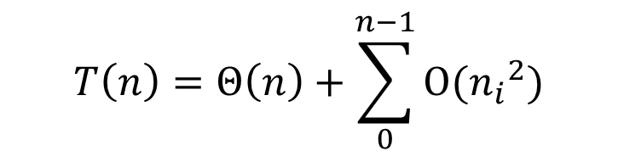

Sorting in Linear Time
(Bucket Sort: Running Time)
Let $n_{i}$ be the random variable denoting the number of elements placed in bucket B[i].
Since insertion sort runs in quadratic time, the running time of bucket sort is
$$T\left(n\right)=Θ\left(n\right)+\sum_{0}^{n−1}{Ο({n_{i}}^{2})}$$

Slide 68
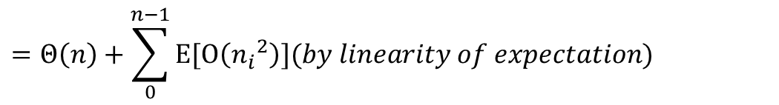
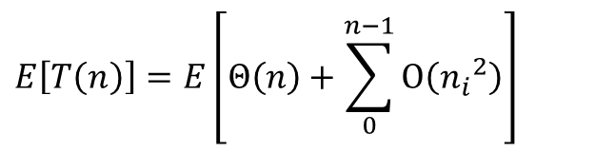
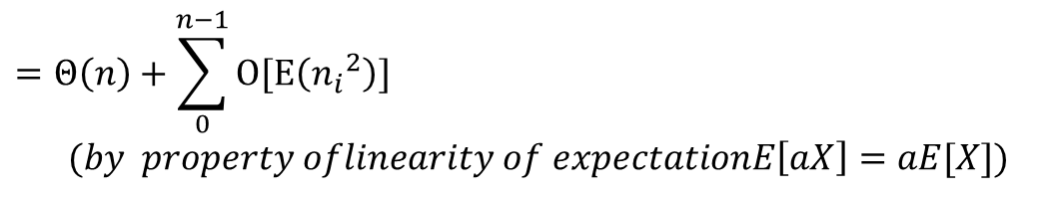
Sorting in Linear Time
(Bucket Sort: Running Time)
We analyze the average-case running time of bucket sort, by computing the expected value of the running time.
We take the expectation over the input distribution.
$$E\left[T\left(n\right)\right]=E\left[Θ\left(n\right)+\sum_{0}^{n−1}{Ο\left({n_{i}}^{2}\right)}\right]$$
$$=Θ\left(n\right)+\sum_{0}^{n−1}{E[Ο\left({n_{i}}^{2}\right)}](by linearity of expectation)$$
$$=Θ\left(n\right)+\sum_{0}^{n−1}{O[E\left({n_{i}}^{2}\right)}]$$
$(by property oflinearity of expectationE\left[aX\right]=aE[X])$

Slide 69
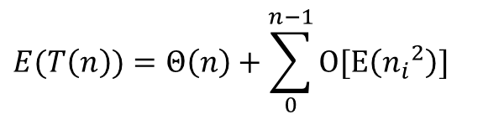
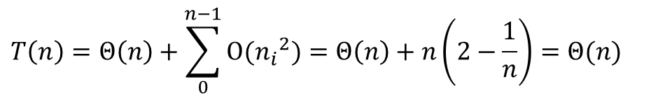
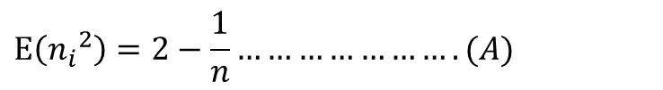
Sorting in Linear Time
(Bucket Sort: Running Time)
From equation
We claim that
We can prove our claim (A) by defining indicator random variables (skip). If our claim is true, we can conclude the running time of Bucket sort as:
$$E(T\left(n\right))=Θ\left(n\right)+\sum_{0}^{n−1}{O[E\left({n_{i}}^{2}\right)}]$$
$$E\left({n_{i}}^{2}\right)=2−\frac{1}{n}………………….(A)$$
$$T\left(n\right)=Θ\left(n\right)+\sum_{0}^{n−1}{Ο({n_{i}}^{2})}=Θ\left(n\right)+n\left(2−\frac{1}{n}\right)=Θ(n)$$

