Slide 1
Preview
Greedy Algorithms
  Coin Change
  Huffman Code
  Activity Selection Problem

Slide 2
Greedy Algorithms
Greedy algorithms are simple and straightforward.
Greedy algorithms are used to solve optimization problems.
Greedy algorithms always make the choice that looks best at the moment.
Greedy choice make a locally optimal, but it might or might not become globally optimal.

Slide 3
Greedy Algorithm
(Coin Change)
Coins available are:
  dollars (100 cents)
  quarters (25 cents)
  dimes (10 cents)
  nickels (5 cents)
  pennies (1 cent)
Problem Make a change of a given amount using the smallest possible number of coins.

Slide 4
Greedy Algorithm
(Coin Change)
Greedy strategy
  Sum = 0
  Chose largest coin C such that
  Sum + C ≤ Total change amount

Slide 5
Greedy Algorithm
(Coin Change)
MAKE-CHANGE (n)
C ← {100, 25, 10, 5, 1} // constant.
S ← {}; // set that will hold the solution set. Sum ← 0 sum of item in solution set
WHILE sum ≠ n
x = largest item in set C such that sum + x ≤ n
IF no such item THEN
RETURN "No Solution"
S ← S + {value of x}
sum ← sum + x
RETURN S

Slide 6
Greedy Algorithm
(Coin Change)
Greedy Method does not work all cases
Ex) Coin sets = { 8, 5, 1} Change = 10.
Greedy Solution = {8, 1, 1}
Optimal Solution = { 5, 5}

Slide 7
From ASCII Coding to Huffman Coding
Many programming languages use ASCII (American Standard Code for Information Interchange) coding for characters.
Some recent languages, e.g., Java, use UNICODE which, because it can encode a bigger set of characters, is more useful for languages like Japanese and Chinese which have a larger set of characters.

Slide 8
From ASCII Coding to Huffman Coding
In ASCII, every character is encoded with the same number of bits: 8 bits per character.
Since there are 256 different values that can be encoded with 8 bits, there are potentially 256 different characters in the ASCII character set.
Huffman coding compresses data by using fewer bits to encode more frequently occurring characters so that not all characters are encoded with 8 bits.

Slide 9
A simple example “go go gophers”
ASCII requires 104 bits.
3-bits (fixed-length) requires 39 bits.
Char | ASCII | Binary
g | 103 | 1100111
o | 111 | 1101111
p | 112 | 1110000
h | 104 | 1101000
e | 101 | 1100101
r | 114 | 1110010
s | 115 | 1110011
space | 32 | 1000000
Char | ASCII | Binary
g | 0 | 000
o | 1 | 001
p | 2 | 010
h | 3 | 011
e | 4 | 100
r | 5 | 101
s | 6 | 110
space | 7 | 111

Slide 10
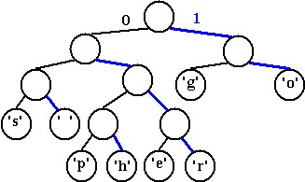
Variable-Length-Code requires 37 bits.
Char | Binary
g | 10
o | 11
p | 0100
h | 0101
e | 0110
r | 0111
s | 000
space | 001
1011001101100110110100010101100111000

Slide 11
Huffman Codes
Used for compressing data
Binary Character code can be represented by
  Fixed-Length-Code – each character is represented by fixed size unique code
  Ex) a = 000, b=001, c= 010, d = 011,
  Variable-Length-Code – each character is represented by variable size unique code
  Ex) a = 0, b= 101, c= 100, d =111

Slide 12
Huffman Codes
To save and retrieve character
  How to encode characters into unique code ?
  How to decode a code into character ?
Prefix code can be used for encoding characters.
Prefix code - set of words such that no word of the set is a prefix of another word in the set
Ex) S = {0, 100, 101, 1100, 1101, 111 }

Slide 13
Huffman Codes
Huffman used greedy algorithm for constructing an optimal prefix code called Huffman code
Lets
  C: set of n characters
  c ∈ C: a member of C
  f (c) : frequency of character c in a file.

Slide 14
Huffman Codes
The algorithm builds a binary tree corresponding to the optimal prefix code in bottom-up manner.
The algorithm start with set of leaves |C| which is sorted by increasing order on frequency f(c)
Lets Q = C; (use priority queue : build heap O(n)
For i = 1 to |C| - 1 do
  Create new node z.
  Get two minimum frequency leaves x and y from Q where f[x] ≥ f[y] ; O(2 log n) –get max twice and call heapify twice
  z’s left child pointer (label with 0) point to x and right child pointer (label with 1) point to y
  f[z] =f[x] + f[y]
  Set Q = Q –{x, y} ∪ {z}; O(log n)
End of for loop

Slide 15
Huffman Codes
F: 5
E: 9
C: 12
B: 13
D: 16
A: 45

Slide 16
Huffman Codes
F: 5
E: 9
C: 12
B: 13
D: 16
A: 45

Slide 17
Huffman Codes
14
C: 12
B: 13
D: 16
A: 45
0
1
F: 5
E: 9

Slide 18
Huffman Codes
C: 12
B: 13
14
D: 16
A: 45
0
1
F: 5
E: 9

Slide 19
Huffman Codes
C: 12
B: 13
14
D: 16
A: 45
0
1
F: 5
E: 9

Slide 20
Huffman Codes
25
14
D: 16
A: 45
0
1
0
1
C: 12
B: 13
F: 5
E: 9

Slide 21
Huffman Codes
14
D: 16
25
A: 45
0
1
0
1
F: 5
E: 9
C: 12
B: 13

Slide 22
Huffman Codes
14
D: 16
25
A: 45
0
1
0
1
F: 5
E: 9
C: 12
B: 13

Slide 23
Huffman Codes
30
25
A: 45
0
1
0
1
14
D: 16
C: 12
B: 13
0
1
F: 5
E: 9

Slide 24
Huffman Codes
25
30
A: 45
0
1
0
1
C: 12
B: 13
14
D: 16
0
1
F: 5
E: 9

Slide 25
Huffman Codes
25
30
A: 45
0
1
0
1
C: 12
B: 13
14
D: 16
0
1
F: 5
E: 9

Slide 26
Huffman Codes
55
A: 45
0
1
25
30
0
1
0
1
C: 12
B: 13
14
D: 16
0
1
F: 5
E: 9

Slide 27
Huffman Codes
A: 45
55
0
1
25
30
0
1
0
1
C: 12
B: 13
14
D: 16
0
1
F: 5
E: 9

Slide 28
Huffman Codes
A: 45
55
0
1
25
30
0
1
0
1
C: 12
B: 13
14
D: 16
0
1
F: 5
E: 9

Slide 29
Huffman Codes
100
0
1
A: 45
55
0
1
A: 0
25
30
0
1
0
1
C: 12
B: 13
14
D: 16
0
1
D: 111
C: 100
B: 101
O (n log n)
F: 5
E: 9
F: 1100
E: 1101

Slide 30
Correctness of Huffman Algorithm
Lemma 1) Lets
  C: set of n characters
  c ∈ C: a member of C
  f (c): frequency of character c in a file.
  x, y ∈ C having the lowest frequencies.
There exist and optimal prefix code for C where the code words for x and y have the same length and differ only with in the last bit.

Slide 31
Correctness of Huffman Algorithm
Lets T is a tree corresponding to a prefix code.
Lets
  C: set of n characters
  c ∈ C: a member of C
  f (c): frequency of character c in a file.
  d_{T} (c): the depth of c’s leaf in the T (number of bit need for encoding c).
  B(T): number of bits required to encode a file

Slide 32
Correctness of Huffman Algorithm
T
T’
T’’
x
a
a
y
y
b
a
b
x
b
x
y
Lets a, b ∈ C (sibling leaf) and d_{T}(a) and d_{T}(b) are maximum and f(a) ≤ f(b) in T.
Let f(x) and f(y) is minimums such that f(x) ≤ f(y)
Also f(x) ≤ f(y) ≤ f(a) ≤ f(b)

Slide 33
Correctness of Huffman Algorithm
T
T’
T’’
x
a
a
y
y
b
a
b
x
b
x
a

Slide 34
Correctness of Huffman Algorithm
T
T’
T’’
x
a
a
y
y
b
a
b
x
b
x
y
Which means T’ take less bits then T for encoding a file
Also we can compare T’ and T’’ and conclude with T’’ take less bits then T’ for encoding a file
We can conclude T’’ is an optimal tree in which x, y appears as sibling leaves of maximum depth (lemma 1)

Slide 35
Correctness of Huffman Algorithm
Lemma 2) Lets
  C: set of n characters
  c ∈ C: a member of C
  f (c): frequency of character c in a file.
  x, y ∈ C having the lowest frequencies.
  C’ = C – {x, y} ∪ {z}
  f(z) = f(x) + f(y)
  T’ : represent a tree generation optimal prefix code for the C’
Then the tree T, obtained from T’ by replacing the leaf node for z with an internal node having x and y as children, presents an optimal prefix code for the alphabet C. (see text book)

Slide 36
Correctness of Huffman Algorithm
Theorem: Huffman algorithm produces and optimal prefix code
Proof) from Lemma 1 and Lemma 2, it is true.

Slide 37
Greedy Algorithm
(An activity-selection problem)
n activities require exclusive use of a common resource. For example, scheduling the use of a classroom.
Set of activities S = {a₁, . . . , a_{n}}.
a_{i} needs resource during period [s_{i} , f_{i} ), which is a half-open interval, where s_{i} =
start time and f_{i} = finish time.

Slide 38
Greedy Algorithm
(An activity-selection problem)
Goal: Select the largest possible set of non-overlapping (mutually compatible) activities.
Note: Could have many other objectives:
  Schedule room for longest time.
  Maximize income rental fees.

Slide 39
Greedy Algorithm
(An activity-selection problem)
Example: set of activities S sorted by finish time:
I | 1 | 2 | 3 | 4 | 5 | 6 | 7 | 8 | 9
S_{i} | 1 | 2 | 4 | 1 | 5 | 8 | 9 | 11 | 13
F_{i} | 3 | 5 | 7 | 8 | 9 | 10 | 11 | 14 | 16

Slide 40
Greedy Algorithm
(An activity-selection problem)
Maximum-size mutually compatible set: $\{a1, a3, a6, a8\}.$
Not unique: also $\{a2, a5, a7, a9\}.$

Slide 41
Greedy Algorithm
(An activity-selection problem)
Problem Description
Input : set of activities with starting time and finish time. Activities are sorted by finishing time.
Output: maximum size of subset of compatible activities which could share an activity room

Slide 42
Greedy Algorithm
(An activity-selection problem)

Slide 43
Greedy Algorithm
(An activity-selection problem)
Time
0
a_{i}
s_{i}
f_{i}
a_{j}
s_{j}
f_{j}
a_{k}
s_{k}
f_{k}
a_{l}
s_{l}
f_{l}
Compatible activities: between a_{i} and a_{j}
between a_{i} and a_{l}
between a_{k} and a_{j}
between a_{k} and a_{l}

Slide 44
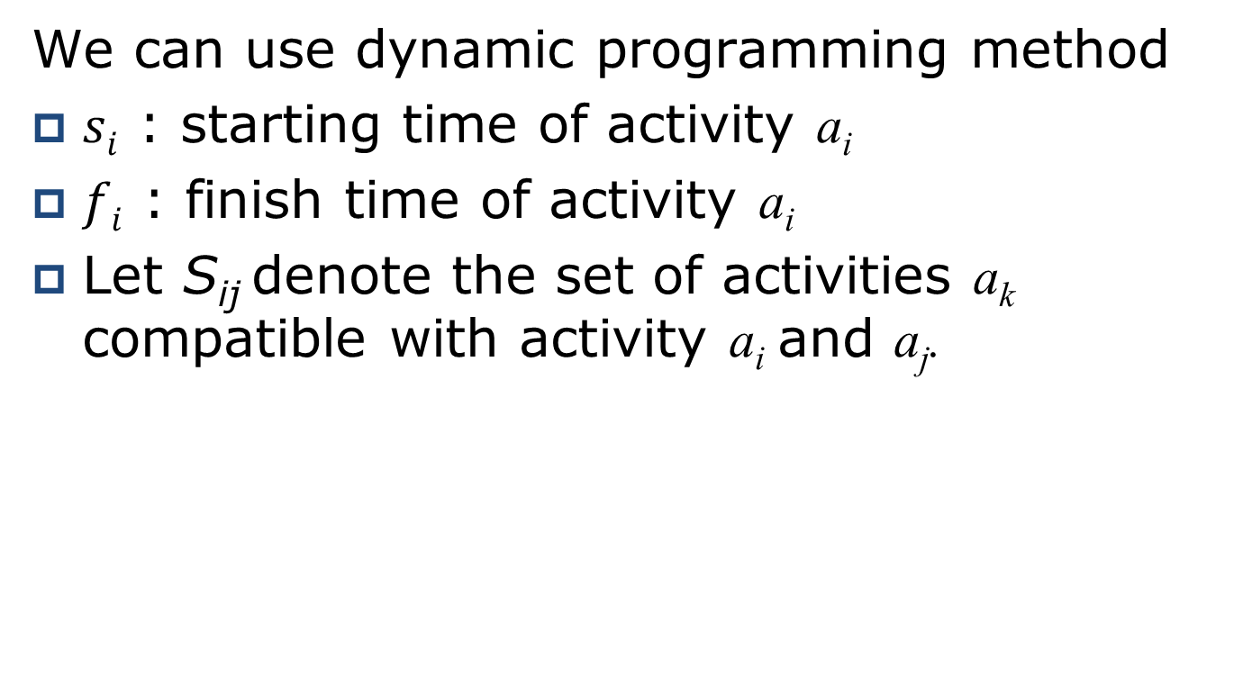
Greedy Algorithm
(An activity-selection problem)
We can use dynamic programming method
$si$ : starting time of activity a_{i}
$fi$ : finish time of activity a_{i}
Let S_{ij} denote the set of activities a_{k} compatible with activity a_{i} and a_{j}.

Slide 45
Greedy Algorithm
(An activity-selection problem)
f_{i}
s_{j}
a₁
a₂
a₃
a₄
Possible S_{ij} are
{a₂, a₄, a₇}
{a₂, a₅, a₇}
{a₃, a₅, a₇}
a₅
a₆
a₇
a₈

Slide 46
Greedy Algorithm
(An activity-selection problem)
Lets c[i, j] be a number of activities in a maximum-size of mutually compatible activities in S_{ij}.
We have c[i, j] = 0 whenever S_{ij} =∅.
If a_{k} is used for maximum-size of mutually compatible activities of S_{ij}, we also use maximum-size of mutually compatible activities for S_{ik} and S_{kj}.

Slide 47
Greedy Algorithm
(An activity-selection problem)
S_{ik}
s_{k}
f_{k}
S_{kj}
f_{i}
s_{j}
a₁
a₂
a₃
a₄
a₅
a₆
a₇
Possible S_{ij} are
{a₂, a₄, a₇}
{a₂, a₅, a₇}
{a₃, a₅, a₇}
a₈

Slide 48
Greedy Algorithm
(An activity-selection problem)
Now we can write recursive equation

Slide 49
Greedy Algorithm
(An activity-selection problem)
Active_Selection (s, f, i , n)
{
m = i + 1
while m ≤ n and s_{m} < f_{i} do
m = m + 1;
if m ≤ n then
return {a_{m}} ∪ Active_Selection (s, f, m, n)
else
return ∅
}

Slide 50
Greedy Algorithm
(An activity-selection problem)
GREEDY-ACTIVITY-SELECTOR(s, f, n)
{
A = {a₁}
i = 1
for m = 2 to n
{
if s_{m} ≥ f_{i}
{
A = A ∪ {a_{m}}
i = m //a_{i} is most recent addition to A
}
}
return A
}

Slide 51
Greedy Algorithm
(An activity-selection problem)
 | a₁ | a₂ | a₃ | a₄ | a₅ | a₆ | a₇ | a₈ | a₉ | a₁₀ | a₁₁
s_{i} | 1 | 3 | 0 | 5 | 3 | 5 | 6 | 8 | 8 | 2 | 12
f_{i} | 4 | 5 | 6 | 7 | 8 | 9 | 10 | 11 | 12 | 13 | 14

Slide 52
Greedy Algorithm
(An activity-selection problem)
0 1 2 3 4 5 6 7 8 9 10 11 12 13 14
a₁
a₂
a₃
a₄
a₅
a₆
a₇
a₈
a₉
a₁₀
a₁₁

Slide 53
Greedy Algorithm
(An activity-selection problem)
0 1 2 3 4 5 6 7 8 9 10 11 12 13 14
a₁
a₂
a₃
a₄
a₅
a₆
a₇
a₈
a₉
a₁₀
a₁₁

Slide 54
Greedy Algorithm
(An activity-selection problem)
0 1 2 3 4 5 6 7 8 9 10 11 12 13 14
a₁
a₂
a₃
a₄
a₅
a₆
a₇
a₈
a₉
a₁₀
a₁₁

Slide 55
Greedy Algorithm
(An activity-selection problem)
0 1 2 3 4 5 6 7 8 9 10 11 12 13 14
a₁
a₂
a₃
a₄
a₅
a₆
a₇
a₈
a₉
a₁₀
a₁₁

Slide 56
Greedy Algorithm
(An activity-selection problem)
0 1 2 3 4 5 6 7 8 9 10 11 12 13 14
a₁
a₂
a₃
a₄
a₅
a₆
a₇
a₈
a₉
a₁₀
a₁₁

