Slide 1
Data Structure COSC 220
Linked List
  Singly Linked List
  Doubly Linked List
  Functions for managing Linked List
    Insert
      Sorted List
      Insert as a Last element always
    Delete
    Search

Slide 2
Data Structure COSC 220
Stack :LIFO
  Functions for managing a Stack
    Push
    Pop
    IsEmpty
    IsFull
    Top
  A Stack Implementation
    With Linked List
    With Array

Slide 3
Data Structure COSC 220
Queue: FIFO
  Functions for managing a Queue
    EnQueue
    DeQueue
    EmptyQ
    FullQ
    FrontQ
  A Queue Implementation
    With a Linked List
    With Array

Slide 4
Hash Tables
Many application require a dynamic data set for supporting the dictionary operations: insert, search and delete.
A hash table is an effective data structure for implementing dictionary operation.
Even though worst case running time for search takes linear time O(n), under reasonable assumptions, the average time to search takes constant time O(1).

Slide 5
Hash Tables
(Direct-Address Table)
Direct addressing is a simple technique that works well when the universe U of key is reasonably small.
With U={0, 1, 2, …, m –1} we use an array by T[0..m-1]
Direct-address table with
U={ 0 ,1, 2, 3, 4, 5, 6, 7, 8, 9 }
K={ 2, 3, 5, 8 }
/
0
1
2
3
4
5
6
7
8
9
key
data
/
2
U
(universe of keys)
3
1
6
/
7
9
0
5
4
/
K (Actual keys used)
2
3
/
5
8
8
/

Slide 6
Hash Tables
With Direct Addressing:
  The problem with direct addressing is if the universe U is large, storing a table of size |U| may be impractical or impossible. ( range of key are positive integer)
  Often, the set K of keys actually stored is small, compared to U, so that most of the space allocated for T is wasted.
  (ex: range of key is 0 ~ 1000000 but there are 10000 inputs)
With Hash Table
  When K is much smaller than U, a hash table requires much less space than a direct-address table.
  Can reduce storage requirements to (|K|).
  Can still get O(1) search time, but in the average case, not the worst case.

Slide 7
Hash Tables
Hash table is a data structure that uses a hash function to map identifying values, known as keys (e.g., a person's name, ID number …), to their associated values.
Idea: Instead of storing an element with key k in slot k, use a function h and store the element in slot h(k).
  We call h a hash function.
  h : U → {0, 1, . . . ,m − 1}, so that h(k) is a legal slot number in T .
  We say that k hashes to slot h(k).

Slide 8
Hash Tables
T
/
0
m - 1
/
h(k₁)
U
(universe of keys)
h(k₄)
/
k₁
h(k₅)
K (Actual
keys used)
k₄
k₅
/
h(k₂)
k₂
k₃
h(k₃)
/
Hash table with a hash function h

Slide 9
Hash Tables
Collisions: When two or more keys hash to the same slot.
  Can happen when there are more possible keys than slots (|U| > m). (m is number of slot in a hash table)
  For a given set K of keys with |K| ≤ m, may or may not happen. Definitely happens if |K| > m.
  Therefore, must be prepared to handle collisions in all cases.
  Use two solutions for collisions:
    Chaining and
    Open Addressing.

Slide 10
Hash Table
T
/
0
m - 1
/
h(k₁)
U
(universe of keys)
h(k₄)
/
Collisions
k₁
h(k₅)= h(k₂)
K (Actual
keys used)
k₄
k₅
/
/
k₂
k₃
h(k₃)
/
Hash table with a hash function h

Slide 11
Hash Table
(Collision Solution by Chaining)
Collision Solution by Chaining
  Slot j contains a pointer to the head of the list of all stored elements that hash to j (or to the sentinel if using a circular, doubly linked list with a sentinel)
  If there are no such elements, slot j contains NIL.

Slide 12
Hash Table
(Collision Solution by Chaining)
T
/
0
m - 1
h(k₁)=h(k₄)
/
k₁
k₄
/
/
U
(universe of keys)
/
/
k₁
h(k₂)=h(k₅)=h(k₇)
/
k₅
k₂
k₇
/
K (Actual
keys used)
k₄
k₅
/
k₇
h(k₃)
/
k₃
/
k₂
k₃
/
k₈
k₆
/
k₈
k₆
h(k₆)=h(k₈)
/
Hash table with a hash function h

Slide 13
Hash Table
(Collision Solution by Chaining)
sequence of keys for data
000
/
Sam Smith
001
Sue Marker
1678933
/
002
/
Sandra Lee
134
/
Ted Doe
135
Sam Smith
1467898
Ted Doe
1278902
/
136
Sam Parker
137
/
Mike Backer
1424578
/
138
/
139
/
Mike Backer
248
Sandra Lee
1789356
/
Sue Marker
249
250
/
Sam Parker
1567334
/

Slide 14
Hash Table
(Operations in Hashing with Chaining)
Insertion:
CHAINED_HASH_INSERT(T, x)
  Insert x at the head of list T [h(x->key)]
  Worst-case running time is O(1).
  Assumes that the element being inserted isn’t already in the list.
  It would take an additional search to check if it was already inserted.

Slide 15
Hash Table
(Operations in Hashing with Chaining)
Search:
CHANED_HASH_SEARCH(T, k)
  Search for an element with key k in list T[h(k)]
  Running time is proportional to the length of the list of elements in slot h(k).

Slide 16
Hash Table
(Operations in Hashing with Chaining)
Deletion:
CHAINED-HASH-DELETE(T, x)
  Delete x from the list in T [h(x->key)]
  Given pointer x to the element to delete, so no search is needed to find this element.
  Worst-case running time is O(1) time if the lists are doubly linked.
  If the lists are singly linked, then deletion takes as long as searching, because we must find x’s predecessor in its list in order to correctly update next pointers.

Slide 17
Hash Table
(Analysis of Hashing with Chaining)
We can analyze Hashing with Chaining based on the load factor.
Load factor is the average number of elements loaded in each slot.
  Let n is the number of elements in the hash table
  Let m is the number of slots in the table
  Load factor α=n/m
  α can be α > 1, α=1, or α < 1
  Worst case is when all n keys hash to the same slot ⇒ get a single list of length n ⇒worst-case time to search is Θ(n), plus time to compute hash function.
  Average case depends on how well the hash function distributes the keys among the slots.

Slide 18
Hash Table
(Analysis of Hashing with Chaining)
Average-case performance of hashing with chaining.
  For average-case performance, we assume simple uniform hashing: any given element is equally likely to hash into any of the m slots.
  For j = 0, 1, . . . ,m − 1, we denote the length of list T [ j ] by n_{j} . Then total number of elements
  n = n₀ + n₁ +· · · +n_{m−1}. (n is total number of input)
  Average value of n_{j} is α = n/m.
  Assume that we can compute the hash function in O(1) time, so that the time required to search for the element with key k depends on the length n_{h(k)} of the list T [h(k)].

Slide 19
Hash Table
(Analysis of Hashing with Chaining)
To analyze average case, we need consider two cases:
  If the hash table contains no element with key k, then the search is unsuccessful.
  If the hash table does contain an element with key k, then the search is successful
Theorem 1)
An unsuccessful search takes expected time Θ(1 + α).
Theorem 2)
A successful search takes expected time Θ(1 + α).

Slide 20
Hash Table
(Hash Function)
What makes a good hash function?
  Ideally, the hash function satisfies the assumption of simple uniform hashing.
  Practically, it’s not possible to satisfy this assumption, since we don’t know in advance the probability distribution that keys are drawn from, and the keys may not be drawn independently.
  Often use heuristics, based on the domain of the keys, to create a hash function that performs well.

Slide 21
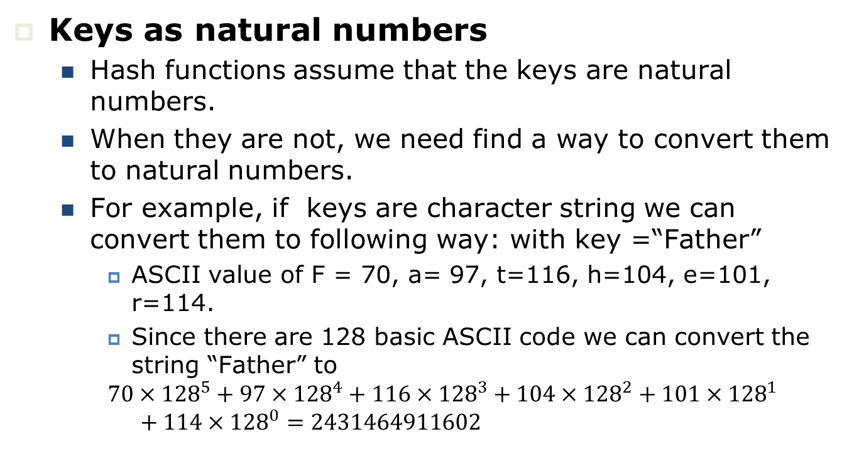
Hash Table
(Hash Function)
Keys as natural numbers
  Hash functions assume that the keys are natural numbers.
  When they are not, we need find a way to convert them to natural numbers.
  For example, if keys are character string we can convert them to following way: with key =“Father”
    ASCII value of F = 70, a= 97, t=116, h=104, e=101, r=114.
    Since there are 128 basic ASCII code we can convert the string “Father” to
    $$70×{128}^{5}+97×{128}^{4}+116×{128}^{3}+104×{128}^{2}+101×{128}^{1}+114×{128}^{0}=2431464911602$$

Slide 22
Hash Table
(Hash Function: The Division Method)
Map a key k into one of m slots by taking the remainder of k divided by m: h(k) = k mod m
  Advantage: Fast, since requires just one division operation.
  Disadvantage: Have to avoid certain values of m:
    Powers of 2 are bad. If m = 2^{p} for integer p, then h(k) is just the least significant p bits of k.
  Good choice for m: A prime not too close to an exact power of 2.

Slide 23
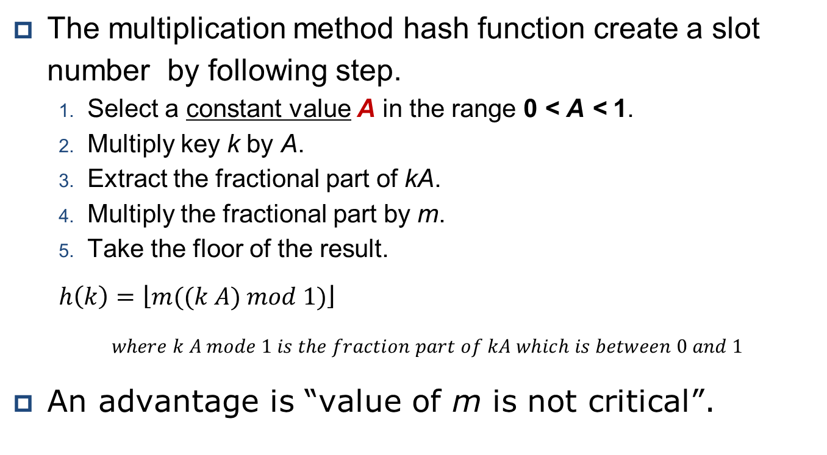
Hash Table
(Hash Function: The Multiplication Method)
The multiplication method hash function create a slot number by following step.
  Select a constant value A in the range 0 < A < 1.
  Multiply key k by A.
  Extract the fractional part of kA.
  Multiply the fractional part by m.
  Take the floor of the result.
  $$h\left(k\right)=\left\lfloor m\right.\left.((k A) mod 1)\right\rfloor$$
  $where k A mode 1 is the fraction part of kA which is between 0 and 1$
An advantage is “value of m is not critical”.

Slide 24
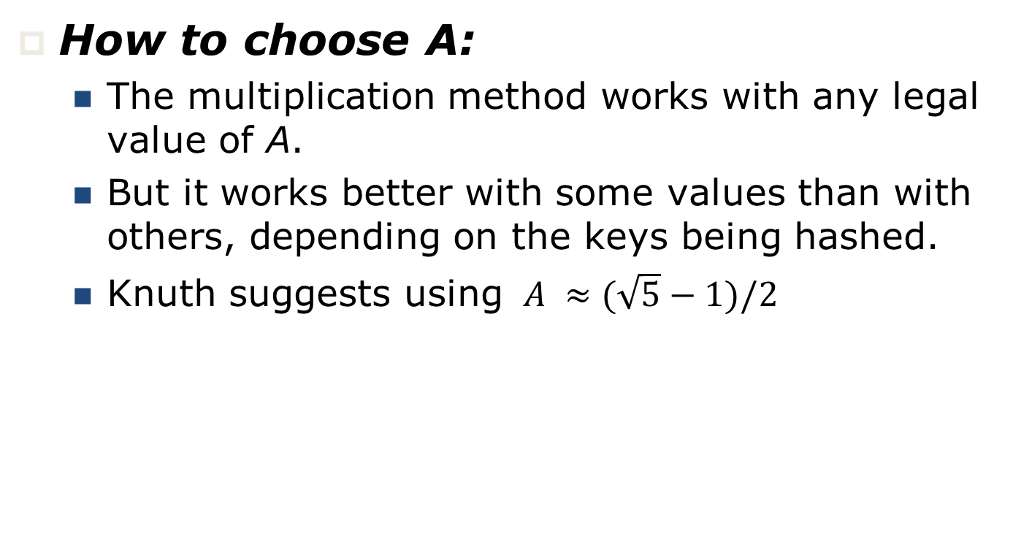
Hash Table
(Hash Function: The Multiplication Method)
How to choose A:
  The multiplication method works with any legal value of A.
  But it works better with some values than with others, depending on the keys being hashed.
  Knuth suggests using $A ≈(\sqrt{5}−1)/2$

Slide 25
Hash Table
(Collision Solution by Open Addressing)
Hash collision can be solved by open addressing.
In open addressing, all elements occupy the hash table itself.
Store all keys in the hash table itself.
Each slot contains either a key or NIL.
To search for key k:
  Compute h(k) and examine slot h(k). Examining a slot is known as a probe.
  If slot h(k) contains key k, the search is successful. If this slot contains NIL, the search is unsuccessful.
  If slot h(k) contains a key that is not k. We compute the index of some other slot, based on k and on which probe (count from 0: 0th, 1st, 2nd, etc.) were on.
  Keep probing until we either find key k (successful search) or we find a slot holding NIL (unsuccessful search).

Slide 26
Hash Table
(Collision Solution by Open Addressing)
sequence of data with key
000
Sam Smith
001
Sue Marker
1678933
002
Sandra Lee
134
Ted Doe
135
Sam Smith
1467898
136
Ted Doe
1278902
Sam Parker
137
Mike Backer
1424578
138
139
Mike Backer
248
Sandra Lee
1789356
Sue Marker
249
Sam Parker
1567334
250

Slide 27
Hash Table
(Collision Solution by Open Addressing)
We need the sequence of slots probed to be a permutation of the slot numbers <0, 1, . . . , m − 1> (so that we examine all slots if we have to, and so that we don’t examine any slot more than once).
Thus, the hash function h is a function of
h: U × P → P (where U is set of key and P is set of slot numbers)
The requirement that the sequence of slots be a permutation of 0, 1, . . . ,m − 1 is equivalent to requiring that the probe sequence h(k, 0), h(k, 1),. . . , h(k, m − 1) be a permutation of <0, 1, . . . ,m − 1>.
To insert, act as though we’re searching, and insert at the first NIL slot we find.

Slide 28
Hash Table
(Collision Solution by Open Addressing)
// HASH-SEARCH returns the index of a slot containing key k, or
// NIL if the search is unsuccessful.
HASH-SEARCH(T, k)
{
1 i = 0;
2 rval = NIL;
do {
3 j = h(k, i);
4 if T [j] = k
5 rval = j;
6
7 i = i + 1;
8 }while (T[j] ≠ NIL and T[j]≠ k and i ≠ m)
9 return rval;
}

Slide 29
Hash Table
(Collision Solution by Open Addressing)
HASH_INSERT(T, k)
{
1 i = 0;
2 stop = false;
3 do {
4 j = h(k, i );
5 if (T[j] == NIL)
{
6 T [j]= k;
7 stop = true;
}
8 else
9 i = i + 1;
10 }while (!stop and i ≠ m)
11 if (i == m)
12 “Hash table overflow error”
}

Slide 30
Hash Table
(Collision Solution by Open Addressing)
Deletion: Cannot just put NIL into the slot containing the key we want to delete.
000
Sam Smith
001
Sue Marker
1678933
002
Delete Ted Doe
Sandra Lee
134
Ted Doe
135
Sam Smith
1467898
136
Ted Doe
1278902
Sam Parker
137
Mike Backer
1424578
138
139
Mike Backer
248
Sandra Lee
1789356
Sue Marker
249
Sam Parker
1567334
250

Slide 31
Hash Table
(Collision Solution by Open Addressing)
Deletion: Cannot just put NIL into the slot containing the key we want to delete.
000
Sam Smith
001
Sue Marker
1678933
002
Search Mike Backer
Sandra Lee
134
135
Sam Smith
1467898
136
Fail
Sam Parker
137
Mike Backer
1424578
138
139
Mike Backer
248
Sandra Lee
1789356
Sue Marker
249
Sam Parker
1567334
250

Slide 32
Hash Table
(Collision Solution by Open Addressing)
Deletion: Cannot just put NIL into the slot containing the key we want to delete.
Solution: Use a special value DELETED instead of NIL when marking a slot as empty during deletion.
  Search should treat DELETED as though the slot holds a key that does not match the one being searched for.
  Insertion should treat DELETED as though the slot were empty, so that it can be reused.
The disadvantage of using DELETED is that now search time is no longer dependent on the load factor α.

Slide 33
Hash Table
(Collision Solution by Open Addressing)
HASH_INSERT(T, k)
{
1 i = 0;
2 stop = false;
3 do {
4 j = h(k, i );
5 if (T[j] == NIL || T[j]==DELETED)
{
6 T [j]= k;
7 stop = true;
}
8 else
9 i = i + 1;
10 }while (!stop and i ≠ m)
11 if (i == m)
12 “Hash table overflow error”
}

Slide 34
Hash Table
(Collision Solution by Open Addressing: Probe Sequences)
Probe sequences are the list of locations which a method for open addressing produces as alternatives in case of a collision.
  Linear probing
  Quadratic probing
  Double hashing:

Slide 35
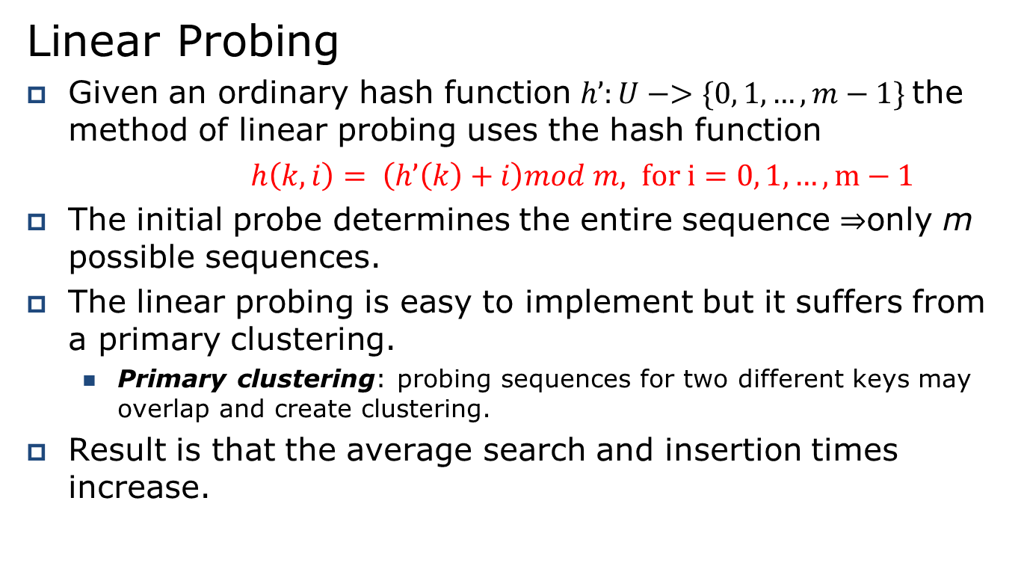
Hash Table
(Collision Solution by Open Addressing: Probe Sequences)
Linear Probing
Given an ordinary hash function $h’:U−>\{0, 1, …, m−1\}$the method of linear probing uses the hash function
$h\left(k, i\right)= \left(h’\left(k\right)+i\right)mod m, for i=0, 1, …, m−1$
The initial probe determines the entire sequence ⇒only m possible sequences.
The linear probing is easy to implement but it suffers from a primary clustering.
  Primary clustering: probing sequences for two different keys may overlap and create clustering.
Result is that the average search and insertion times increase.

Slide 36
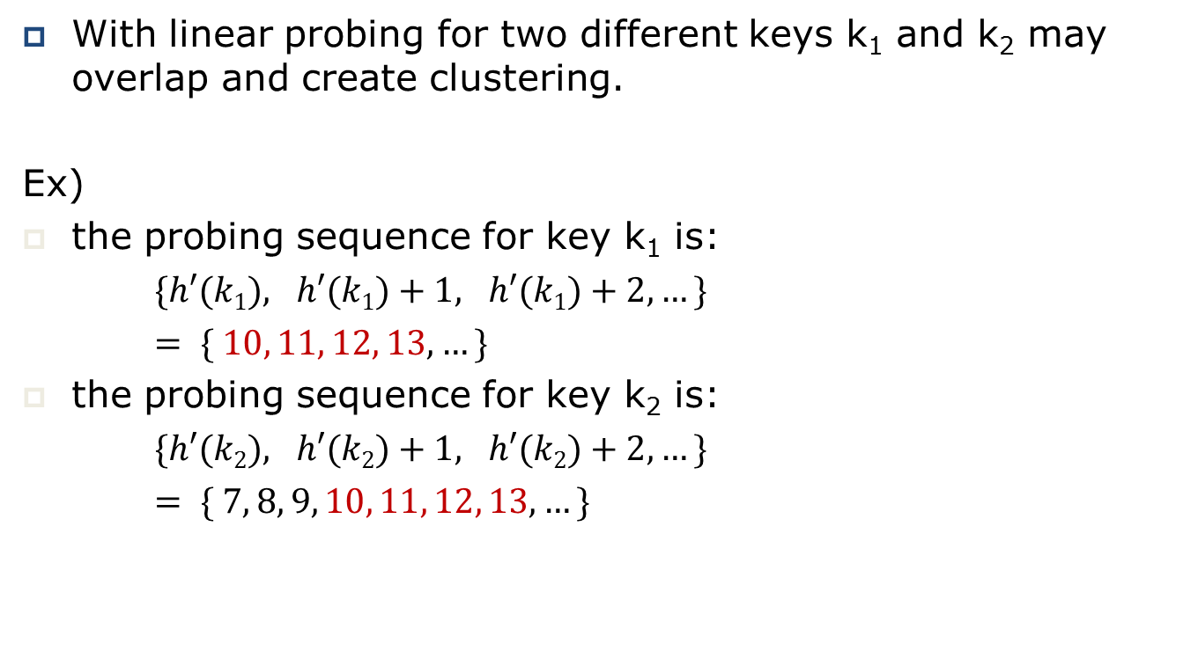
Hash Table
(Collision Solution by Open Addressing: Probe Sequences)
With linear probing for two different keys k₁ and k₂ may overlap and create clustering.
Ex)
the probing sequence for key k₁ is:
$\{h′(k1), h′(k1)+1, h′(k1)+2, …\}$
$= \{ 10, 11, 12, 13, …\}$
the probing sequence for key k₂ is:
$\{h′(k2), h′(k2)+1, h′(k2)+2, …\}$
$= \{ 7, 8, 9, 10, 11, 12, 13, …\}$

Slide 37
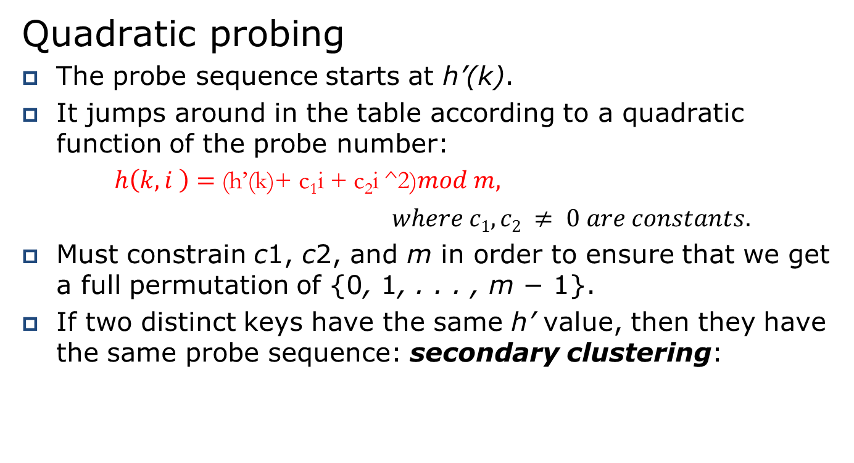
Hash Table
(Collision Solution by Open Addressing: Probe Sequences)
Quadratic probing
The probe sequence starts at h’(k).
It jumps around in the table according to a quadratic function of the probe number:
$h\left(k, i \right)=$(h’(k)+ c₁i + c₂i ^2)$mod m,$
$where c1, c2 ≠ 0 are constants.$
Must constrain c1, c2, and m in order to ensure that we get a full permutation of {0, 1, . . . , m − 1}.
If two distinct keys have the same h’ value, then they have the same probe sequence: secondary clustering:

Slide 38
Hash Table
(Collision Solution by Open Addressing: Probe Sequences)
Double Hashing
Use two auxiliary hash functions, h₁ and h₂.
h₁ gives the initial probe, and h₂ gives the remaining probes:
h(k, i ) = (h₁(k) + i*h₂(k)) mod m
Must have h₂(k) be relatively prime to m (no factors in common other than 1) in order to guarantee that the probe sequence is a full permutation of <0,1,. . . ,m−1>.
  Could choose m to be a power of 2 and h₂ to always produce an odd number > 1.
  Could let m be prime and have 1 < h₂(k) < m.

