Slide 1
Preview
Red-Black Tree
  Red-Black Tree Property
  Red-Black Tree Operations
    Rotation
    Insertion
    Deletion

Slide 2
Red-Black Tree
Red-black tree is a binary search tree that are balanced in order to guarantee that basic dynamic-set operations take O(log n) time in the worst case.
A red-black tree is a binary search tree with one extra bit of storage per node: its color, which can be either red or black.
Each node has fields: color, key, left, right and parent.
  All leaves are empty (T.nil) and colored black.
  We use a single sentinel, T.nil, for all the leaves of red-black tree T .
  color T.nil is black.
  The root’s parent is also T.nil.

Slide 3
Red-Black Tree
Red-Black Trees Properties
  Every node is either red or black
  The root is black
  Every leaf is black
  If a node is red, then both its children are black
  Every simple path from a node to a descendant leaf contains the same number of black nodes
Height of a red-black tree
  Height of a node is the number of edges in a longest path to a leaf.
  Black-height of a node x: bh(x) is the number of black nodes (including T.nil)on the path from x to leaf, not counting x.

Slide 4
Red-Black Tree
h=6
bh=3
h=5
bh=3
26
h=4
bh=2
h=4
bh=2
17
h=3
bh=2
h=3
bh=2
41
h=1
bh=1
14
21
30
47
h=3
bh=2
h=1
bh=1
h=2
bh=1
h=2
bh=1
h=1
bh=1
h=2
bh=1
NIL
NIL
10
16
19
23
28
38
h=2
bh=1
h=1
bh=1
h=1
bh=1
h=1
bh=1
NIL
NIL
NIL
NIL
NIL
NIL
7
12
15
h=1
bh=1
20
h=1
bh=1
35
39
h=1
bh=1
NIL
NIL
NIL
NIL
NIL
NIL
NIL
NIL
NIL
NIL
3
NIL
NIL

Slide 5
Red-Black Tree
26
17
41
14
21
30
47
10
16
19
23
28
38
7
12
15
20
35
39
3
T.nil

Slide 6
Red-Black Tree
26
17
41
14
21
30
47
10
16
19
23
28
38
7
12
15
20
35
39
3

Slide 7
Red-Black Tree
Lemma: A red-black tree with n internal nodes has height at most 2log₂ (n+1)
Proof) We start by claim that subtree starting at x contains at least 2^{bh(x)}-1 internal nodes. By induction on height of x:
Base case)
If x is a leaf then there is no internal node. If x is leaf, bh(x) = 0, 2^{bh(x)} – 1= 1 – 1 =0
Induction)
Lets assume x has height h, x's children have height h -1
x's children black-height is either bh(x) or bh(x) -1 (depend on x is red or black respectively). Since the height of x is greater than height of it’s child,
By inductive hypotheses x's children subtree has 2^{bh(x)-1}-1 internal nodes
So subtree starting at x contains at least
2^{bh(x)-1}-1 + 2^{bh(x)-1}-1 + 1 = 2^{bh(x)}-1 internal nodes which prove claim

Slide 8
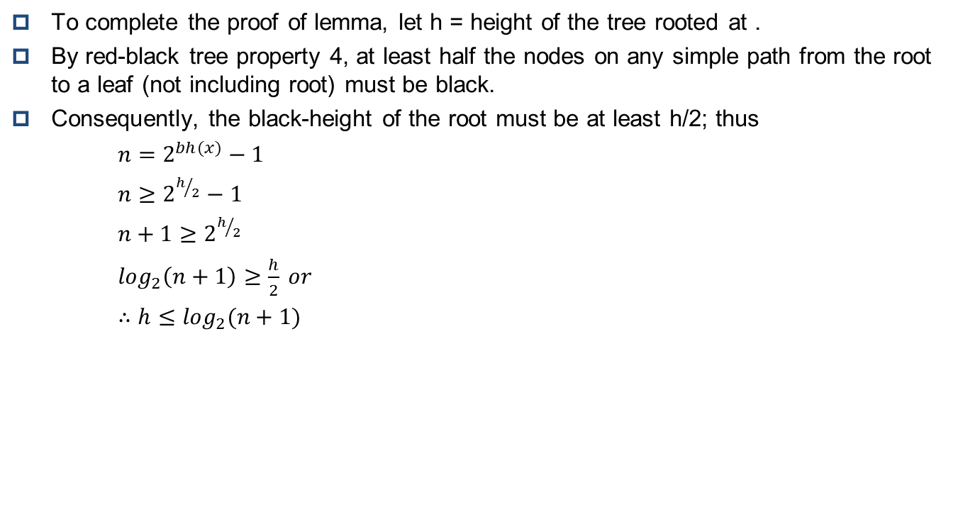
Red-Black Tree
To complete the proof of lemma, let h = height of the tree rooted at .
By red-black tree property 4, at least half the nodes on any simple path from the root to a leaf (not including root) must be black.
Consequently, the black-height of the root must be at least h/2; thus
$$n=2^{bh(x)}−1$$
$$n≥2^{h/2}−1$$
$$n+1≥2^{h/2}$$
$$\log_{2}\left(n+1\right)≥\frac{h}{2} or$$
$$∴h≤\log_{2}(n+1)$$

Slide 9

Red-Black Tree
As an immediate consequence of this lemma, the running time of operations for Search, Minimum Maximum, Successor and Predecessor are in $Ο(\log_{2}n)$ on red-black tree.

Slide 10
Red-Black Tree
(Operations on RB-Trees)
Operations on red-black trees
The non-modifying binary-search-tree operations MINIMUM, MAXIMUM, SUCCESSOR, PREDECESSOR, and SEARCH run in O(height) time. Thus, they take O(log₂ n) time on red-black trees.
Insertion and deletion are not so easy.
If we insert, what color to make the new node?
  Red: Might violate property 4 (If a node is red, then both its children are black).
  Black: Might violate property 5. (same bh())
z
x
x
z
Insert red node z
z
Insert black node z
x
x
bh(x)= ??
violate property 4
violate property 5
z
bh(x)= n

Slide 11
Red-Black Tree
(Operations on RB-Trees)
If we delete, thus removing a node, what color was the node that was removed?
  Red: OK, since we won’t have changed any black-heights, nor will we have created two red nodes in a row. Also, cannot cause a violation of property 2, since if the removed node was red, it could not have been the root.
  Black: Could cause there to be two reds in a row (violating property 4), and can also cause a violation of property 5. Could also cause a violation of property 2, if the removed node was the root and its child (which becomes the new root) was red.

Slide 12
Red-Black Tree
(functions: Rotation)
After delete or insert a new node on a red-black tree, the result might violate the red-black tree properties.
Rotation and recoloring are used to restore these properties after insert or delete node
There are Left_Rotate() and Right_Roate() to restore theses properties.
Rotation running time are both constant time O(1)

Slide 13
Red-Black Tree
(functions: Rotation)
x
x
Left_Rotate(T, x)
γ
α
y
α
β
β
γ
Right_Rotate(T, x)

Slide 14
Red-Black Tree
(functions: Left Rotation)
x
A
B
Left_Rotate(T, x)
α
B
A
γ
β
γ
α
β

Slide 15
Red-Black Tree
(functions: Left Rotation)
LEFT-ROTATE(T, x)
{
1 y=x->right; // Set y.
2 x->right=y->left// Turn y's left subtree into x's right subtree.
3 y->left->parent = x;
4 y->parent = x->parent // Link x's parent to y.
5 if x->parent==nil
6 T->root =y;
7 else if x == x->parent->left
8 x->parent->left = y;
9 else
10 x->parent->right = y;
11 y->left = x; //Put x on y's left.
12 x->parent = y;
}
Running time of Left_Rotate is Θ(1)

Slide 16
Red-Black Tree
(functions: Left Rotation)
Case1) x== x->parent->right
y->parent = x->parent
Left_Rotate(T, x)
x->parent->right = y;
x
x
y->left = x
x->parent = y
α
y=x->right
α
y
γ
x->right=y->left
β
γ
y->left->parent = x;
β
γ
α
β
Case2) x== x->parent->left
y->parent = x->parent
Left_Rotate(T, x)
x->parent->left = y;
x
x
y->left = x
x->parent = y
α
y=x->right
α
y
γ
β
γ
x->right=y->left
β
γ
α
β
y->left->parent = x;

Slide 17
Red-Black Tree
(functions: Right Rotation)
Right_Rotate(T, x)
A
B
B
γ
α
A
α
β
β
γ

Slide 18
Red-Black Tree
(functions: Right Rotation)
Right_ROTATE(T, x)
{
1 y=x->left; // Set y.
2 x->left=y->right// Turn y's right subtree into x's left subtree.
3 y->right->parent = x;
4 y->parent = x->parent // Link x's parent to y.
5 if x->parent==nil
6 T->root =y;
7 else if x == x->parent->right
8 x->parent->right = y;
9 else
10 x->parent->left = y;
11 y->right = x; //Put x on y's right.
12 x->parent = y;
}
Running time of Right_Rotate is Θ(1)

Slide 19
Red-Black Tree
(functions: Right Rotation)
Case1) x== x->parent->right
Right_Rotate(T, x)
y->right = x
y->parent = x->parent
x->parent = y
x->parent->right = y
x
x
y=x->left
γ
y
γ
x->left=y->right
α
y->right->parent = x
α
β
α
β
β
γ
Case2) x== x->parent->left
Right_Rotate(T, x)
y->parent = x->parent
y->right = x
x->parent->left = y
x->parent = y
x
x
y=x->left
γ
y
γ
x->left=y->right
α
y->right->parent = x
α
β
α
β
β
γ

Slide 20
Red-Black Tree
(functions: Rotation)
7
x
4
11
y
3
6
9
18
α
2
14
19
Left_Rotate(T, x)
β
12
17
γ
22
7
y
20
4
x
18
3
6
11
19
2
9
14
γ
22
α
β
12
17
20

Slide 21
Red-Black Tree
(functions: Insertion)
Insert Node
  Color inserting node to red.
  Insert a node using Binary-search tree insert.
  Then call RB_Insert_Fixup which adjust a red-black tree property with rotation and recoloring.
There are three cases for adjesting red-black tree property after insert with BST insert.

Slide 22
Red-Black Tree
(functions: Insertion)
Lets check five property of red-black tree.
  Every node is either red or black
  The root is black
  Every leaf (nil) is black
  If a node is red, then both its children are black
  Every simple path from a node to a descendant leaf contains the same number of black nodes
After insert a node, the only properties that might be violated are property 2, and 4.
  Property 2 is violated if z is root
  Property 4 is violated if z’s parent is red.

Slide 23
Red-Black Tree
(functions: Insertion)
RB_INSERT(T, z)
{
1 y = T.nil;
2 x = root;
3 while x ≠ T.nil
{
4 y = x;
5 if z->key < x->key
6 x = x->left;
7 else
8 x = x->right;
9 z->parent = y;
10 if y = T.nil
11 root = z;
12 else if z->key < y->key
13 y->left = z;
14 else
15 y->right = z;
}
16 z->left = T.nil;
17 z->right = T.nil;
18 z->color = RED
19 RB_INSERT_FIXUP(T, z)
}

Slide 24
RB-INSERT-FIXUP(T, z)
{
while (z->parent->color == RED)
{
if (z->parent== z->parent->parent->left)
{
3 y=z->parent->parent->right;
4 if (y->color == RED)
{
5 z->parent->color = BLACK; //Case 1
6 y->color = BLACK; //Case 1
7 z->parent->parent->color= RED; //Case 1
8 z = z->parent->parent; //Case 1
}
9 else
{
10 if (z == z->parent->right)
{
11 z =z->parent; //Case 2
12 LEFT-ROTATE(T, z); //Case 2
}
13 z->parent->color = BLACK; //Case 3
14 z->parent->parent->color = RED; //Case 3
15 RIGHT-ROTATE(T, z->parent->parent); //Case 3
}
}
16 else
{
(same as then clause with "right" and "left" exchanged)
}
}
28 T->root->color = BLACK;
}

Slide 25
RB-INSERT-FIXUP(T, z)
{
while (z->parent->color == RED)
{
if (z->parent== z->parent->parent->left)
{
}
16 else
{
17 y=z->parent->parent->left;
18 if (y->color == RED)
{
19 z->parent->color = BLACK; //Case 1
20 y->color = BLACK; //Case 1
21 z->parent->parent->color= RED; //Case 1
22 z = z->parent->parent; //Case 1
}
23 else
{
24 if (z == z->parent->left)
{
25 z =z->parent; //Case 2
26 RIGHT-ROTATE(T, z); //Case 2
}
27 z->parent->color = BLACK; //Case 3
28 z->parent->parent->color = RED; //Case 3
29 LEFT-ROTATE(T, z->parent->parent); //Case 3
}
}
}
16 T->root->color = BLACK;
}

Slide 26
Red-Black Tree
(RB_Insert_Fixup Operation)
11
2
14
1
7
15
y
Case1)
5
8
if (y->color == RED)
{
z->parent->color = BLACK; //Case 1
y->color = BLACK; //Case 1
z->parent->parent->color= RED; //Case 1
z = z->parent->parent; //Case 1
}
if (z->parent== z->parent->parent->left)
y=z->parent->parent->right;
z
4
11
y
2
14
z
1
7
15
5
8
4
Case1) After node z is inserted, both z and z’s parent are red, violation of property 4. Since z’s uncle y is red, case1 in the code. We recolor nodes and move the pointer z up the tree result case 2

Slide 27
Red-Black Tree
(RB_Insert_Fixup Operation)
11
y
2
14
z
1
7
15
Case2)
if (z->parent== z->parent->parent->left)
5
8
else if (z == z->parent->right)
{
z =z->parent; //Case 2
LEFT-ROTATE(T, z); //Case 2
}
y=z->parent->parent->right;
4
11
y
z
7
14
2
8
15
1
5
4

Slide 28
Red-Black Tree
(RB_Insert_Fixup Operation)
11
y
z
7
14
2
8
15
Case3) re-coloring and right rotation
1
5
4
z->parent->color = BLACK; //Case 3
z->parent->parent = RED; //Case 3
RIGHT-ROTATE(T, z->parent->parent); //Case 3
if (z->parent== z->parent->parent->left)
7
y=z->parent->parent->right;
z
2
11
1
5
8
14
4
15

Slide 29
Red-Black Tree
(RB_Insert_Fixup Operation)
new z
C
C
Re-color
A
D
y
A
D
z
α
B
δ
ε
α
B
δ
ε
β
γ
β
γ
1 while (z->parent->color == RED)
{
2 if (z->parent == z->parent->parent->left)
{
3 y = z->parent->parent->right;
4 if (y->color == RED)
{
5 z->parent->color = BLACK;
6 y->color = BLACK;
7 z->parent->parent->color = RED;
8 z = z->parent->parent;
}
Case 1)
Case 1 of the RB_Insert_Fixup()

Slide 30
Red-Black Tree
(RB_Insert_Fixup Operation)
Re-color
new z
C
C
y
B
D
B
D
z
A
γ
δ
ε
A
γ
δ
ε
α
β
α
β
1 while (z->parent->color == RED)
{
2 if (z->parent == p->parent->parent->left)
{
3 y = z->parent->parent->right;
4 if (y->color == RED)
{
5 z->parent->color = BLACK;
6 y->color = BLACK;
7 z->parent->parent->color = RED;
8 z = z->parent->parent;
}
Case 1)

Slide 31
Red-Black Tree
(RB_Insert_Fixup Operation)
LEFT-ROTATE(T, z->parent)
C
C
δ
y
δ
y
A
B
z
z
α
B
A
γ
Case 2)
Case 3)
β
γ
α
β
1 while (z->parent->color == RED)
{
2 if (z->parent == p->parent->parent->left)
{
3 y = z->parent->parent->right;
4 if (y->color == RED)
{
Case1)
}
9 else if (z == z->parent->right)
{
10 z =z->parent;
11 LEFT-ROTATE(T, z);
}

Slide 32
Red-Black Tree
(RB_Insert_Fixup Operation)
C
B
δ
y
B
z
A
C
z
A
γ
α
β
γ
δ
α
β
Case 3) Re-color & RIGHT-ROTATE(T, z->parent->parent)
1 while (z->parent->color == RED)
{
2 if (z->parent == z->parent->parent->left)
{
3 y = z->parent->parent->right;
4 if (y->color == RED)
{
Case1)
}
9 else if (z == z->parent->right)
{
Case 2)
}
12 z->parent->color = BLACK;
13 z->parent->parent->color = RED;
14 RIGHT-ROTATE(T, z->parent->parent);
}
Case 3)

Slide 33
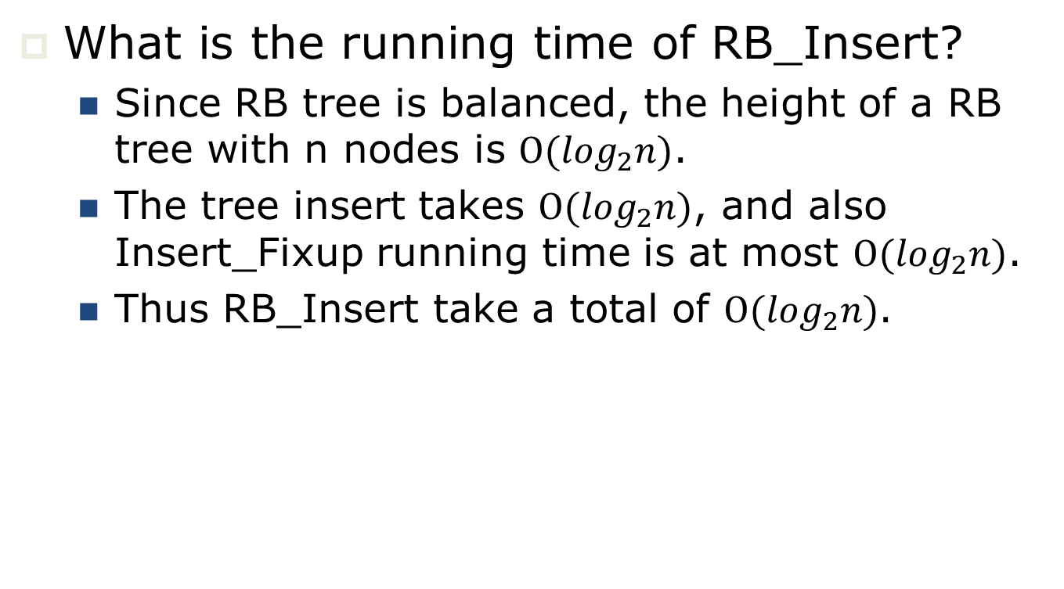
Red-Black Tree
(functions: Insertion: running time)
What is the running time of RB_Insert?
  Since RB tree is balanced, the height of a RB tree with n nodes is $Ο(\log_{2}n)$.
  The tree insert takes $Ο(\log_{2}n)$, and also Insert_Fixup running time is at most $Ο(\log_{2}n)$.
  Thus RB_Insert take a total of $Ο(\log_{2}n)$.

Slide 34
Red-Black Tree
(functions: Deletion)
As we discussed before, in order to simplify boundary conditions in the code, we use a sentinel to present T.nil.
For a red-black tree T, the sentinel T.nil is an object with the same fields as an ordinary node. It’s color is BLACK, and its other field can set to arbitrary values.
In all red-black tree, all pointers to the NIL are replaced by pointer to the sentinel T.nil
The RB_Delete is a minor modification of the Tree_Delete in binary search tree.

Slide 35
Red-Black Tree
(functions: Deletion)
RB_DELETE(T, z)
{
1 if z->left==T.nil or z->right == T.nil
2 y = z;
else
3 y = TREE_SUCCESSOR(z)
4 if y->left ≠ T.nil
5 x = y->left;
else
6 x = y->right;
7 x->parent = y->parent;
8 if y->parent== T.nil
9 T->root = x;
10 else if y == y->parent->left
11 y->parent->left = x;
else
12 y->parent->right = x;
13 if y ≠ z
{
14 z->key = y->key;
15 copy y's satellite data into z
}
16 if y->color = BLACK
17 RB_DELETE_FIXUP(T, x)
18 return y //delete y
}

Slide 36
Red-Black Tree
(functions: Deletion)
y is the node that was actually spliced out.
(y must have one child or no child)
x is either
  y’s sole non-sentinel child before y was spliced out, or
  the sentinel, if y had no children.
In both cases, x->parent is now the node that was previously y’s parent.

Slide 37
Red-Black Tree
(functions: Deletion: RB_DELETE_FIXUP)
Once a black node is deleted, it cause violate red-black tree property.
RB_DELETE_FIXUP function is called to fix the violated red-black tree by re-coloring and rotation.

Slide 38
RB-DELETE-FIXUP(T, x)
{
1 while x ≠ T.root and x->color = BLACK
{
2 if x == x-> parent->left
{
3 w = x->parent->right; //w is x’s sibling
4 if w->color = RED
{
5 w->color = BLACK; // Case 1
6 x->parent->color = RED; // Case 1
7 LEFT-ROTATE(T, x->parent); // Case 1
8 w = x->parent->right; // Case 1
}
9 if w->left->color == BLACK and w->right->color = BLACK
{
10 w->color ← RED; // Case 2
11 x = x->parent; // Case 2
}
12 else
{
if w->right->color == BLACK
{
13 w->left->color = BLACK; // Case 3
14 w->color = RED; // Case 3
15 RIGHT_ROTATE(T, w) // Case 3
16 w = x->parent->right; // Case 3
}
17 w->color =x->parent->color; // Case 4
18 x->parent->color = BLACK; // Case 4
19 w->right->color = BLACK; // Case 4
20 LEFT_ROTATE(T, x->parent); // Case 4
21 x= T.root; // Case 4
}
}
22 else
{
(same as then clause with "right" and "left" exchanged)
}
} // end while
43 x->color = BLACK;
}

Slide 39
RB-DELETE-FIXUP(T, x)
{
1 while x ≠ T.root and x->color = BLACK
{
2 if x == x-> parent->left
{
}
22 else // if x== x->parent->right
{
23 w = x->parent->left; //w is x’s sibling
24 if w->color = RED
{
25 w->color = BLACK; // Case 1
26 x->parent->color = RED; // Case 1
27 RIGHT-ROTATE(T, x->parent); // Case 1
28 w = x->parent->left; // Case 1
}
29 if w->right->color == BLACK and w->left->color = BLACK
{
30 w->color ← RED; // Case 2
31 x = x->parent; // Case 2
}
32 else
{
33 if w->left->color == BLACK
{
34 w->right->color = BLACK; // Case 3
35 w->color = RED; // Case 3
36 LEFT_ROTATE(T, w) // Case 3
37 w = x->parent->left; // Case 3
}
38 w->color =x->parent->color; // Case 4
39 x->parent->color = BLACK; // Case 4
40 w->left->color = BLACK; // Case 4
41 RIGHT_ROTATE(T, x->parent); // Case 4
42 x= T.root; // Case 4
}
}
} // end while
43 x->color = BLACK;
}

Slide 40
Red-Black Tree
(functions: Deletion: RB_DELETE_FIXUP)
Case 1: x’s sibling w is red
  w must have black children.
  Make w black and x->parent red.
  Then left rotate on x->parent.
  New sibling of x was a child of w before rotation ⇒ must be black.
  Go immediately to case 2, 3, or 4.

Slide 41
Red-Black Tree
(functions: Deletion: RB_DELETE_FIXUP)
B
Re-coloring & LEFT_ROTATE(T, x->parent)
D
x
w
A
D
B
E
x
α
β
C
E
A
New w
C
ε
ζ
γ
δ
ε
ζ
α
β
γ
δ
Case1) x’s sibling w is red
4 if w->color = RED
{
5 w->color = BLACK; // Case 1
6 x->parent->color = RED; // Case 1
7 LEFT-ROTATE(T, x->parent); // Case 1
8 w = x->parent->right; // Case 1
}

Slide 42
Red-Black Tree
(functions: Deletion: RB_DELETE_FIXUP)
Case 2: w and both of w’s children are black
  Take 1 black off x (⇒singly black) and off w (⇒red).
  Move that black to x->parent.
  Do the next iteration with x->parent as the new x.
  If entered this case from case 1, then x->parent was red ⇒ new x is red & black
  ⇒ color attribute of new x is RED ⇒ loop terminates. Then new x is made
  black in the last line.

Slide 43
Red-Black Tree
(functions: Deletion: RB_DELETE_FIXUP)
Unknown color
Re-coloring
new x
B
B
x
w
A
D
A
D
α
β
C
E
α
β
C
E
γ
δ
ε
ζ
γ
δ
ε
ζ
Case 2) x’s sibling w is black, and both of w’ children are black
9 if w->left->color == BLACK and w->right->color = BLACK
{
10 w->color = RED; // Case 2
11 x = x->parent; // Case 2
}

Slide 44
Red-Black Tree
(functions: Deletion: RB_DELETE_FIXUP)
Case 3: w is black, w’s left child is red, and w’s right child is black
  Make w red and w’s left child black.
  Then right rotate on w.
  New sibling w of x is black with a red right child ⇒case 4.

Slide 45
Red-Black Tree
(functions: Deletion: RB_DELETE_FIXUP)
B
Re-coloring & RIGHT_ROTATE(T, w)
B
x
w
x
new w
A
D
A
C
α
β
C
E
α
β
γ
D
γ
δ
ε
ζ
δ
E
Case 3) x’s sibling w is black, w’ left child is red, and w’s right child is black
ε
ζ
12 else if w->right->color == BLACK
{
13 w->left->color = BLACK; // Case 3
14 w->color = RED; // Case 3
15 RIGHT_ROTATE(T, w) // Case 3
16 w = x->parent->right; // Case 3
}

Slide 46
Red-Black Tree
(functions: Deletion: RB_DELETE_FIXUP)
Case 4: w is black, w’s left child is black, and w’s right child is red.
  Make w be x’s parent's color (c).
  Make x’s parents' color black and w’s right child black.
  Then left rotate on x->parent.
  Remove the extra black on x (⇒ x is now singly black) without violating any red-black properties.
  All done. Setting x to root causes the loop to terminate.

Slide 47
Red-Black Tree
(functions: Deletion: RB_DELETE_FIXUP)
B
Re-coloring & LEFT_ROTATE(T, x->parent)
D
x
w
A
D
B
E
x
α
β
C
E
A
C
ε
ζ
γ
δ
ε
ζ
α
β
γ
δ
Case 4) x’s sibling w is black, w’ right child is red
17 w->color =x->parent->color; // Case 4
18 x->parent->color = BLACK; // Case 4
19 w->right->color = BLACK; // Case 4
20 LEFT_ROTATE(T, x->parent); // Case 4
21 x= T.root; // Case 4

Slide 48
Red-Black Tree
(functions: Deletion: Running Time Analysis)
O(log₂n) time to get through RB-DELETE up to the call of RB-DELETE-FIXUP.
Within RB-DELETE-FIXUP:
  Case 2 is the only case in which more iterations occur.
    x moves up 1 level.
    Hence, O(lg n) iterations.
  Each of cases 1, 3, and 4 has 1 rotation take >=3 rotations in all.
Hence, RB-DELETE takes O(log₂n) time.

